Slide 1
Carrier Ethernet
Service OAM
MEF Reference Presentation
November 2011

Slide 2
MEF Reference Presentations
Intention
  These MEF reference presentations are intended to give general overviews of the MEF work and have been approved by the MEF Marketing Committee
  Further details on the topic are to be found in related specifications, technical overviews, white papers in the MEF public site Information Center:
  http://metroethernetforum.org/InformationCenter
  Notice
  © The Metro Ethernet Forum 2011.
  Any reproduction of this document, or any portion thereof, shall contain the following statement: "Reproduced with permission of the Metro Ethernet Forum." No user of this document is authorized to modify any of the information contained herein.

Slide 3

Session Topics
Carrier Ethernet Service Management
  SOAM Fundamentals and Importance
  OAM Industry Standards and the MEF Approach
Service Life Cycle
  Configuration, Activation, Verification
  Performance Management
  Fault Management and New MEF specifications
Future Work and Summary

Slide 4
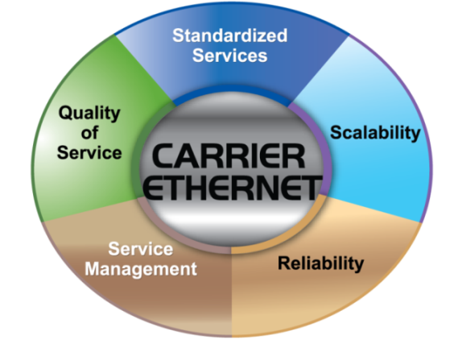
MEF Service Operation, Administration & Maintenance (SOAM)
What It Is and Why We Care
OAM – Operations, Administration, and Maintenance
Processes that support billed services
The “backroom” of the service provider
Touches every attribute of Carrier Ethernet Service
How service is managed
“ MEF OAM is the essential set of tools that enables automated, provisioning, monitoring and fault isolation that makes Carrier Ethernet a truly integrated, scalable and interconnected service”

Slide 5
The MEF Approach to OAM
Augment ITU, IEEE device and network management with Service Management to support rich set of MEF based Carrier Ethernet services
Facilitate standardized settings and methods to enable automation and scalability of global interconnection
Rifle shooting specific processes where interoperability, standardization required

Slide 6






Key Ethernet OAM Standards
Standards Bodies | Ethernet OAM and Enablers
 | 802.3 clause 57 (802.3ah) – Ethernet in the First Mile 802.1ag – Connectivity Fault Management 802.1aj – Two Port MAC Relay 802.1ap – MIB Definitions for VLAN bridges 802.1q/802.1ad – VLANs & Provider Bridging
 | MEF 7.1 – EMS-NMS Info Model MEF 13 – UNI-Type 1 MEF 15 – NE Management Req MEF 16 – Ethernet Local Mgmt Interface MEF 17 – OAM Requirements & Framework MEF 20 – UNI-Type 2 MEF 26 – Ethernet Network to Network Interface MEF 30 – Service OAM Fault Management IA MEF 31 – SOAM Fault Management Definition of Managed Objects
 | Y.1730/Y.1731 – Ethernet OAM Req & Mechanisms G.8031/G.8032 – Ethernet Protection Y.1563 – Performance and Availability Y.1564 – Service Activation Methodology
 | RFC 2544 – Benchmarking Method for Ntwk Interconnect Dev RFC 2819 – Remote Monitoring (RMON Etherstats)
 | TMF814 – EMS to NMS Model (Corba) TMF854 – EMS to NMS (Web services - MTOSI)

Slide 7
Ongoing OAM Related MEF Projects
Services
Classes of Service Phase 2 IA | Bill Rembert, AT&T
Hybrid NID Service (HNS) | Henry Fowler, AT&T
Management
Service OAM Performance Monitoring Ph 1 IA | Scott Mansfield, Ericcson | Andrew Corlett, Qosera
Service OAM PM MIB | Steve Mood, Omnitron Systems
Service OAM FM and PM, YANG Models | Steve Mood, Omnitron Systems
Service Activation Test | Brian Hedstrom, Cablelabs
Service OAM Fault Management Ph 2 IA | John Lemon, Adtran
Ethernet Service Latching Loopback | Paul Marshall, Sunrise Telecom
Test
Abstract Test Suite for ENNI | Carsten Rossenhoevel, EANTC
Abstract Test Suite for Ethernet Access Services | Isabelle Morency, Iometrix

Slide 8
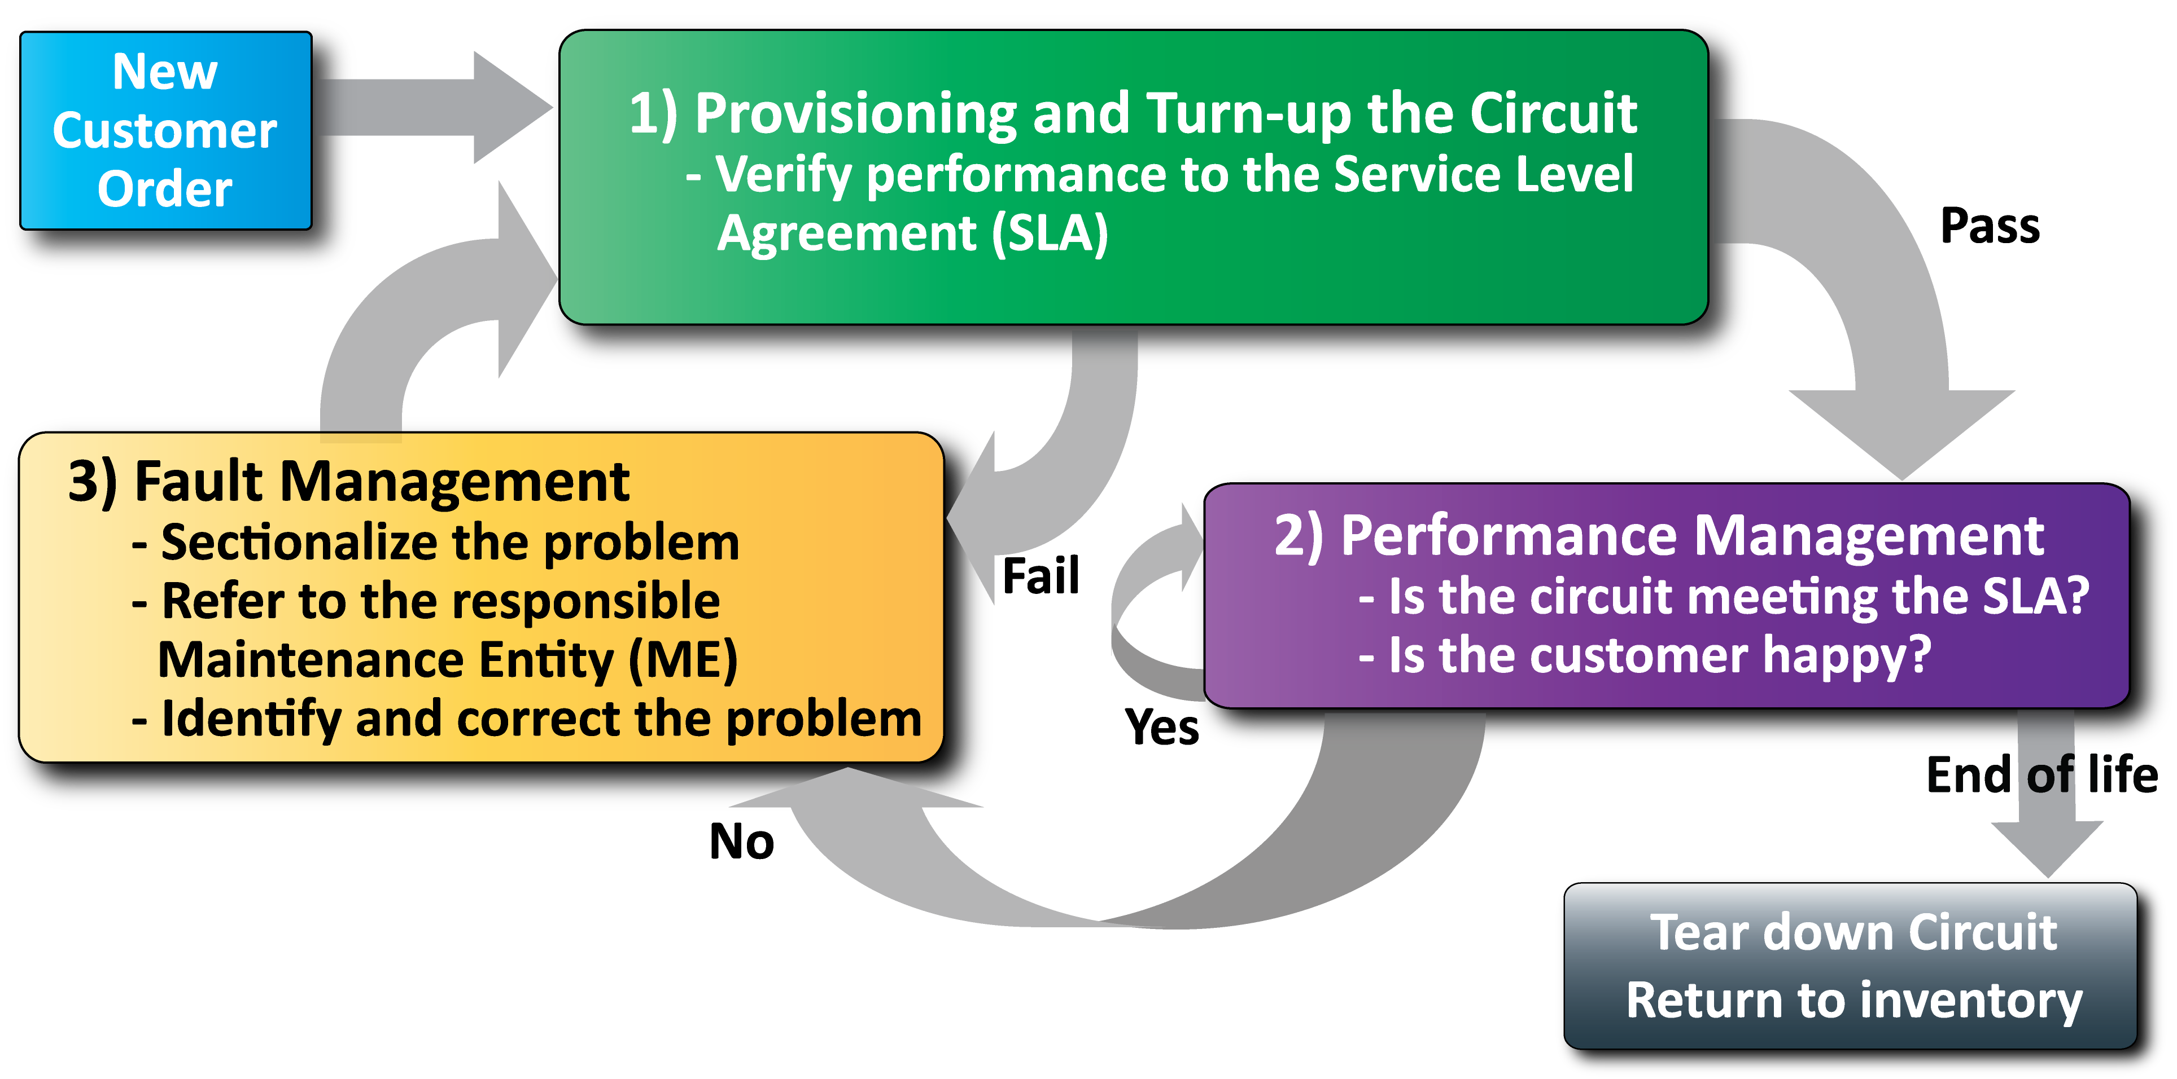
The Service Life Cycle – A MEF OAM Focus
  [MEF SAT]
  [MEF LLB]
  ITU Y.1564
  [MEF SOAM PM]
  [MEF SOAM-PM MIB]
  ITU Y.1731
  [MEF SOAM-FM MIB, YANG]
  MEF SOAM-FM
  IEEE 802.1ag
  IEEE 802.3ah
  [] Denotes ongoing MEF Project
  We’ll Focus Today on Y.1564
Notes:
Now that we’ve given you an overview of some of the newest work in MEF regarding Service OAM for connectivity fault management, let’s look at a few more of the OAM processes linked together throughout the lifecycle of an Ethernet service. We just covered box #3, Fault management, where MEF has made the greatest contribution in this area, but we’ll also cover Service Activation Testing and Performance Monitoring.

Slide 9
1) Provision and Activate the Service
Ethernet Service Activation Test Methodology
Verify a new service after provisioning is complete, but before it is turned over to the customer
Check that the configuration is correct
Verify that the performance meets the Service Acceptance Criteria (SAC):
  Ensures attainment of Class of Service Performance Objectives
MEF Projects SAT and LLB building on ITU Y.1564

Slide 10
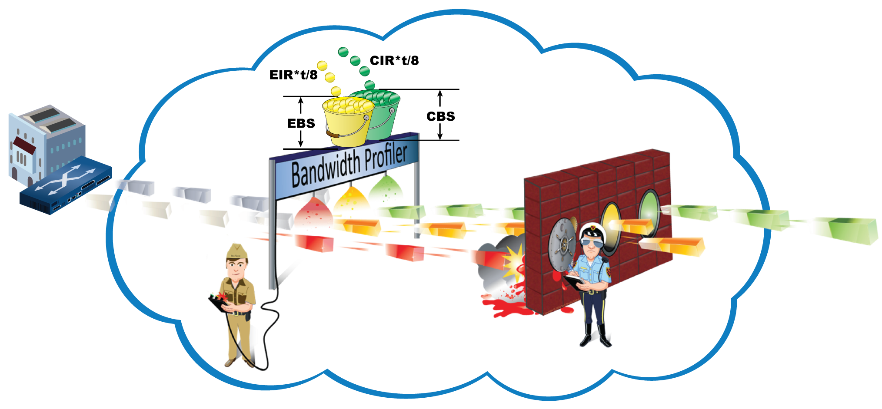

Verify the Configuration is Correct
Verify service attributes and parameters configuration:
  Bandwidth profile
  Virtual Connections
  Class of service marking
Very short tests – problems show up immediately
Fix problems before conducting the Service Performance Test

Slide 11








Verify that Service Performance Meets SAC
Simultaneously validate the quality of service of each defined Ethernet Virtual Connection and ensure attainment of CPOs
  All services are simultaneously generated to their CIR only
  For each service all performance parameters are measured and compared to Service Acceptance Criteria
  Test for 15 minutes to 24 hours depending on network length, reliability, and policies
  Portable test set method shown, other test configurations possible
EVC₁
EVC₂
EVC₃
NID
Operator 1
(Service Provider)
ENNI
Operator 2
(Access Provider)
NID
UNI
UNI

Slide 12
Performance Management

Slide 13
2) Performance Management
What is Performance Monitoring?
Checks end-to-end service quality CoS objectives
Uses synthetic traffic to measure performance
Supports multiple layers of OAM and maintenance domains
Spans ENNI
Allows continuous background performance monitoring
On-demand performance management
MEF SOAM/PM Specification
Nearly complete: Approval scheduled January 2012
Leverages the following specifications:
IEEE 802.1ag Connectivity Fault Management
ITU-T Y.1731 Connectivity Fault Management and Performance Monitoring

Slide 14

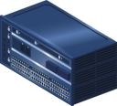
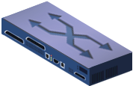

MEF Service Performance Management Framework
Operator 1
(Service Provider)
Operator 2
(Wholesale Operator)
Customer Premises
Customer
Premises
UNI
E-NNI
UNI
Customer Maintenance Association
Service Provider MA
MSG
MSG
RESP
RESP
Operator MA
Operator MA
Performance Measurements with synthetic messages
Delay Measurement (DM), Delay Variation Measurement (DVM)
Loss Measurement (LM)
Measurements end-to-end, NIDs at the customer UNI

Slide 15
Fault Management

Slide 16
3) Fault Management
Operator 1
(Service Provider)
Operator 2
(Wholesale Operator)
Customer Premises
Customer
Premises
UNI
E-NNI
UNI
802.3ah
802.3ah
802.3ah
802.3ah
802.3ah
802.3ah
802.3ah
802.3ah
802.3ah
Link fault management is the original type of FM
Applies to each physical network link, only 1 link at a time
Simple, little or no configuration
Supports
  Auto discovery
  Remote loopback
  Link monitoring and remote failure indication
  (dying gasp, link fault, critical event)
Does not monitor end-to-end across EVC

Slide 17
Connectivity Fault Management (CFM)
Provides end-to-end Ethernet connectivity management – mechanisms to detect, verify, isolate and report faults
  Continuity Check Message
  Loopback
  Linktrace
  RDI
  AIS
  Lock
  Test
Scalable to provide connectivity checking and fault detection across multiple networks and multiple domains
  Partitions the network into Domains to define responsibilities
  of different stakeholders.
  Supports up to 8 Maintenance Domain levels
Notes:
17

Slide 18





Ethernet Link Trace – an Example of CFM
UNI
IP/MPLS Core
Network
UNI
Metro Aggregation
Network
Metro Aggregation Network
Access Network
Access Network
MEP
MIP
MIP
MIP
MIP
MEP
Ethernet Link Trace is analogous to IP’s Traceroute, finds the location of the broken connection

Slide 19
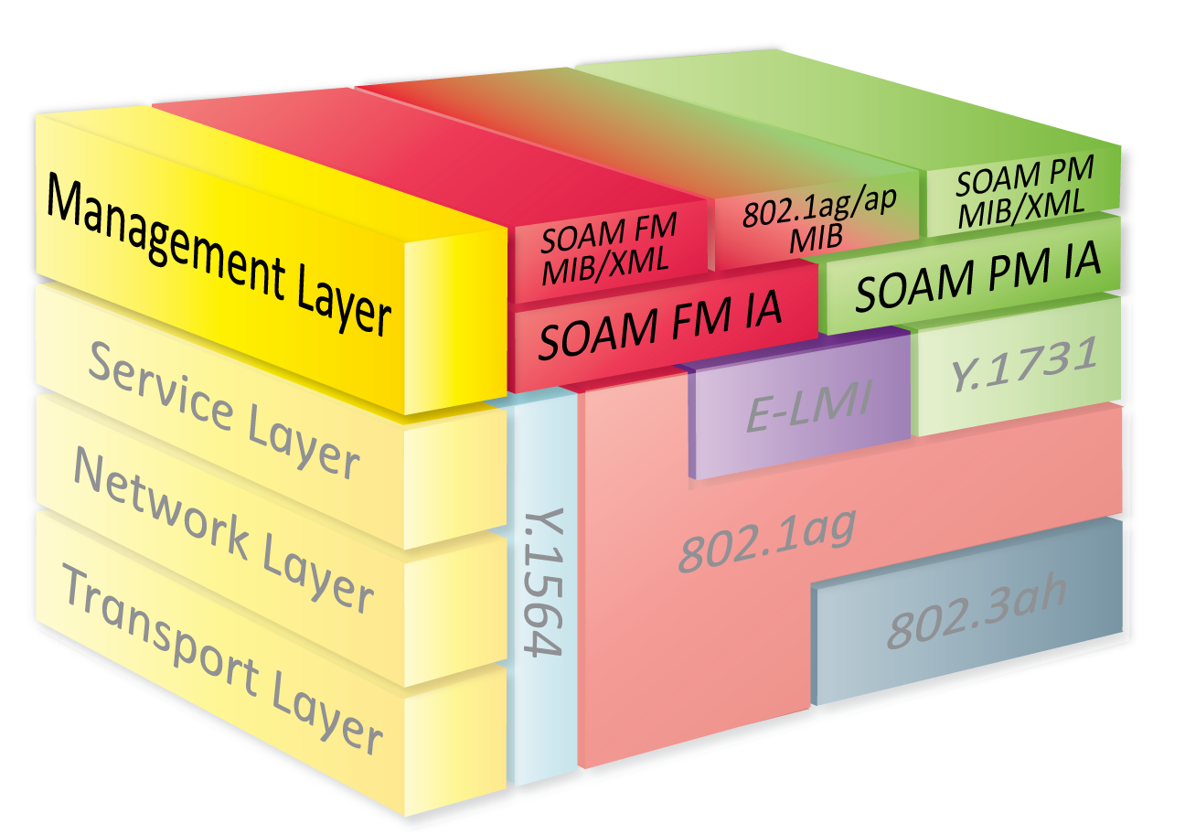
New MEF Technical Work
SOAM Fault Management Implementation Agreement (MEF 30)
  Defines the Framework for Service OAM.
  Provides mechanisms to detect, verify, isolate and report end-to-end Ethernet connectivity faults
  Continuity Check, Remote Defect Indication Signal, Loopback, Linktrace, Alarm Indication Signal, Locked Signal, Test Signal
SOAM Fault Management MIB (MEF 31)
  Facilitates multivendor fault detection
  and trouble shooting
  New Detailed Presentation
  and Technical Specification
  on the MEF website

Slide 20
Future Work and Summary
Work in Progress
  Many New OAM Projects in Progress
New MEF Goals (July 2011):
  “automated, integrated, simple-to-use, on-demand Carrier Ethernet”
  - are OAM centric
Recommendation
  Service Providers should incorporate new MEF OAM processes to achieve service scalability

Slide 21
MEF Reference Presentations
MEF Reference Presentations Covering the Principal Work of the MEF
Overview presentation of the MEF. | This presentation gives basic and most up-to-date information about the work of the MEF. It also introduces the definitions, scope and impact of Carrier Ethernet, the MEF Certification programs and describes the benefits of joining the MEF.
Overview presentation of the Technical Work of the MEF | Includes a summary of the specifications of the MEF, structure of the technical committee, work in progress and relationships with other Industry Standards bodies. For PowerPoint overviews of individual specifications: click here
Carrier Ethernet Services Overview | This presentation defines the MEF Ethernet Services that represent the principal attribute of a Carrier Ethernet Network
Carrier Ethernet User-Network Interface | This presentation discusses the market impact of MEF 20: UNI Type 2 Implementation agreement
Carrier Ethernet Access Technology Overview | This presentation describes how the MEF specifications bring Carrier Ethernet services to the world's Access networks (with examples of Active Ethernet (Direct Fiber), WDM Fiber, MSO Networks(COAX and Direct Fiber), Bonded Copper, PON Fiber and TDM (Bonded T1/E1, DS3/E3))
Carrier Ethernet Interconnect Program. | This is the latest presentation from the Carrier Ethernet Interconnect Working Group which acts as a framework for all presentations given on this topic.
Carrier Ethernet OAM & Management Overview | This presentation describes the management framework and the OAM elements for fault and performance management expressed in terms of the life cycle of a Carrier Ethernet circuit
Carrier Ethernet for Mobile Backhaul | A comprehensive marketing and technical overview of the MEF's initiative on Mobile Backhaul that has lead to the adoption of Carrier Ethernet as the technology of choice for 3G and 4G backhaul networks
Carrier Ethernet Business Services | A comprehensive presentation aimed at business users
The MEF Certification Programs | A presentation of the MEFs three certification programs: Equipment, Services and Professionals. These programs have been a cornerstone of the success of Carrier Ethernet and its deployment in more than 100 countries around the world.
Presentations may be found at http://metroethernetforum.org/Presentations

Slide 22
End of Presentation

