Slide 1
Ethernet Business Services
MEF Reference Presentation
November 2011

Slide 2
MEF Reference Presentations
Intention
These MEF reference presentations are intended to give general overviews of the MEF work and have been approved by the MEF Marketing Committee
Further details on the topic are to be found in related specifications, technical overviews, white papers in the MEF public site Information Center: http://metroethernetforum.org/InformationCenter
Notice
© The Metro Ethernet Forum 2011. Any reproduction of this document, or any portion thereof, shall contain the following statement: "Reproduced with permission of the Metro Ethernet Forum." No user of this document is authorized to modify any of the information contained herein.

Slide 3
Session Topics
Carrier Ethernet Basics
Why Business are Buying Ethernet Services
Top applications, market sectors, benefits
Financial applications
Use Cases
What’s New?
Member Resources and Summary
Notes:
We will discuss Principal Applications for Ethernet Business Services, the market sectors and the benefits of those services
We will then review the multiple service types that we will see presented today
We have 4 use cases in which we will discuss the technical and business value propositions for applications in Finance, Medical, Retail and IT
We will also look at the new Business Services Marketing kit for Service Providers

Slide 4
Ethernet Business Services
Principal Applications
Site-to-site access, server consolidation, business continuity/disaster recovery, Enterprise-class cloud-based applications, Internet access, distributed imaging, distributed storage area networks, VoIP, streamed/interactive video, L2-VPNs, virtualization
Top Market Sectors
Finance, Healthcare, Education, Government, IT, Retail, Real Estate, Legal, Media, etc…
Benefits
Scalability, control, reliability, performance, data center & server consolidation, expedites and enables new applications
Cost reduction, revenue acceleration

Slide 5
Top Applications
Applications | Key benefits experienced
Layer 2 VPNs for IT Infrastructure | Performance
Cloud Computing | Security, Deterministic, Dynamic
Distributed Storage Area Networks | Performance, Bandwidth
Software as a Service (SaaS), Service Orientated Architecture (SOA), | Transparency, Standardization at all locations, management
Distributed Imaging | Bandwidth
Internet Access | Reliability
Site-to-Site Access, Server Consolidation | Performance, Bandwidth
Business continuity/disaster recovery | Performance, Bandwidth
Video Applications | QoS
Server Consolidation | Simplicity
VoIP | Cost
CCTV | Cost ubiquity
Source: actual case studies submitted to the MEF

Slide 6
Top Vertical Markets
Vertical | Most Used
Finance | 33%
Medical | 15%
Education | 6%
Data Center / Storage/ IT | 9%
Real Estate | 9%
Legal | 6%
Retail | 9%
Wholesale Telecom | 9%
Media | 6%
Source: actual case studies submitted to the MEF

Slide 7
Why Carrier Ethernet was Chosen: Financial Applications
The following summarizes why Carrier Ethernet was chosen in 10 actual financial case studies including regional, global and trading banks, financial institutions and the world’s largest stock exchanges
Key Factors for Choosing Carrier Ethernet
Low latency between centers 50 miles apart
Low latency, Flexibility of EVPL
Performance and bandwidth
Seamless scalability and low cost
Delivery of cloud applications, visibility and control are cited in a SAN and ELAN/VPLS interconnected network
Low latency and cost effective bandwidth
Ubiquity and simplicity – important factors.
Speed, reliability, ease of expansion
Reliability and speed
Cost savings and growth potential

Slide 8
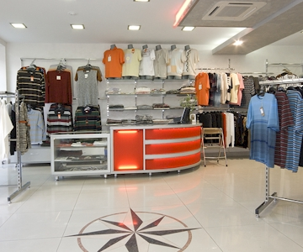
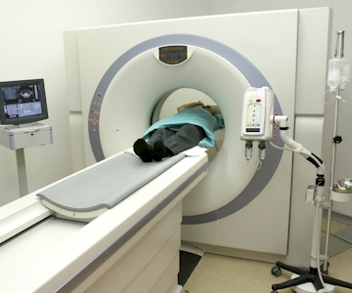
Ethernet Business Services Use Cases
One example compiled from actual case studies submitted to the MEF

Slide 9
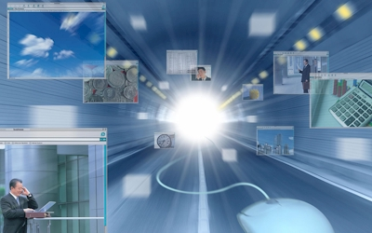
Application: Information Technology Applications for a global IT Development Company
Ethernet Business Services Use Case

Slide 10
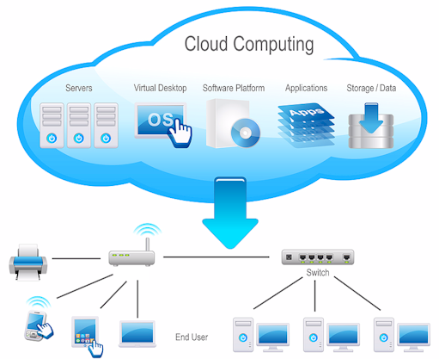
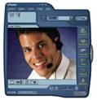
Company Profile and Challenges
Multi-National IT company engaged in systems development, integration and offering outsourcing
Call Centre Services
Development and operations use the same network
Network-delivered apps creating network challenges
Current extended network: mixture of routed networks SDH connections, fixed wireless, DSL, DOCSIS and a wide variety of solutions in international locations
Lack of consistent service quality results in unpredictable performance
Cost constraints
On-line HD Video Conferencing
Common Business Applications
On-line ERP Services
SaaS
On-line VoIP Services
On-line DB Services
Notes:
Multi-National IT company engaged in systems development, integration and offering outsourcing and technical support through data centres
Call Centre Services have been and important element of the company’s success but new opportunities to leverage the company’s expertise are driving business
Increasingly the development and deployment of business-class applications must share the same network resources as operational networks
The advent of network-delivered applications such as cloud computing is creating new challenges for development deployment and operation

Slide 11
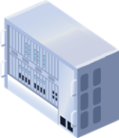
Worldwide Carrier Ethernet Deployment
Internet information & Software apps
HD TV, TVoD, VoD, Content Providers
Host applications, Consolidated Servers
Software as a Service, Cloud Services
Voice/Video
Telephony
Video
Source
Co-Location, Data Centre and Exchanges
American Carrier Ethernet Service Providers
European Carrier Ethernet Service Providers
UNI
ENNI
ENNI
UNI
Company and Client Locations
Company and Client Locations
SAN
Carrier Ethernet Exchange
Direct Connection
ENNI
Asia Pacific Carrier Ethernet Service Providers
ENNI
African Carrier Ethernet Service Providers
Direct Connection
Company and Client Locations
UNI
UNI
Company and Client Locations

Slide 12
Enabled Overall Benefits
Application performance is predictable, reliable and can be delivered in all locations independent of access technology
Each application type can be managed and operated independently
Adding new applications, clients is easy
Ethernet Infrastructure means bandwidth growth is unlimited and future proof
Notes:
Application performance is predictable, reliable and can be delivered in all locations independent of access technology
Each application type can be managed and operated independently without wide area network over-provisioning and within it’s own virtual environment with IT management in control of resource utilization:
Distributed storage area networks, call center applications, interactive video conferencing, back-up and disaster recovery
Delivery of secure, deterministic, business-class cloud based services.
Adding new applications and clients is easy
Ethernet Infrastructure means bandwidth growth is unlimited and future proof
Ethernet Services can be delivered in all locations with predictable QoS, and bandwidth profiles agnostic to the delivery technology
Each application type can be managed and operated independently without wide area network over-provisioning
Application performance is predictable, reliable and simpler to manage
Adding new applications and clients is easy within the simple framework
Ethernet Infrastructure means bandwidth growth is unlimited and future proof
Each Application has now been enabled to operate within it’s own tuned virtual LAN environment with IT management in control of maximum bandwidth and resource utilization
These are
Distributed Storage area networks,
The Call center applications, Interactive video conferencing
Cloud-based back-up and disaster recovery
Development and support of network-delivered client applications
Delivery of secure, deterministic, business-class cloud based services.

Slide 13
MEF
Carrier Ethernet as Cloud Carrier
Ten Years of Achievement

Slide 14
Carrier Ethernet as Ethernet Cloud Carrier
Current MEF project addresses key issues for the Cloud Community
The secure, business-class delivery of cloud-based applications to businesses
MEF is the first to address business-class delivery of Cloud-based applications
Opens up significant new markets for Cloud Carriers, Cloud Providers and Cloud Carriers
Ethernet Cloud Carrier
Cloud Provider
Enterprise Cloud Consumers
The MEF will be presenting new work in the December/January timeframe
Notes:
The MEF is working with the key stakeholders in the telecoms, Enterprise and Cloud communities and will be presenting new work in the January timeframe.
The new work will augment and relate to existing work by NIST and other organizations in this space with the context of “Carrier Ethernet as Ethernet Cloud Carrier”
The MEF intends to augment the existing service definitions to encompass elastic/dynamic services required for Cloud-based application delivery

Slide 15
MEF Resources
Members’ Ethernet Business Services Kit

Slide 16
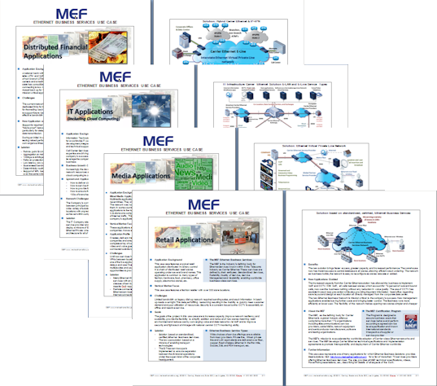
Business Services Kit Contents
Overview / How to Use Guide
A series of PowerPoint presentations delivered as a complete 3 hour seminar.
Enterprise-focus services overviews,
Summaries of applications and 6 use cases.
Six 2 page MSWord Use Cases
A new MEF positioning paper
Available Nov/Dec 2011
Ongoing updates to Event presentations as DRE Cloud messaging develops

Slide 17
Ethernet Business Services Kit
Intention of the MEF Ethernet Business Services Kit
Provide a series of deliverables to help accelerate the adoption of Carrier Ethernet services in the marketplace.
Focus firstly on applications, secondly vertical markets
The intended users are
MEF service provider members engaging
Directly with Enterprise Users
Preparing Service Provider sales forces
By the MEF
Conducting MEF Business Services Seminars or Webinars
This kit is primarily to be used as a starting point
Content may be amended to reflect local or specific market, application or user requirements

Slide 18
Summary: The Big Picture
Worldwide demand for Ethernet services continues to increase
Businesses are optimising their application performance through adoption of Ethernet Business Services
Ethernet Services are key to providers business services portfolio
Ethernet interconnects
Proliferating at a rapid pace, enabled by exchanges generating new retail and wholesale business
MEF continues to lead Ethernet globalization
Notes:
Ideal platform for key distributed IT systems and applications
Network Efficiency enabled by Ethernet Virtual Service Connections
Secure, reliable, high speed connectivity, QoS and bandwidth per application
Converge fragmented networks into a single scalable, high performance, low latency network
Fine-tune bandwidth per site based on application needs and budget
Service consistency across all sites – regionally, nationwide or globally
Low cost /bit – save money

Slide 19
MEF Reference Presentations
MEF Reference Presentations Covering the Principal Work of the MEF
Overview presentation of the MEF. | This presentation gives basic and most up-to-date information about the work of the MEF. It also introduces the definitions, scope and impact of Carrier Ethernet, the MEF Certification programs and describes the benefits of joining the MEF.
Overview presentation of the Technical Work of the MEF | Includes a summary of the specifications of the MEF, structure of the technical committee, work in progress and relationships with other Industry Standards bodies. For PowerPoint overviews of individual specifications: click here
Carrier Ethernet Services Overview | This presentation defines the MEF Ethernet Services that represent the principal attribute of a Carrier Ethernet Network
Carrier Ethernet User-Network Interface | This presentation discusses the market impact of MEF 20: UNI Type 2 Implementation agreement
Carrier Ethernet Access Technology Overview | This presentation describes how the MEF specifications bring Carrier Ethernet services to the world's Access networks (with examples of Active Ethernet (Direct Fiber), WDM Fiber, MSO Networks(COAX and Direct Fiber), Bonded Copper, PON Fiber and TDM (Bonded T1/E1, DS3/E3))
Carrier Ethernet Interconnect Program. | This is the latest presentation from the Carrier Ethernet Interconnect Working Group which acts as a framework for all presentations given on this topic.
Carrier Ethernet OAM & Management Overview | This presentation describes the management framework and the OAM elements for fault and performance management expressed in terms of the life cycle of a Carrier Ethernet circuit
Carrier Ethernet for Mobile Backhaul | A comprehensive marketing and technical overview of the MEF's initiative on Mobile Backhaul that has lead to the adoption of Carrier Ethernet as the technology of choice for 3G and 4G backhaul networks
Carrier Ethernet Business Services | A comprehensive presentation aimed at business users
The MEF Certification Programs | A presentation of the MEFs three certification programs: Equipment, Services and Professionals. These programs have been a cornerstone of the success of Carrier Ethernet and its deployment in more than 100 countries around the world.
Presentations may be found at http://metroethernetforum.org/Presentations

Slide 20
End of Presentation

