Slide 1
Introducing the Specifications of the MEF
MEF 35: Service OAM Performance Monitoring Implementation Agreement
(includes MEF 35.0.1)
December 2013

Slide 2
Outline
Approved MEF Specifications
This Presentation
About this Specification
Overview
Maintenance Entities
PM Solutions
PM Considerations
Summary
Includes information from 35.0.1 Amendment on 1SL

Slide 3
Approved MEF Specifications*
Specification | Description
MEF 2 | Requirements and Framework for Ethernet Service Protection
MEF 3 | Circuit Emulation Service Definitions, Framework and Requirements in Metro Ethernet Networks
MEF 4 | Metro Ethernet Network Architecture Framework Part 1: Generic Framework
MEF 6.1 | Metro Ethernet Services Definitions Phase 2
MEF 7.1 | EMS-NMS Information Model Phase 2
MEF 8 | Implementation Agreement for the Emulation of PDH Circuits over Metro Ethernet Networks
MEF 9 | Abstract Test Suite for Ethernet Services at the UNI
MEF 10.2 | Ethernet Services Attributes Phase 2
MEF 11 | User Network Interface (UNI) Requirements and Framework
MEF 12.1 | Metro Ethernet Network Architecture Framework Part 2: Ethernet Services Layer
MEF 13 | User Network Interface (UNI) Type 1 Implementation Agreement
MEF 14 | Abstract Test Suite for Traffic Management Phase 1
MEF 15 | Requirements for Management of Metro Ethernet Phase 1 Network Elements
MEF 16 | Ethernet Local Management Interface
*Current at time of publication. See MEF web site for official current list, minor updates and superseded work (such as MEF 1 and MEF 5)

Slide 4
Approved MEF Specifications
Specification | Description
MEF 17 | Service OAM Framework and Requirements
MEF 18 | Abstract Test Suite for Circuit Emulation Services
MEF 19 | Abstract Test Suite for UNI Type 1
MEF 20 | User Network Interface (UNI) Type 2 Implementation Agreement
MEF 21 | Abstract Test Suite for UNI Type 2 Part 1: Link OAM
MEF 22.1 | Mobile Backhaul Implementation Agreement Phase 2
MEF 23.1 | Class of Service Implementation Agreement Phase 2
MEF 24 | Abstract Test Suite for UNI Type 2 Part 2: E-LMI
MEF 25 | Abstract Test Suite for UNI Type 2 Part 3: Service OAM
MEF 26.1 | External Network Network Interface (ENNI) – Phase 2
MEF 27 | Abstract Test Suite For UNI Type 2 Part 5: Enhanced UNI Attributes & Part 6: L2CP Handling
MEF 28 | External Network Network Interface (ENNI) Support for UNI Tunnel Access and Virtual UNI
MEF 29 | Ethernet Services Constructs

Slide 5
Approved MEF Specifications
Specification | Description
MEF 30 | Service OAM Fault Management Implementation Agreement
MEF 31 | Service OAM Fault Management Definition of Managed Objects
MEF 32 | Requirements for Service Protection Across External Interfaces
MEF 33 | Ethernet Access Services Definition
MEF 34 | Abstract Test Suite for Ethernet Access Services
MEF 35 | Service OAM Performance Monitoring Implementation Agreement
MEF 35.0.1 | MEF 35 Amendment 1 – 1SL
MEF 36 | Service OAM SNMP MIB for Performance Monitoring
MEF 37 | Abstract Test Suite for ENNI

Slide 6
MEF 35 Specification Overview
MEF 35
Service OAM Performance Monitoring Implementation Agreement
Purpose
An Implementation Agreement (IA) which provides for Service Operations, Administration, and Maintenance (SOAM) that satisfies and extends the Performance Monitoring (PM) framework and requirements described in MEF 17.
Audience
All, since it provides the fundamentals required to deliver Carrier Ethernet services.
Standardized Services

Slide 7
MEF 35.0.1 Specification Overview
Service OAM Performance Monitoring Implementation Agreement Amendment 1
MEF 35.0.1
Purpose
Amendment to MEF 35 to add a fourth (optional) PM solution providing support for Dual-Ended Synthetic Loss Measurement.
Audience
All, since it provides the fundamentals required to deliver Carrier Ethernet services.
Standardized Services

Slide 8
Overview of MEF 35

Slide 9
About MEF 35
Purpose:
This presentation is an introduction to MEF 35 – Service OAM Performance Monitoring Implementation Agreement
Audience
Vendors building devices supporting OAM functions for Carrier Ethernet Services
Service Providers delivering Carrier Ethernet Services
Other Documents
MEF 17 – Service OAM Framework and Requirements
MEF 30 – Service OAM Fault Management Implementation Agreement

Slide 10
Service OAM
MEF 17 provides the framework
Relevant for Subscribers (customers), Operators and Service Providers
Fault Management IA (MEF 30)
FM of MEF Services
Specifies profile of protocols defined in IEEE 802.1ag and ITU-T Y.1731
Provides basic SOAM architecture and requirements for each of the recommended MEGs
Performance Management IA (MEF 35)
PM of MEF Services
Specifies profile of protocols defined in ITU-T Y.1731
Amendment for 1SL (MEF 35.0.1)
Amendment to MEF 35 to add a fourth (optional) PM solution providing support for Dual-Ended Synthetic Loss Measurement.
Related Work
MIBs (SNMP) for FM and PM covered in MEF 31 and MEF 36

Slide 11
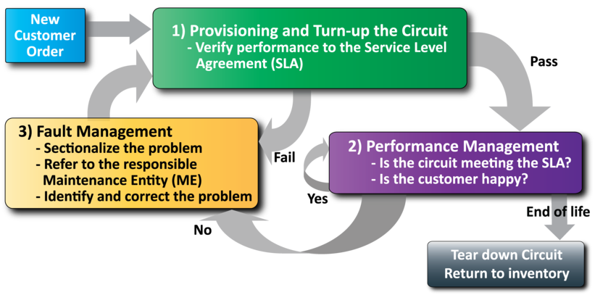
MEF Service Lifecycle and SOAM
Network Management
Performance management is a critical part of a circuit’s lifecycle

Slide 12
MEF 35 Specification Section Review

Slide 13
Introducing MEF 35
The presentation is organized into the following sections:
Overview
Maintenance Entities
PM Solutions
PM Considerations

Slide 14
Performance Monitoring
Based on ITU-T Y.1731
Protocols or Performance Monitoring mechanisms
Frame Delay
Frame Delay Range
Inter-Frame Delay Variation
Frame Loss Ratio
Availability

Slide 15
Hierarchical OAM Domains
Customer
Service Provider
Customer
UNI
ENNI
UNI
CPE
NID
Operator 1 Network
Operator 2 Network
NID
CPE
Customer Domain
Ethernet Virtual Connection
Customer Domain
Provider Domain
Operator 1 Domain
Operator 2 Domain
Hierarchical maintenance domains bind OAM flows & OAM responsibilities

Slide 16
Terminology and Concepts
MEF 35 builds upon MEF 17 and MEF 30 defined SOAM components including:
Maintenance Entity (ME)
Maintenance Entity Group (MEG)
MEG End Point (MEP)
MEG Intermediate Point (MIP)
MEG Level
MEG Class of Service (CoS)
MEF 30 and MEF 35 are based on terminology found in ITU Y.1731

Slide 17
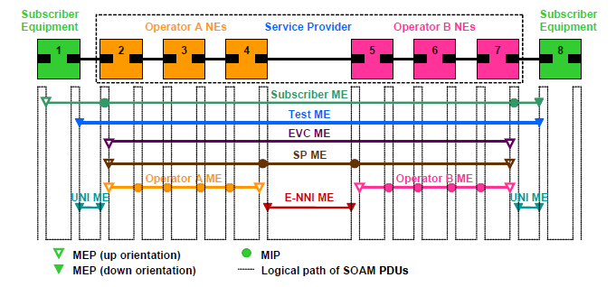
Default MEG Level Usage
Default MEG Level
6
5
4
3
2
1
……
…………
………….….
………….….
………….….
.…….…..
. . . . . . . . . . . . . . .
. . . . . . . . . . . . . . .
This is the complete set of default MEG levels
Not all MEG levels are required in every application

Slide 18
Key Maintenance Entity Groups (MEGs)
MEG | Suggested Use | Default Direction for MEPs | Default MEG Level
Subscriber MEG | Subscriber monitoring of an Ethernet service | Up or Down | 6
Test MEG | Service Provider isolation of subscriber reported problems | Down | 5
EVC MEG | Service Provider monitoring of provided service | Up | 4
Service Provider MEG | Service Provider Monitoring of Service Provider network | Up | 3
Operator MEG | Network Operator monitoring of their portion of a network | Up | 2
UNI MEG | Service Provider monitoring of a UNI | Down | 1
ENNI MEG | Network Operators' monitoring of an ENNI | Down | 1

Slide 19
MEP Terminology
MAC Relay
Up MEP
Down MEP
Frame
Filtering
See IEEE 802.1Q-2011
Figure 22-4
Port Filtering
Port Filtering
Port 1
Port 2
Up MEPs are positioned toward the MAC Relay
Processes the OAM traffic that comes through the MAC Relay
Down MEPs are positioned toward the LAN
Processes traffic that enters the Switch from the LAN

Slide 20
MEG End Point (MEP)
MEG
MEG End Point – MEP
SOAM points associated with a single MEG level (and a single Maintenance Domain)
Can generate and respond to SOAM protocols
Up MEPs are oriented toward the MAC Relay (non-filled triangle)
Down MEPs are oriented toward the network (filled triangle)

Slide 21
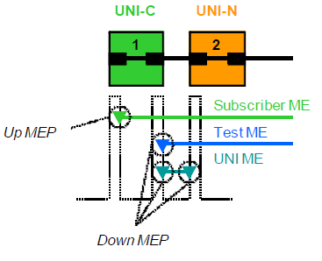
MEG End Point (MEP) Orientation
Down MEP - is a MEP residing in a Bridge that receives SOAM PDUs from, and transmits them towards, the direction of the LAN. Note that in the MEF service model, the LAN is a transmission facility in the egress direction, rather than towards the Bridge Relay Entity.
Up MEP - is a MEP residing in a Bridge that transmits SOAM PDUs towards, and receives them from, the direction of the Bridge Relay Entity . Note that in the MEF service model, the Bridge Relay Entity itself is out of scope.
A given MEG can be terminated by either Up or Down MEPs.
Up MEPs are the most commonly used MEP and are recommended for the following MEG levels: EVC, Service Provider, Operator and optionally the Subscriber.

Slide 22
MEG Intermediate Point (MIP)
MIP
MEG Intermediate Point – MIP
SOAM points associated with a single MEG level (and a single Maintenance Domain)
Can respond to SOAM protocols, but cannot generate requests
Defined to be located at External Interfaces such as ENNIs (or UNIs). In practice can also be used in additional internal operator locations where monitoring is desired

Slide 23
PM Sessions

Slide 24
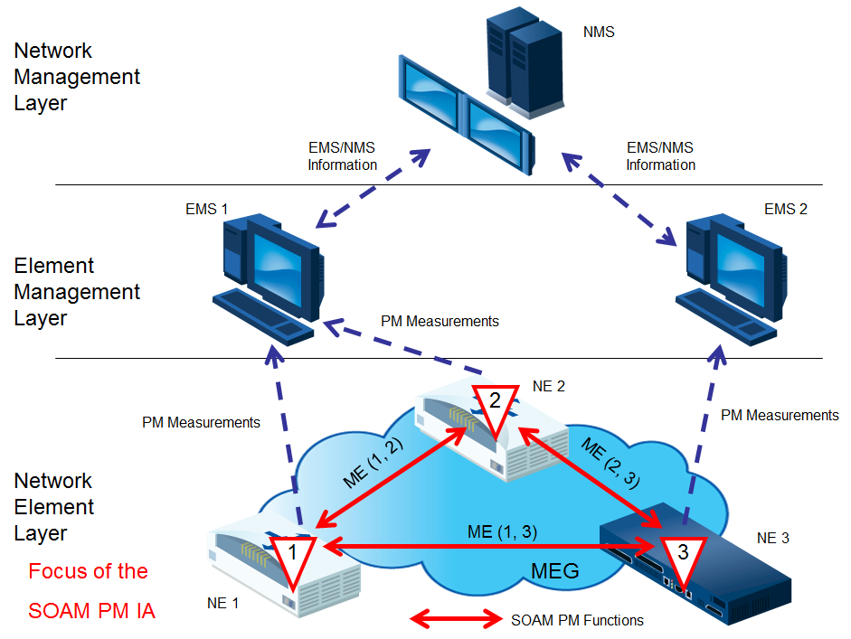
PM Solution Components
SOAM PM IA Focused on the Network Element Layer
A PM Solution is made up of one or more PM Functions

Slide 25
PM Solutions
There are four PM Solutions defined, each with different characteristics
A PM Solution uses PM Functions which use the PM tools defined in ITU-T Y.1731
PM Solution | MEG Type(s) | Measurement Technique for Loss | PM Function(s) | Mandatory or Optional
PM-1 | point-to-point multipoint | Synthetic Testing | Single-Ended Delay Single-Ended Synthetic Loss | Mandatory
PM-2 | point-to-point multipoint | n/a | Dual-Ended Delay | Optional
PM-3 | point-to-point | Counting Service Frames | Single-Ended Service Loss | Optional
PM-4 (35.0.1) | point-to-point multipoint | Synthetic Testing | Dual-Ended Synthetic Loss | Optional
PM Function | ITU-T PM Tool | ITU-T PDU(s)
Single-Ended Delay | ITU-T Two-way ETH-DM | DMM/DMR
Dual-Ended Delay | ITU-T One-way ETH-DM | 1DM
Single-Ended Service Loss | ITU-T Single-Ended ETH-LM | LMM/LMR
Single-Ended Synthetic Loss | ITU-T Single-Ended ETH-SLM | SLM/SLR
Dual-Ended Synthetic Loss | ITU-T Dual-Ended ETH-SLM | 1SL
Notes:
DMM: Delay Measurement Message
DMR: Delay Measurement Reply
1DM: One-way Delay Measurement Message
LMM: Loss Measurement Message
LMR: Loss Measurement Reply
SLM: Synthetic Measurement Message
SLR: Synthetic Measurement Reply

Slide 26
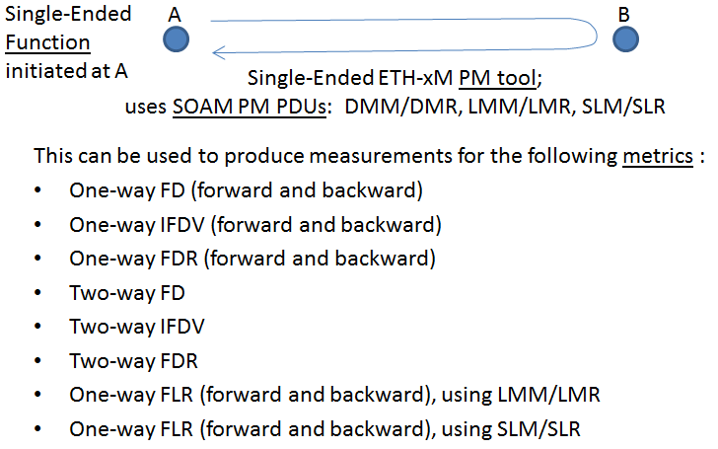
Single-Ended Functions

Slide 27
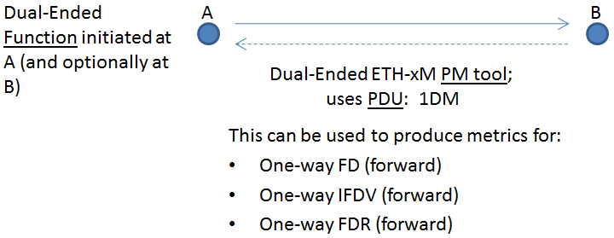
Dual-Ended Functions

Slide 28
PM Solutions
PM-1
Single-Ended Point-to-Point or Multipoint Delay and Synthetic Loss
Single-Ended functions send messages from a Controller MEP to a Responder MEP which responds back to the Controller MEP
Metrics Collected
One-way Frame Delay
One-way Mean Frame Delay
One-way Frame Delay Range
Inter-Frame Delay Variation
One-way Frame Loss Ratio
Availability for an EVC or OVC
Resiliency-related metrics for EVC or OVC

Slide 29
PM Solutions (continued)
PM-2
Dual-Ended Point-to-Point or Multipoint Delay
Dual-Ended functions send measurements from a Controller MEP to a Sink MEP where the calculations are made
Metrics Collected
One-way Frame Delay
One-way Mean Frame Delay
One-way Frame Delay Range
Inter-Frame Delay Variation
PM-3
Single-Ended Service Loss Measurement
This solution uses the service traffic instead of synthetic traffic
Metrics Collected
One-way Frame Loss Ratio

Slide 30
PM Solutions (continued)
PM-4 (35.0.1)
Dual-Ended Point-to-Point or Multipoint Delay
Dual-Ended functions send measurements from a Controller MEP to a Sink MEP where the calculations are made
Metrics Collected
One-way Frame Loss

Slide 31
PM-1 Example

Slide 32
Single-Ended Synthetic Loss Measurement
NID-A
ENNI
NID-B
Operator 1
(Service Provider)
Operator 2
(OOF operator)
UNI
UNI
SLM→
SLM
MEP-A
MEP-B
←SLR
←SLR
SLM Message created at the Controller MEP (at MEP-A)
TestID is in the PDU to differentiate
Source MEP ID
Value of local counter (at MEP-A) containing the number of SLM messages sent
SLR Message is created at the Responder MEP (at MEP-B)
Received counts are copied
Local counter of received SLM messages are sent back to the Controller MEP
Frame Loss is calculated at the Controller MEP

Slide 33
Threshold Crossing Alert

Slide 34
Summary

Slide 35
Related Specifications
MEF 35 section 6 lists a full list of related MEF specifications
MEF 35.0.1
MEF 30 SOAM FM
MEF 31 SOAM FM MIB
MEF 36 SOAM PM MIB
ITU-T Y.1731
MEF 17 SOAM requirements and frameworks phase 1
MEF 12.1 Carrier Ethernet Network Architecture Part 2 – ETH Service Layer

Slide 36
Final Word
Service OAM
In the context of MEF 35, mechanisms are defined that support service-level OAM in MENs.
Next Actions
Read the MEF 35 specification
Read the MEF 30 specification
Read IEEE 802.1Q-2011 clauses 18, 19, 29, 21, and 22
Read ITU-T Y.1731
Review of MEF 17, MEF 10 and MEF 15 may also be helpful
Understand the principal service OAM components and capabilities
Review also MEF 36, MEF 31 and MEF 12.1 specification

Slide 37
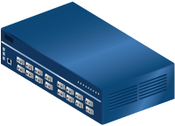
For Full Details …
Please visit www.metroethernetforum.org Select Information Center on Left Navigation to access the full specification and extracted MIB files
E-Line Service type
Carrier Ethernet 2.0
EVPL Services
UNI
UNI
CE
E-LAN Service type
Carrier Ethernet Network
CE
Carrier Ethernet 2.0
EVP-LAN Service
Internet
ISP POP
UNI
UNI
CE
CE
EVC: Ethernet Virtual Connection
UNI: User Network Interface. the physical demarcation point between the responsibility of the Service Provider and the responsibility of the End-User/Subscriber
CE Customer Equipment
CE
UNI
UNI
Carrier Ethernet Network
CE

Slide 38
Accelerating Worldwide Adoption of Carrier-class Ethernet Networks and Services
www.MetroEthernetForum.org

