Slide 1
Introducing the Specifications of the MEF
MEF 38: Service OAM Fault Management YANG Modules Technical Specification
April 2012

Slide 2
MEF Reference Presentations
Intention
These MEF reference presentations are intended to give general overviews of the MEF work and have been approved by the MEF Marketing Committee
Further details on the topic are to be found in related specifications, technical overviews, white papers in the MEF public site Information Center: http://metroethernetforum.org/InformationCenter
Notice
© The Metro Ethernet Forum 2012. Any reproduction of this document, or any portion thereof, shall contain the following statement: "Reproduced with permission of the Metro Ethernet Forum." No user of this document is authorized to modify any of the information contained herein.

Slide 3
Outline
Approved MEF Specifications
This presentation
About this Specification
In Scope / Out of Scope
Terminology, Concepts & Relationship to other standards
Section Review
Major topics
Minor topics
Examples/Use Cases
Summary

Slide 4
Approved MEF Specifications*
Specification | Description
MEF 2 | Requirements and Framework for Ethernet Service Protection
MEF 3 | Circuit Emulation Service Definitions, Framework and Requirements in Metro Ethernet Networks
MEF 4 | Metro Ethernet Network Architecture Framework Part 1: Generic Framework
MEF 6.1 | Metro Ethernet Services Definitions Phase 2
MEF 7.1 | EMS-NMS Information Model Phase 2
MEF 8 | Implementation Agreement for the Emulation of PDH Circuits over Metro Ethernet Networks
MEF 9 | Abstract Test Suite for Ethernet Services at the UNI
MEF 10.2 | Ethernet Services Attributes Phase 2
MEF 11 | User Network Interface (UNI) Requirements and Framework
MEF 12.1 | Metro Ethernet Network Architecture Framework Part 2: Ethernet Services Layer
MEF 13 | User Network Interface (UNI) Type 1 Implementation Agreement
MEF 14 | Abstract Test Suite for Traffic Management Phase 1
MEF 15 | Requirements for Management of Metro Ethernet Phase 1 Network Elements
MEF 16 | Ethernet Local Management Interface
*Current at time of publication. See MEF web site for official current list, minor updates and superseded work (such as MEF 1 and MEF 5)

Slide 5
Approved MEF Specifications
Specification | Description
MEF 17 | Service OAM Framework and Requirements
MEF 18 | Abstract Test Suite for Circuit Emulation Services
MEF 19 | Abstract Test Suite for UNI Type 1
MEF 20 | User Network Interface (UNI) Type 2 Implementation Agreement
MEF 21 | Abstract Test Suite for UNI Type 2 Part 1: Link OAM
MEF 22.1 | Mobile Backhaul Implementation Agreement Phase 2
MEF 23.1 | Class of Service Implementation Agreement Phase 2
MEF 24 | Abstract Test Suite for UNI Type 2 Part 2: E-LMI
MEF 25 | Abstract Test Suite for UNI Type 2 Part 3: Service OAM
MEF 26.1 | External Network Network Interface (ENNI) – Phase 2
MEF 27 | Abstract Test Suite For UNI Type 2 Part 5: Enhanced UNI Attributes & Part 6: L2CP Handling
MEF 28 | External Network Network Interface (ENNI) Support for UNI Tunnel Access and Virtual UNI
MEF 29 | Ethernet Services Constructs

Slide 6
Approved MEF Specifications
Specification | Description
MEF 30 | Service OAM Fault Management Implementation Agreement
MEF 31 | Service OAM Fault Management Definition of Managed Objects
MEF 32 | Requirements for Service Protection Across External Interfaces
MEF 33 | Ethernet Access Services Definition
MEF 34 | Abstract Test Suite for Ethernet Access Services
MEF 35 | Service OAM Performance Monitoring Implementation Agreement
MEF 36 | Service OAM SNMP MIB for Performance Monitoring
MEF 37 | Abstract Test Suite for ENNI
MEF 38 | Service OAM Fault Management YANG Modules Technical Specification
MEF 39 | Service OAM Performance Monitoring YANG Modules Technical Specifications

Slide 7
MEF 38 Specification Overview
MEF 38
Service OAM Fault Management YANG Modules Technical Spec
Purpose
An Implementation Agreement (IA) which provides for Service Operations, Administration, and Maintenance (SOAM) that satisfies and extends the Performance Monitoring (PM) framework and requirements described in MEF 17.
Audience
All, since it provides the fundamentals required to deliver Carrier Ethernet services.
Standardized Services

Slide 8
MEF Specification Overview
MEF 38 - Service OAM Fault Management YANG Modules Technical Specification
Purpose
Specifies the Fault Management (FM) YANG Modules necessary to implement Service Operations, Administration, and Maintenance (OAM) that satisfies the Service OAM requirements and framework specified by MEF 17, MEF 30, the management objects specified in MEF 7.1, MEF 31, and the FM functions defined in IEEE 802.1Q and ITU-T Y.1731.
Audience
Applicable to entire Metro Ethernet Market including Service Providers, Access Providers, equipment vendors, and EMS/NMS/OSS vendors to provision and monitor equipment that is MEF compatible.
Standardized Services

Slide 9
Overview of MEF 38

Slide 10
About MEF 38
Purpose:
This presentation is an introduction to MEF 38 - Service OAM Fault Management YANG Modules
Audience
Equipment Manufacturers building devices that will carry Carrier Ethernet Services
Service Providers delivering Carrier Ethernet Services
EMS/NMS/OSS tool vendors developing back office applications for managing Carrier Ethernet Services
Other Documents
Presentations of other MEF specifications and an overview of all specifications is available on the MEF web site
Other materials such as white papers and case studies are also available

Slide 11
Service OAM
MEF 17 provides the framework
Relevant for Subscribers (customers), Operators and Service Providers
Fault Management IA (MEF 30)
FM of MEF Services
Specifies profile of protocols defined in IEEE 802.1Q and ITU-T Y.1731
Provides basic SOAM architecture and requirements for each of the recommended MEGs
Performance Management IA (MEF 35)
PM of MEF Services
Specifies profile of protocols defined in ITU-T Y.1731
MEF 31 & MEF 36
SNMP MIBs (Definition of Management Objects) for FM (MEF 31) and PM (MEF 36)
Provides data models for SNMP-based network management

Slide 12
MEF 38 - In Scope/Out of Scope
MEF 38 requirements are primarily driven by MEF 30 and leverage the OAM functions & managed objects defined by MEF 31, IEEE 802.1Q and ITU-T Y.1731
Managed objects to perform Fault Management functions such as Continuity Check, Loopback and Link Trace are covered in this Technical Specification
SOAM Performance Management capabilities are covered in MEF 39

Slide 13
Terminology and Concepts
MEF 38 adheres to MEF 30 terminology:
Refer to MEF 30 for ME, MEG, MEP, MIP, MEG Level, MEG CoS
Continuity Check Message (CCM)
Alarm Indication Signal (AIS)
Remote Defect Indication (RDI)
MEF 38 introduces protocol specific terminology
Network Configuration Protocol (NETCONF)
NETCONF Client/Server
YANG Data Modeling Language and Modules
Element/Network Management System (EMS/NMS)
Operations Support System (OSS)
Remote Procedure Call (RPC)
Extensible Markup Language (XML)
Secure Shell (SSH)
MEF-30 aligns with terminology found in ITU Y.1731

Slide 14
Relationship with other Specifications

Slide 15
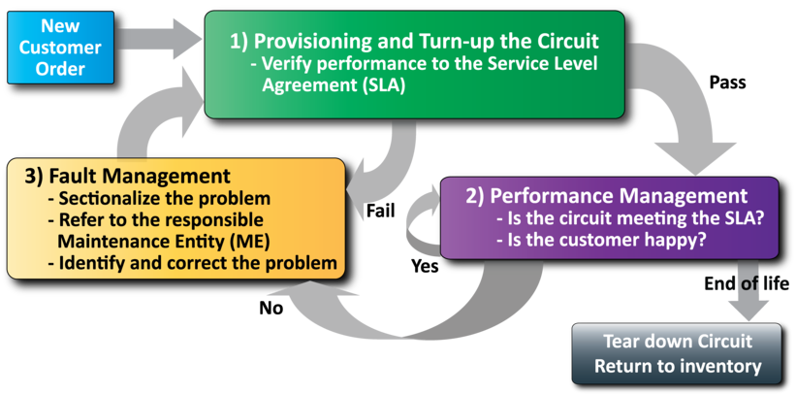
MEF Service Lifecycle and SOAM
Network Management
Fault management is a critical part of a circuit’s lifecycle

Slide 16
MEF Specification Section Review

Slide 17
Introducing MEF 38
The presentation is broken into sections:
Overview
Network Management Concepts/Topologies
Initial Configuration
OAM Functions
Configuration
Status
Summary
Where to find additional information

Slide 18
Overview of NETCONF
NETCONF is an IETF network management protocol designed to manage configuration:
Distinction between configuration and state data
Multiple configuration data stores:
Candidate, running, startup
Configuration change validations
Configuration change transactions
Selective data retrieval with filtering
Extensible Remote Procedure Call (RPC) mechanism

Slide 19
Overview of YANG
YANG is a data modeling language for NETCONF:
Human readable, and easy to learn representation
Hierarchical configuration data models
Reusable types and groupings (structured types)
Extensibility through augmentation mechanisms
Supports definition of operations (RPCs)
Formal constraints for configuration validation
Data modularity through modules and sub-modules
Well defined versioning rules

Slide 20
Why Not SNMP for Configuration?
Feature | Drawback
Stateless, connectionless, single attribute get and set | Not practical for complex, multi-device configuration changes
No difference between configuration and state data | No support for backup and restore
Data-centric (table-driven) view of the world | Semantic mismatch with task-oriented world of configuration
NETCONF specifically not meant to replace SNMP in general but to significantly improve in the area of configuration management

Slide 21
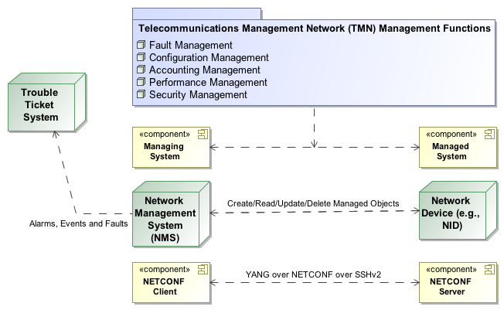
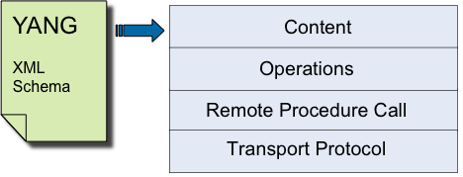
Management Framework
NETCONF 4-Layer Model
Service OAM
ITU-T Y.1731 End-to-End Performance Monitoring
IEEE 802.1ag End-to-End Connectivity Fault Management

Slide 22
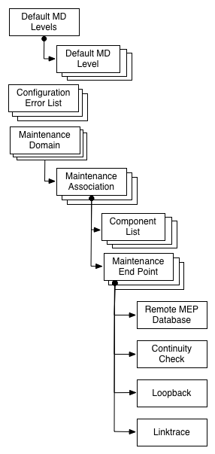
SOAM CFM YANG Module Overview
Connectivity Fault Management module describes IEEE 802.1Q and 802.1ap by implementing the objects and fuctions
Provides all managed objects which are defined in the corresponding SNMP MIB Modules:
IEEE8021-CFM-MIB
IEEE8021-CFM-V2-MIB
IEEE8021-TC-MIB
Provides top level structure of Ethernet CFM
MD, MA, MEP

Slide 23
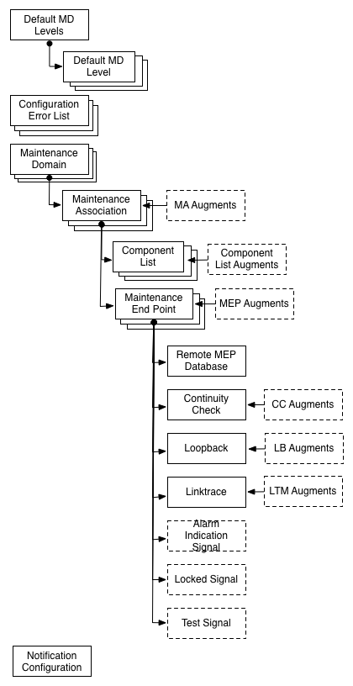
SOAM FM YANG Module Overview
Fault Management module describes SOAM FM (MEF 30) by implementing the objects and fuctions
Provides all managed objects which are defined in the corresponding SNMP MIB Modules (MEF 31):
MEF-SOAM-FM-MIB
MEF-SOAM-TC-MIB
Provides extensions to IEEE
CC, LB, LT, AIS, LCK, Test

Slide 24
YANG Module Details

Slide 25
mef-cfm.yang Module Details
The next several slides highlight the data model hierarchy of the mef-cfg.yang module.
Refer to the specification for node descriptions
Container: default-md-levels
Leaf: md-level
Leaf: mhf-creation
Leaf: default-id-permission
List: default-md-level
Leaf: primary-vid (key)
Leaf: component-id (key)
Leaflist: vid
Leaf: status
Leaf: md-level
Leaf: mhf-creation
Leaf: default-id-permission

Slide 26
mef-cfm.yang Module Details
List: configuration-error-list
Leaf: vlan-identifier (key)
Leaf: interface (key)
Leaf: error-conditions
List: maintenance-domain
Leaf: id (key)
Leaf: name-type
Leaf: name
Leaf: md-level
Leaf: mhf-creation
Leaf: id-permission

Slide 27
mef-cfm.yang Module Details
List: maintenance-association
Leaf: id (key)
Leaf: name-type
Leaf: name
List: component-list
Leaf: component-id (key)
Leaflist: vid
Leaf: mhf-creation
Leaf: id-permission
Leaf: ccm-interval
Leaflist: remote-meps
List: maintenance-association-end-point
Leaf: mep-identifier (key)

Slide 28
mef-cfm.yang Module Details
Leaf: interface
Leaf: direction
Leaf: primary-vid
Leaf: administrative-state
Leaf: mac-address
Leaf: ccm-ltm-priority
Container: continuity-check
Leaf: cci-enabled
Leaf: fng-state
Leaf: lowest-fault-priority-defect
Leaf: highest-priority-defect-found
Leaf: fng-alarm-time
Leaf: fng-reset-time
Leaf: active-defects

Slide 29
mef-cfm.yang Module Details
Leaf: last-error-ccm
Leaf: last-cross-connect-ccm
Leaf: ccm-sequence-error-count
Leaf: sent-ccms
Container: loopback
Leaf: replies-received
Leaf: replies-transmitted
Leaf: out-of-order-replies-received
Leaf: bad-msdu
Container: linktrace
Leaf: unexpected-replies-received
Container: linktrace-database
List: linktrace
Leaf: transaction-id (key)

Slide 30
mef-cfm.yang Module Details
Container: target-address
Choice: address-type
Leaf: mac-address
Leaf: mep-id
Leaf: transmit-ltm-flags
Leaf: default-ttl
List: reply
Leaf: reply-order (key)
Leaf: reply-ttl
Leaf: forwarded
Leaf: terminal-mep
Leaf: last-egress-identifier
Leaf: next-egress-identifier
Leaf: ltr-relay

Slide 31
mef-cfm.yang Module Details
Choice: chassis-id-subtype
Leaf: chassis-component
Leaf: interface-alias
Leaf: port-component
Leaf: mac-address-type
Leaf: network-address
Leaf: interface-name
Leaf: local
Container: management-address
Choice: management-address
<series of case statements>
Leaf: ingress-action
Leaf: ingress-mac
Container: ingress-port-id

Slide 32
mef-cfm.yang Module Details
Choice: port-id-subtype
Leaf: interface-alias
Leaf: port-component
Leaf: mac-address
Leaf: network-address
Leaf: interface-name
Leaf: agent-circuit-id
Leaf: local
Leaf: egress-action
Leaf: egress-mac
Container: egress-port-id
Choice: port-id-subtype (see above)
Leaf: organization-specific-tlv

Slide 33
mef-cfm.yang Module Details
Container: remote-mep-database
List: remote-mep
Leaf: remote-mep-id (key)
Leaf: remote-mep-state
Leaf: failed-ok-time
Leaf: mac-address
Leaf: rdi
Leaf: port-status-tlv
Leaf: interface-status-tlv
Choice: chassis-id-subtype (see above)

Slide 34
mef-cfm.yang Module Details
RPC: transmit-loopback
Inputs: mep-id, target-address, number-of-messages, data-tlv, vlan-priority, vlan-drop-eligible
Outputs: none
RPC: abort-loopback
Inputs: mep-id
Outputs: none
RPC: transmit-linktrace
Inputs: mep-id, target-address, transmit-ltm-flags, default-ttl
Outputs: transaction-id

Slide 35
mef-cfm.yang Module Details
Notification identifier: fault-alarm
Container: alarm
Leaf: mep-id
Leaf: active-defects

Slide 36
Summary

Slide 37
Summary MEF 38
MEF 38 defines the managed objects specified with the YANG data modeling language for using the NETCONF network management interface for the MEF 30 Service OAM Fault Management protocol
MEF 38 enables MEF equipment providers to provide a standardized XML-based new generation management interface for the SOAM Fault Management functions:
Continuity Check/Remote Defect Indication
Loopback
Linktrace
Alarm Indication Signal
Lock Signal
Test Signal

Slide 38
Related Specifications
MEF 30 SOAM FM
MEF 31 SOAM FM MIB
IEEE 802.1Q
ITU-T Y.1731
MEF 17 SOAM Requirements & Framework - Phase 1
MEF 12.1 CE Network Architecture Framework Part 2: ETH Service Layer – Base Elements
IETF RFC 6241 (NETCONF) & RFC 6020 (YANG)

Slide 39
Final Word
Service OAM
In the context of MEF 38, data models (YANG Modules) are defined that support service-level OAM in MENs
Next Actions (For Further Information)
Read the full MEF 30 Fault Management Implementation Agreement specification
Read the full MEF 38 specification (note, review of MEF 17, MEF 7.1, MEF 31 and MEF 15 may also be helpful)
Understand the principal service OAM components and capabilities
Notes:
This section goes into further detail in detailing the defined Service Attributes and parameters requirement and recommendations as specified for each of the defined services: EPL, EVPL and E-LAN.
(Refer to the Specs and the accompanying Ethernet Service Description document for more details)

Slide 40
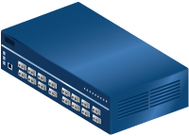
For Full Details …
Please visit www.metroethernetforum.org Select Information Center on Left Navigation to access the full specification and extracted YANG files
E-Line Service type
Carrier Ethernet 2.0
EVPL Services
UNI
UNI
CE
E-LAN Service type
Carrier Ethernet Network
CE
Carrier Ethernet 2.0
EVP-LAN Service
Internet
ISP POP
UNI
UNI
CE
CE
EVC: Ethernet Virtual Connection
UNI: User Network Interface. the physical demarcation point between the responsibility of the Service Provider and the responsibility of the End-User/Subscriber
CE Customer Equipment
CE
UNI
UNI
Carrier Ethernet Network
CE

Slide 41
Accelerating Worldwide Adoption of Carrier-class Ethernet Networks and Services
www.MetroEthernetForum.org

