Slide 1
Introducing the Specifications of the MEF
MEF 39: Service OAM Performance Monitoring YANG Module Technical Specification

Slide 2
Outline
Approved MEF Specifications
This presentation
About this Specification
In Scope / Out of Scope
Terminology, Concepts & Relationship to other standards
Section Review
Major topics
Minor topics
Examples/Use Cases
Summary

Slide 3
Approved MEF Specifications*
Specification | Description
MEF 2 | Requirements and Framework for Ethernet Service Protection
MEF 3 | Circuit Emulation Service Definitions, Framework and Requirements in Metro Ethernet Networks
MEF 4 | Metro Ethernet Network Architecture Framework Part 1: Generic Framework
MEF 6.1 | Metro Ethernet Services Definitions Phase 2
MEF 7.1 | EMS-NMS Information Model Phase 2
MEF 8 | Implementation Agreement for the Emulation of PDH Circuits over Metro Ethernet Networks
MEF 9 | Abstract Test Suite for Ethernet Services at the UNI
MEF 10.2 | Ethernet Services Attributes Phase 2
MEF 11 | User Network Interface (UNI) Requirements and Framework
MEF 12.1 | Metro Ethernet Network Architecture Framework Part 2: Ethernet Services Layer
MEF 13 | User Network Interface (UNI) Type 1 Implementation Agreement
MEF 14 | Abstract Test Suite for Traffic Management Phase 1
MEF 15 | Requirements for Management of Metro Ethernet Phase 1 Network Elements
MEF 16 | Ethernet Local Management Interface
*Current at time of publication. See MEF web site for official current list, minor updates and superseded work (such as MEF 1 and MEF 5)

Slide 4
Approved MEF Specifications
Specification | Description
MEF 17 | Service OAM Framework and Requirements
MEF 18 | Abstract Test Suite for Circuit Emulation Services
MEF 19 | Abstract Test Suite for UNI Type 1
MEF 20 | User Network Interface (UNI) Type 2 Implementation Agreement
MEF 21 | Abstract Test Suite for UNI Type 2 Part 1: Link OAM
MEF 22.1 | Mobile Backhaul Implementation Agreement Phase 2
MEF 23.1 | Class of Service Implementation Agreement Phase 2
MEF 24 | Abstract Test Suite for UNI Type 2 Part 2: E-LMI
MEF 25 | Abstract Test Suite for UNI Type 2 Part 3: Service OAM
MEF 26.1 | External Network Network Interface (ENNI) – Phase 2
MEF 27 | Abstract Test Suite For UNI Type 2 Part 5: Enhanced UNI Attributes & Part 6: L2CP Handling
MEF 28 | External Network Network Interface (ENNI) Support for UNI Tunnel Access and Virtual UNI
MEF 29 | Ethernet Services Constructs

Slide 5
Approved MEF Specifications
Specification | Description
MEF 30 | Service OAM Fault Management Implementation Agreement
MEF 31 | Service OAM Fault Management Definition of Managed Objects
MEF 32 | Requirements for Service Protection Across External Interfaces
MEF 33 | Ethernet Access Services Definition
MEF 34 | Abstract Test Suite for Ethernet Access Services
MEF 35 | Service OAM Performance Monitoring Implementation Agreement
MEF 36 | Service OAM SNMP MIB for Performance Monitoring
MEF 37 | Abstract Test Suite for ENNI
MEF 38 | Service OAM Fault Management YANG Modules Technical Specification
MEF 39 | Service OAM Performance Monitoring YANG Module Technical Specification

Slide 6
MEF Specification Overview
MEF 39 - Service OAM Performance Monitoring YANG Modules Technical Specification
Purpose
Specifies the Performance Monitoring (PM) YANG Modules necessary to implement Service Operations, Administration, and Maintenance (OAM) that satisfies the Service OAM requirements and framework specified by MEF 17, MEF 35, the PM management objects specified in MEF 7.1, MEF 36, and the PM functions defined in ITU-T Y.1731.
Audience
Applicable to entire Metro Ethernet Market including Service Providers, Access Providers, equipment vendors, and EMS/NMS/OSS vendors to provision and monitor equipment that is MEF compatible.
Standardized Services

Slide 7
Overview of MEF 39

Slide 8
About MEF 39
Purpose:
This presentation is an introduction to MEF 39 - Service OAM Performance Monitoring YANG Modules
Audience
Equipment Manufacturers building devices that will carry Carrier Ethernet Services
Service Providers delivering Carrier Ethernet Services
EMS/NMS/OSS tool vendors developing back office applications for managing Carrier Ethernet Services
Other Documents
Presentations of other MEF specifications and an overview of all specifications is available on the MEF web site
Other materials such as white papers and case studies are also available

Slide 9
Service OAM
MEF 17 provides the framework
Relevant for Subscribers (customers), Operators and Service Providers
Fault Management IA (MEF 30)
FM of MEF Services
Specifies profile of protocols defined in IEEE 802.1Q and ITU-T Y.1731
Provides basic SOAM architecture and requirements for each of the recommended MEGs
Performance Management IA (MEF 35)
PM of MEF Services
Specifies profile of protocols defined in ITU-T Y.1731
MEF 31 & MEF 36
SNMP MIBs (Definition of Management Objects) for FM (MEF 31) and PM (MEF 36)
Provides data models for SNMP-based network management

Slide 10
MEF 39 - In Scope/Out of Scope
MEF 39 requirements are primarily driven by MEF 35 and leverage the OAM functions & managed objects defined by MEF 7.1, and ITU-T Y.1731
Managed objects to perform Performance Monitoring functions such as loss and delay measurements and threshold crossing alerts are covered in this Technical Specification
SOAM Fault Management YANG capabilities are covered in MEF 38

Slide 11
Terminology and Concepts
MEF 39 adheres to MEF 30 & 35 terminology:
Refer to MEF 30 for ME, MEG, MEP, MIP, MEG Level, MEG CoS
Refer to MEF 35 for Single-Ended, Dual-Ended, one-way, two-way, PM Function, PM Session, PM Solution, PM Tool, Controller MEP, Responder MEP, Measurement Bin, and Measurement Interval
MEF 38 introduces protocol specific terminology
Network Configuration Protocol (NETCONF)
NETCONF Client/Server
YANG Data Modeling Language and Modules
Element/Network Management System (EMS/NMS)
Operations Support System (OSS)
Remote Procedure Call (RPC)
Extensible Markup Language (XML)
Secure Shell (SSH)
MEF 30 & 35 aligns with terminology found in ITU Y.1731

Slide 12
Relationship with other Specifications

Slide 13
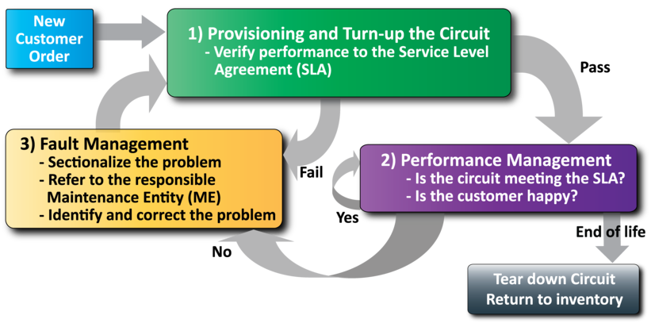
MEF Service Lifecycle and SOAM
Network Management
Performance Management is use to monitor the service

Slide 14
MEF Specification Section Review

Slide 15
Introducing MEF 39
The presentation is broken into sections:
Overview of NETCONF and YANG
Network Management Concepts/Topologies
Overview of PM Module
Detailed YANG Tree output
Summary
Where to find additional information

Slide 16
Overview of NETCONF
NETCONF is an IETF network management protocol designed to manage configuration:
Distinction between configuration and state data
Multiple configuration data stores:
Candidate, Running, Startup
Configuration change validations
Configuration change transactions
Selective data retrieval with filtering
Extensible Remote Procedure Call (RPC) mechanism

Slide 17
Overview of YANG
YANG is a data modeling language for NETCONF:
Human readable, and easy to learn representation
Hierarchical configuration data models
Reusable types and groupings (structured types)
Extensibility through augmentation mechanisms
Supports definition of operations (RPCs)
Formal constraints for configuration validation
Data modularity through modules and sub-modules
Well defined versioning rules

Slide 18
Why Not SNMP for Configuration?
Feature | Drawback
Stateless, connectionless, single attribute get and set | Not practical for complex, multi-device configuration changes
No difference between configuration and state data | No support for backup and restore
Data-centric (table-driven) view of the world | Semantic mismatch with task-oriented world of configuration
NETCONF specifically not meant to replace SNMP in general but to significantly improve in the area of configuration management

Slide 19
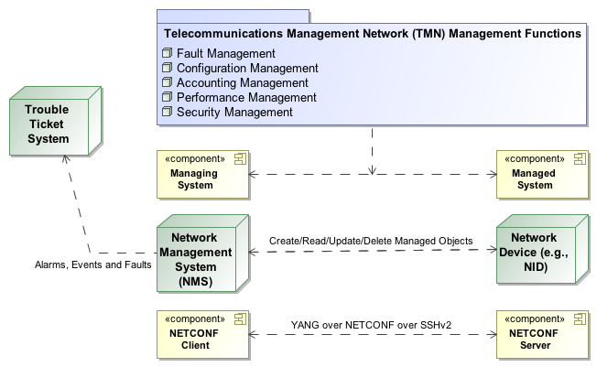
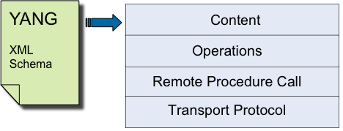
Management Framework
NETCONF 4-Layer Model
Service OAM
ITU-T Y.1731 End-to-End Performance Monitoring
IEEE 802.1ag End-to-End Connectivity Fault Management

Slide 20
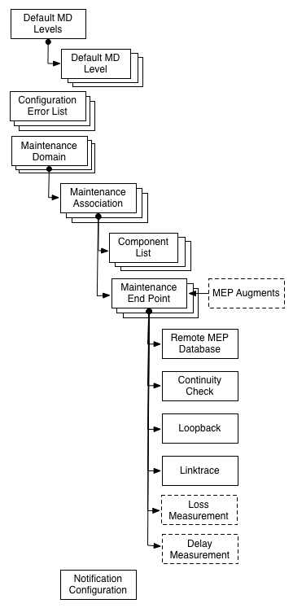
SOAM PM YANG Module Overview
Performance Monitoring module augments the CFM MEP with parameters/functions related to SOAM PM
Defines Loss Measurement
Defines Delay Measurement
Defines PM Notifications

Slide 21
YANG Module Details
The following slide includes an embedded HTML file which details the data model hierarchy of the module
Refer to the specification for detailed descriptions

Slide 22
Module Details
Module Tree View Symbol Legend
config indicates a configuration node
no config indicates operational state data
[Brackets] enclose & identify list keys
? indicates optional node
(Parentheses) enclose choice and case nodes
case nodes are marked with a colon :
Leaf nodes are followed by their data type
Note: Double-click the icon to launch
a web browser to view a navigable version
of the YANG PM Module. The Module
is best viewed with Google Chrome or
Mozilla Firefox.
Remote Procedure Calls (RPCs)
YANG RPCs are used to define NETCONF RPC Operations
Each RPC node has a mandatory identifier.
An optional input is defined which includes the input parameters to the operation.
An optional output is defined which includes the outputs from the operation.
Notifications
YANG notifications are used to define NETCONF Notifications
Each Notifications node has a mandatory identifier.
A leaf marked as mandatory=true must be sent in the notification.

Slide 23
Summary

Slide 24
Summary MEF 39
MEF 39 defines the managed objects specified with the YANG data modeling language for using the NETCONF network management interface for the MEF 35 Service OAM Performance Monitoring protocol
MEF 39 enables MEF equipment providers to provide a standardized XML-based new generation management interface for the SOAM Performance Monitoring functions:
Loss Measurement
Delay Measurement
Threshold Crossing Configuration and Alerts

Slide 25
Related Specifications
MEF 35 SOAM PM
ITU-T Y.1731
MEF 17 SOAM Requirements & Framework - Phase 1
MEF 12.1 CE Network Architecture Framework Part 2: ETH Service Layer – Base Elements
IETF RFC 6241 (NETCONF) & RFC 6020 (YANG)

Slide 26
Final Word
Service OAM
In the context of MEF 39, data models (YANG Modules) are defined that support service-level OAM in CENs
Next Actions (For Further Information)
Read the full MEF 35 Performance Monitoring Implementation Agreement specification
Read the full MEF 39 specification (note, review of MEF 17, MEF 7.1, and MEF 15 may also be helpful)
Understand the principal Service OAM components and capabilities
Notes:
This section goes into further detail in detailing the defined Service Attributes and parameters requirement and recommendations as specified for each of the defined services: EPL, EVPL and E-LAN.
(Refer to the Specs and the accompanying Ethernet Service Description document for more details)

Slide 27
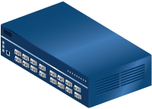
For Full Details …
Please visit www.metroethernetforum.org Select Information Center on Left Navigation to access the full specification and extracted YANG files
E-Line Service type
Carrier Ethernet 2.0
EVPL Services
UNI
UNI
CE
E-LAN Service type
Carrier Ethernet Network
CE
Carrier Ethernet 2.0
EVP-LAN Service
Internet
ISP POP
UNI
UNI
CE
CE
EVC: Ethernet Virtual Connection
UNI: User Network Interface. the physical demarcation point between the responsibility of the Service Provider and the responsibility of the End-User/Subscriber
CE Customer Equipment
CE
UNI
UNI
Carrier Ethernet Network
CE

Slide 28
Accelerating Worldwide Adoption of Carrier-class Ethernet Networks and Services
www.MetroEthernetForum.org

