Slide 1
Introducing the Specifications of the MEF
MEF 7.2: Carrier Ethernet
Management Information Model
July 2013

Slide 2
MEF Reference Presentations
Intention
These MEF reference presentations are intended to give general overviews of the MEF work and have been approved by the MEF Marketing Committee
Further details on the topic are to be found in related specifications, technical overviews, white papers in the MEF public site Information Center: http://metroethernetforum.org/InformationCenter
Notice
© The Metro Ethernet Forum 2013. Any reproduction of this document, or any portion thereof, shall contain the following statement: "Reproduced with permission of the Metro Ethernet Forum." No user of this document is authorized to modify any of the information contained herein.

Slide 3
Outline
Approved MEF Specifications
Specification Overview
OAM Overview
Use Cases
Summary

Slide 4
Approved MEF Specifications*
Specification | Description
MEF 2 | Requirements and Framework for Ethernet Service Protection
MEF 3 | Circuit Emulation Service Definitions, Framework and Requirements in Metro Ethernet Networks
MEF 4 | Metro Ethernet Network Architecture Framework Part 1: Generic Framework
MEF 6.1 | Metro Ethernet Services Definitions Phase 2
MEF 7.2 | Carrier Ethernet Management Information Model
MEF 8 | Implementation Agreement for the Emulation of PDH Circuits over Metro Ethernet Networks
MEF 9 | Abstract Test Suite for Ethernet Services at the UNI
MEF 10.2 | Ethernet Services Attributes Phase 2
MEF 11 | User Network Interface (UNI) Requirements and Framework
MEF 12.1 | Metro Ethernet Network Architecture Framework Part 2: Ethernet Services Layer
MEF 13 | User Network Interface (UNI) Type 1 Implementation Agreement
MEF 14 | Abstract Test Suite for Traffic Management Phase 1
MEF 15 | Requirements for Management of Metro Ethernet Phase 1 Network Elements
MEF 16 | Ethernet Local Management Interface
*Current at time of publication. See MEF web site for official current list, minor updates and superseded work (such as MEF 1 and MEF 5)

Slide 5
Approved MEF Specifications
Specification | Description
MEF 17 | Service OAM Framework and Requirements
MEF 18 | Abstract Test Suite for Circuit Emulation Services
MEF 19 | Abstract Test Suite for UNI Type 1
MEF 20 | User Network Interface (UNI) Type 2 Implementation Agreement
MEF 21 | Abstract Test Suite for UNI Type 2 Part 1: Link OAM
MEF 22.1 | Mobile Backhaul Implementation Agreement Phase 2
MEF 23.1 | Class of Service Implementation Agreement Phase 2
MEF 24 | Abstract Test Suite for UNI Type 2 Part 2: E-LMI
MEF 25 | Abstract Test Suite for UNI Type 2 Part 3: Service OAM
MEF 26.1 | External Network Network Interface (ENNI) – Phase 2
MEF 27 | Abstract Test Suite For UNI Type 2 Part 5: Enhanced UNI Attributes & Part 6: L2CP Handling
MEF 28 | External Network Network Interface (ENNI) Support for UNI Tunnel Access and Virtual UNI
MEF 29 | Ethernet Services Constructs

Slide 6
Approved MEF Specifications
Specification | Description
MEF 30.1 | Service OAM Fault Management Implementation Agreement: Phase 2
MEF 31 | Service OAM Fault Management Definition of Managed Objects
MEF 32 | Requirements for Service Protection Across External Interfaces
MEF 33 | Ethernet Access Services Definition
MEF 34 | Abstract Test Suite for Ethernet Access Services
MEF 35 | Service OAM Performance Monitoring Implementation Agreement
MEF 36 | Service OAM SNMP MIB for Performance Monitoring
MEF 37 | Abstract Test Suite for ENNI
MEF 38 | Service OAM Fault Management YANG Modules Technical Specification
MEF 39 | Service OAM Performance Monitoring YANG Modules Technical Specifications
MEF 40 | UNI and EVC Definition of Managed Objects
*Current at time of publication. See MEF web site for official current list, minor updates (such as MEF 31.0.1 amendment to this document) and superseded work (such as MEF 1 and MEF 5)

Slide 7
MEF Specification Overview
MEF 7 - EMS-NMS Information Model Element Management System–Network Management System
Purpose
This Specification defines a common set of managed object definitions that are consistent and readily integrated into a Carrier Ethernet Provider’s operations environment. This common management model helps ensure that vendors provide management functionality and information in their OSSs, NMSs, EMSs, and NEs in a logically consistent fashion, and allows service providers to readily integrate such capabilities into their management environment..
Audience
Equipment Manufacturers building devices that will carry Carrier Ethernet Services
Useful for Service Providers architecting their systems and providing services.
Tool vendors for developing back office applications

Slide 8
About MEF 7.2
Purpose:
This presentation is an introduction to MEF 7.2 – Carrier Ethernet Management Information Model
Audience
Equipment Manufacturers building devices that will carry Carrier Ethernet Services
Service Providers delivering Carrier Ethernet Services
EMS/NMS/OSS tool vendors developing back office applications for managing, provisioning and monitoring Carrier Ethernet Services
Other Documents
Presentations of other MEF specifications and an overview of all specifications is available on the MEF web site
Other materials such as white papers and case studies are also available

Slide 9
EMS – NMS Information Model
A Specification
Enable consistent definition of the management information required to manage Carrier Ethernet.
A Model
Defines the specific EMS-NMS management interface and objects for each specific interface profile such as Common Object Request Broker Object (CORBA) IDL, Simple Network Management Protocol (SNMP), JAVA, XML, etc.
Scope
Ethernet (ETH) layer UNI configuration provisioning
ETH layer configuration and provisioning
ETH layer network connection and fault management (including setup/modification, notification, testing)
Ethernet External Network Network Interface (ENNI) Service Attributes
UNI Tunnel Access (UTA) / Virtual User Network Interface (VUNI) Service Attributes
SOAM Service Attributes
Virtual Network Interface Device (vNID) Remote Management Interface
Ethernet Access Services

Slide 10
OAM Overview

Slide 11
MEF Service OAM
MEF 7.2 defines a means to provide OAM at the Ethernet Services layer
Does not define OAM at the transport link/ network layers
Compliments/relies on the work done in the ITU, IEEE and IETF at the Transport data link and Network layers
Provides a frame work and concepts for managing and monitoring flows across a connectionless network
From end to end
From Operator to Operator
Provides mechanism to perform:
Node Discovery, Establish connectivity, monitor CoS, and detect service impairments

Slide 12
Key Assumptions behind MEF OAM
Assumes Ethernet is only common denominator
For example: 802.3 Ethernet, Ethernet over SONET/SDH, RPR, etc.
Must use Ethernet framing for OAM communications
Ethernet segments interconnected with forwarding entities (bridges, etc.)
Connectionless (like IP)
Segment can be real or virtual
Must measure “per service” and “fate share” with the data plane
Out-of-band OAM not reflective of the data plane
OAM mixes with user data within the core network
Small initial focus on “SLA” metrics
Connectivity, latency, loss, jitter, availability
Other functions may follow later
Traceroute, RDI/AIS, other
Domain oriented
Domain may be intra-provider, inter-provider, customer-to-customer, etc.

Slide 13
Network Layering Concepts
IP
ETH
Layer Network Domains
(LND)
MPLS
SONET/SDH
WDM
Flows, connections and resources can all be managed separately at each LND
Each can remain independent
Each in turn can pass information to upper management domains to isolate issues.

Slide 14
Use Cases

Slide 15
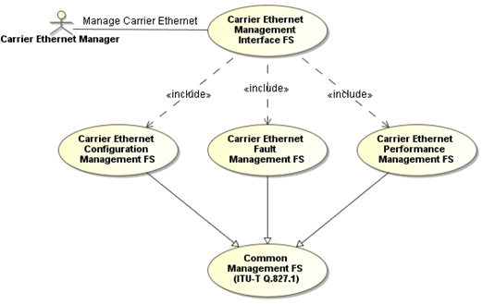
Carrier Ethernet Management
Management Interface includes Configuration, Fault, Performance, and Common functions

Slide 16
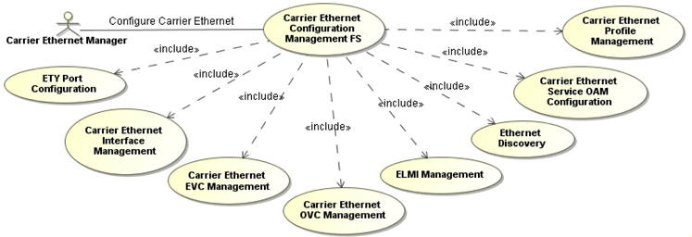
Configuration Management (CM)
Provides the description of the various elements necessary for Configuration of Carrier Ethernet
A couple of Configuration Function examples are given in the following slides

Slide 17
CM Example
The next slide provides an example of the detail contained in MEF 7.2
The figure shows the functions for Interface Management
The slide after that shows the text describing ENNI Creation
Each function is documented in manner displayed on the ENNI Creation Example slide

Slide 18
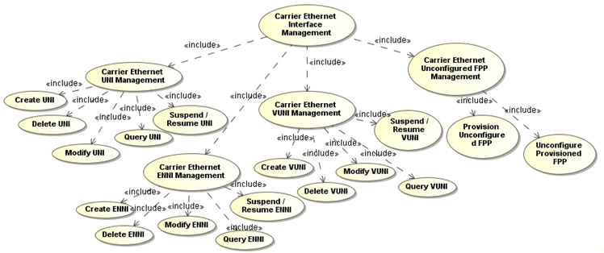
CM Example – Interface Management
Create, Delete, Modify, Query functions defined for
UNI
VUNI
ENNI
Flow Point Pool (FPP) Management

Slide 19
ENNI Creation Example
Name | ETH Flow Point Pool (FPP) ENNI Creation
Summary | The Carrier Ethernet Manager creates and configures an ETH ENNI on a pre-selected port. ETH FPP ENNIs may be created automatically by Managed System when physical ports are created, and can be retrieved by Carrier Ethernet Manager.
Actor(s) | Carrier Ethernet Manager
Assumptions | The Carrier Ethernet Manager has the authority to create the ETH ENNI.
Pre-Conditions | The Carrier Ethernet Manager has established communication with Managed System.
Begins When | The Carrier Ethernet Manager has selected a port (e.g., Generic Transport TTP) and sends a request to provision an ETH_FPP_ENNI representing an Ethernet ENNI on the port.
Description | The Carrier Ethernet Manager needs to create a new ETH ENNI associated with a specific port. The Carrier Ethernet Manager requests the creation of a new Ethernet FPP ENNI to be managed by the Managed System. As part of the creation request, the Carrier Ethernet Manager provides Ethernet ENNI configuration parameters. Based on the creation request, the Managed System creates an instance of ETH FPP ENNI and returns the name of the new ETH FPP ENNI instance. In addition, an Object Creation Notification for the new instance of ETH FPP ENNI is autonomously sent from the Managed System. For an ETH FPP ENNI, the following information may be provided by the Carrier Ethernet Manager as part of the creation request: – FPP Type: Indicates that the ETH FPP is an ENNI. – FPP SubType (Optional): A string that indicates the detailed FPP sub-type. – User Label. – IEEE 802.3Address (Optional): The [IEEE 802.3] address which is placed in the source-address field of any non-FDFr specific Ethernet frames that originate at this interface. – Max Number of Virtual Connections (Optional). – MTU Size.
Description (cont.) | – ENNI Label: Describes the ENNI within the scope of the Ethernet provider domain. The ENNI Label attribute is a value that is assigned to the ENNI by the Ethernet Provider. – Protection Mechanism: The method for protection, if any, against a failure. – SVLAN-ID Mapping: The map that associates each S-Tagged ENNI Frame with an End Point. The End Point Type within an End Point Map for ENNI frames mapped to an OVC MUST take the value of “OVC”. The End Point Type within an End Point Map for ENNI frames mapped to a VUNI MUST take the value of “VUNI”. – Maximum Number of OVC End Points per OVC: The Maximum Number of OVC End Points per OVC provides an upper bound on the number of OVC End Points that are associated by an OVC that the Operator can support at the ENNI. Note that if the Maximum Number of OVC End Points per OVC is one, then hairpin switching cannot be supported at the ENNI. – Supported By (GET, SET BY CREATE): Relationship with supporting objects. – Client/Server (GET, SET BY CREATE): Relationship with TRANS layer TTP (Encapsulation Port). – Flow Domain Interfaces (GET, SET BY CREATE): Relationship with ETH Flow Domain that contains the FPP in a given layer. – Ingress Bandwidth Profile (Optional): This attribute indicates the ingress bandwidth profile for all ETH services at the ETH FPP ENNI in the ingress direction. – Egress Bandwidth Profile (Optional): This attribute indicates the egress bandwidth profile for all ETH services at the ETH FPP ENNI in the egress direction
Ends When | 1) Managed System returns the creation response to Carrier Ethernet Manager 2) Exception happens
Exceptions | 1) Unknown Managed Entity 2) Managed System Processing Error 3) Invalid Parameter
Post-Conditions | A new instance of ETH Flow Point Pool ENNI is created.

Slide 20
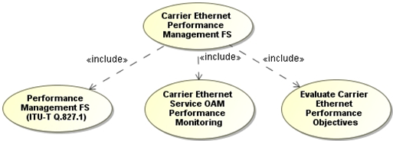
Performance Management
Functions to control SOAM PM (MEF 35)
Loss, Delay, and Availability are covered

Slide 21
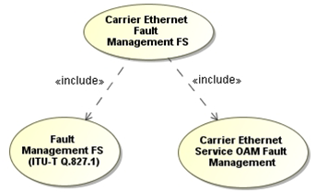
Fault Management
Fault Management functions as defined by MEF 30
Loopback, Link Trace, Lock
Alarm and Notifications

Slide 22
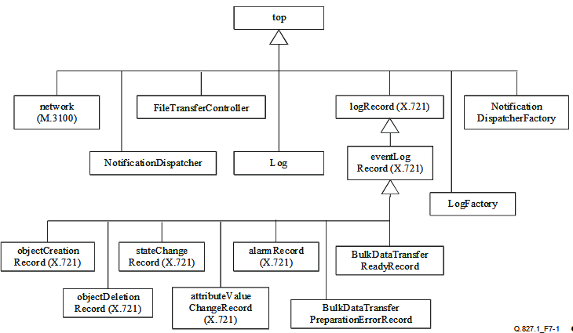
Information Model
MEF 7.2 provides MEF specific extensions to the ITU-T Q.827.1 information model

Slide 23
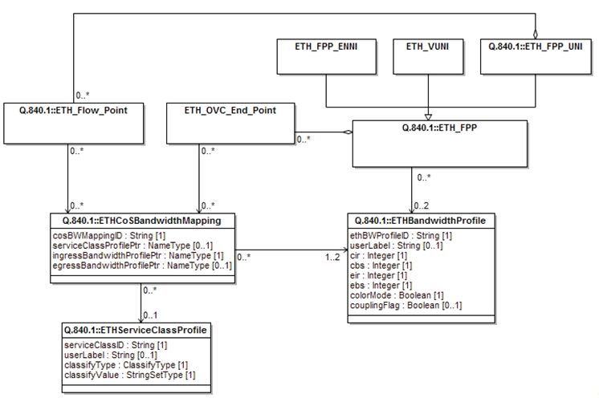
MEF Specific Information Model
MEF 7.2 provides the class object diagrams for the MEF specific Carrier Ethernet Services
For example, below is the diagram for the ENNI related bandwidth profile attributes:

Slide 24
Summary

Slide 25
Summary MEF 7.2
MEF 7.2 provides the EMS-NMS Management Information Model
Provides the Use Cases needed for the EMS-NMS Management Interface
Provides detailed functional decomposition
Shows the linkage between the MEF specific objects and the common models from the ITU-T and TMF

Slide 26
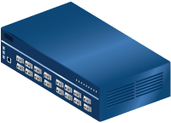
For Full Details …
Please visit www.metroethernetforum.org Select Information Center on Left Navigation to access the full specification and extracted MIB files
E-Line Service type
Carrier Ethernet 2.0
EVPL Services
UNI
UNI
CE
E-LAN Service type
Carrier Ethernet Network
CE
Carrier Ethernet 2.0
EVP-LAN Service
Internet
ISP POP
UNI
UNI
CE
CE
EVC: Ethernet Virtual Connection
UNI: User Network Interface. the physical demarcation point between the responsibility of the Service Provider and the responsibility of the End-User/Subscriber
CE Customer Equipment
CE
UNI
UNI
Carrier Ethernet Network
CE

Slide 27
Accelerating Worldwide Adoption of Carrier-class Ethernet Networks and Services
www.MetroEthernetForum.org

