Slide 1
Introducing the Specifications of the MEF
MEF 54: Ethernet Interconnection Point (EIP):
An ENNI Implementation Agreement
April 2016

Slide 2
MEF Reference Presentations
Intention
These MEF reference presentations are intended to give general overviews of the MEF work and have been approved by the MEF Marketing Committee
Further details on the topic are to be found in related specifications, technical overviews, white papers in the MEF public site Information Center: http://www.mef.net/carrier-ethernet/technical-specifications

Slide 3
Outline
Approved MEF Specifications
Implementation Guide Overview
About MEF 54
In Scope / Out of Scope
Terminology / Concepts
Key Companies That Made This Possible
Project Review
Summary
Notes:
Approved MEF Specifications
Implementation Guide Overview
About MEF 5X
In Scope / Out of Scope
Terminology / Concepts
Key Companies That Made This Possible
Project Review
Era of Ethernet
Interconnection Landscape
MEF Specifications and Possible Obstacles
Evolution of Tagging and TPIDs
EIP Project
Rapid Prototyping at UNH IOL
Overview of Network Connection Tested
Summary of Test Results
Operator Becomes Completely Isolated
Operator Becomes Partially Isolated
Operator Becomes Bilingual
Obstacles and How We Overcame
Operators Need to Know
Summary
What’s Next for EIP
Full Details
Related Documents
How to Perform EIP Testing and Certification

Slide 4
Approved MEF Specifications*
Specification | Description
MEF 2 | Requirements and Framework for Ethernet Service Protection
MEF 3 | Circuit Emulation Service Definitions, Framework and Requirements in Metro Ethernet Networks
MEF 4 | Metro Ethernet Network Architecture Framework Part 1: Generic Framework
MEF 6.2 | EVC Ethernet Services Definitions Phase 3
MEF 7.2 | Carrier Ethernet Information Model
MEF 8 | Implementation Agreement for the Emulation of PDH Circuits over Metro Ethernet Networks
MEF 9 | Abstract Test Suite for Ethernet Services at the UNI
MEF 10.3 | Ethernet Services Attributes Phase 3
MEF 11 | User Network Interface (UNI) Requirements and Framework
MEF 12.2 | Carrier Ethernet Network Architecture Framework Part 2: Ethernet Services Layer
MEF 13 | User Network Interface (UNI) Type 1 Implementation Agreement
MEF 14 | Abstract Test Suite for Traffic Management Phase 1
MEF 15 | Requirements for Management of Metro Ethernet Phase 1 Network Elements
MEF 16 | Ethernet Local Management Interface
MEF 17 | Service OAM Framework and Requirements
*Current at time of publication. See MEF web site for official current list, minor updates and superseded work (such as MEF 1 and MEF 5)

Slide 5
Approved MEF Specifications
Specification | Description
MEF 18 | Abstract Test Suite for Circuit Emulation Services
MEF 19 | Abstract Test Suite for UNI Type 1
MEF 20 | User Network Interface (UNI) Type 2 Implementation Agreement
MEF 21 | Abstract Test Suite for UNI Type 2 Part 1: Link OAM
MEF 22.2 | Mobile Backhaul Phase 3 Implementation Agreement
MEF 23.1 | Class of Service Implementation Agreement Phase 2
MEF 24 | Abstract Test Suite for UNI Type 2 Part 2: E-LMI
MEF 25 | Abstract Test Suite for UNI Type 2 Part 3: Service OAM
MEF 26.1 | External Network Network Interface (ENNI) – Phase 2
MEF 27 | Abstract Test Suite For UNI Type 2 Part 5: Enhanced UNI Attributes & Part 6: L2CP Handling
MEF 28 | External Network Network Interface (ENNI) Support for UNI Tunnel Access and Virtual UNI
MEF 29 | Ethernet Services Constructs
MEF 30.1 | Service OAM Fault Management Implementation Agreement Phase 2
MEF 30.1.1 | Service OAM Fault Management Implementation Agreement Phase 2
MEF 31 | Service OAM Fault Management Definition of Managed Objects

Slide 6
Approved MEF Specifications
Specification | Description
MEF 32 | Requirements for Service Protection Across External Interfaces
MEF 33 | Ethernet Access Services Definition
MEF 34 | Abstract Test Suite for Ethernet Access Services
MEF 35.1 | Service OAM Performance Monitoring Implementation Agreement
MEF 36 | Service OAM SNMP MIB for Performance Monitoring
MEF 37 | Abstract Test Suite for ENNI
MEF 38 | Service OAM Fault Management YANG Modules Technical Specification
MEF 39 | Service OAM Performance Monitoring YANG Modules Technical Specification
MEF 40 | UNI and EVC Definition of Managed Objects Technical Specification
MEF 41 | Generic Token Bucket Algorithm Technical Specification
MEF 42 | ENNI and OVC Definition of Managed Objects Technical Specification
MEF 43 | Virtual NID (vNID) Functionality for E-Access Services Technical Specification
MEF 44 | Virtual NID (vNID) Definition of Managed Objects Technical Specification
MEF 45 | Multi-CEN L2CP Technical Specification
MEF 46 | Latching Loopback Protocol and Functionality Technical Specification

Slide 7
Approved MEF Specifications
Specification | Description
MEF 47 | Carrier Ethernet Services for Cloud Implementation Agreement
MEF 48 | Service Activation Testing Technical Specification
MEF 49 | Service Activation Testing Control Protocol and PDU Formats Technical Specification
MEF 49.0.1 | Amendment to Service Activation Testing Control Protocol and PDU Formats
MEF 50 | Carrier Ethernet Service Lifecycle Process Model Guidelines
MEF 51 | OVC Services Definitions Technical Specification
MEF 52 | Carrier Ethernet Performance Reporting Framework
MEF 53 | Carrier Ethernet Services Qualification Questionnaire
MEF 54 | Ethernet Interconnection Point (EIP): An ENNI Implementation Agreement
MEF 55 | Lifecycle Service Orchestration (LSO): Reference Architecture and Framework

Slide 8
MEF 54 Implementation Agreement Overview
MEF 54: Ethernet Interconnection Point (EIP): An ENNI Implementation Agreement
Purpose | A guideline document providing Ethernet Operators practical advice to help them on their journey towards creating MEF standardized Carrier Ethernet Interconnections with other Operators. These Interconnections are what the MEF calls “ENNIs.” If an Operator cannot create an ENNI, the Guideline provides instruction on how to create a non-standard interconnection known as an “NNI.” The guideline covers myriad topics covering key areas such as current market assessment, where the market is heading, technical expectations, obstacles that may be encountered, and the need for an Operator to be “bi-lingual” until the market moves to MEF standardized Interconnections.
Audience | All Ethernet Operators who wish to interconnect their network with another Operator to create EVCs spanning two Operators.

Slide 9
Overview of MEF 54
Ethernet Interconnection Point (EIP):
An ENNI Implementation Agreement

Slide 10
About MEF 54
Purpose
This presentation is an introduction to MEF 54 – Ethernet Interconnection Point (EIP): An ENNI Implementation Agreement.
Audience
Operators who buy wholesale Ethernet services from other Operators and interconnect their networks for the purpose of E-Access.
e.g. – Operator 1 buys an Ethernet UNI (ENNI) from Operator 2 and uses this UNI (ENNI) to reach multiple customers located within Operator 2’s footprint.
Other Documents
MEF 26.1 - Technical specifications for External Network Network Interface (ENNI) – Phase 2 (Provider Bridging)
MEF 33 - Ethernet Access Services Definition
MEF 51 - OVC Services Definitions Technical Specification

Slide 11
MEF 54 - In Scope/Out of Scope
In Scope
This version of the Implementation Agreement (IA) used the most basic Ethernet E-Access configuration possible so that the six Operators performing interoperability testing could interconnect and create Ethernet Private Line (EPL) service spanning two Operators.
Out of Scope
Ethernet Virtual Private Line (EVPL), Access EVPL
E-LAN, E-Tree, E-Transit
Any service with an Excess Information Rate (EIR)
Class of Service (CoS) Medium and Low

Slide 12
Terminology & Concepts
Key Terminology
ENNI = External Network to Network Interface
E-Access = Ethernet Access
NNI = Network to Network Interface
TPID = Tag Protocol Identification
S-Tag = An Ethertype with a value of 0x88a8
C-Tag = An Ethertype with a value of 0x8100
Q-in-Q = Non-standard double tagging method commonly used in the industry. Uses two C-Tags.
New Terminology
Bilingual Operator – An Ethernet Operator that can create Ethernet Interconnections using either a non-standard NNI or the new ENNI
Rapid Prototyping – Quick interoperability testing between Operators at the University of New Hampshire

Slide 13
Key Companies That Made This Possible
This project relied heavily upon the six Operators who donated time, talent, and a spirit of mutual respect and cooperation to moving the industry forward (AT&T, Frontier, CenturyLink, TelePacific, Verizon, Windstream) – Thank you!
This Project relied heavily upon the testing (rapid prototyping) conducted at the University of New Hampshire’s Interoperability Lab – Thank you!
This project relied heavily upon the equipment vendors who donated time and equipment to facilitate the testing at UNH Lab (Accedian, Alcatel-Lucent, Canoga Perkins, Ciena, Cisco, Juniper, RAD) – Thank you!
This project relied heavily upon Veryx technologies to measure performance between Operators during testing – Thank you!

Slide 14
Global Era of Ethernet
------The Era of the T1/E1/J1----------------------------------The Era of SONET-----------------------The Era of Ethernet--------
TDM technologies
USA/Canada Implements “T1/T3”
USA/Canada Implements SONET (OCX)
Europe / Asia / CALA Implements “E1/E3”
Global Ethernet Implementation
Most of World Implements SDH (STMx)
Japan Implements “J1/J3”
Japan Implements “T1/T3”
Ethernet in the LAN
Ethernet in the Metro
Ethernet across the WAN
Ethernet in the LAN
Ethernet in the Metro
Ethernet in the LAN
1970 1980 1990 2000 2010 2020
Dates are demonstrative to show market trends
Notes:
The telecommunications industry has entered the “Era of Ethernet,” and for the first time in history, a globally recognized standard for networking is unfolding. What's most remarkable is the same technology is used in a LAN, Metro, and WAN. Never before in the history of telecom has a single technology been so universal for both customers (subscribers), and Operators (Carriers). While the specific dates below are debatable, the trend is not.

Slide 15
Multi-Carrier Interconnection Capability: TDM vs. Ethernet
1970 - 2020 2005 - 2020 2020 - Forward
Current TDM Interconnection Capability
Future Ethernet Interconnection Capability
Current TDM Interconnection Capability
Current Ethernet Interconnection Capability
Current Ethernet Interconnection Capability
Standardized TDM Meet Points enabled mass scalability of Private Lines (T1) and were the foundation of the Internet and the digital explosion (~1990-2010)
Lack of standardization is hindering Ethernet growth. This gets worse as more customers demand Ethernet. Solution is getting the industry to use the MEF standard (ENNI)
As MEF standardized Ethernet Interconnections take hold, (ENNIs) Ethernet availability becomes as ubiquitous as TDM
AT&T TDM
AT&T
Ethernet
AT&T
Ethernet
MP
MP
CC
CC
ENNI
ENNI
MP
CC
Frontier TDM
Century-Link TDM
Frontier Ethernet
Century-Link Ethernet
Frontier Ethernet
ENNI
Century-Link Ethernet
MP
CC
ENNI
MP
MP
CC
CC
ENNI
ENNI
Verizon TDM
Verizon
Ethernet
Verizon
Ethernet
MP
= Standardized TDM Meet Point
CC
= Non-Standard Ethernet Collector Circuit
ENNI
= External Network to Network Interface
Notes:
Standardized TDM Meet Points enabled mass scalability of Private Lines (T1) and were the foundation of the Internet and the digital explosion (~1980-2010).
Lack of standardization is hindering Ethernet growth. This gets worse as more customers demand Ethernet. Solution is getting the industry to use the Standard (ENNI) (2010-Present day)

Slide 16
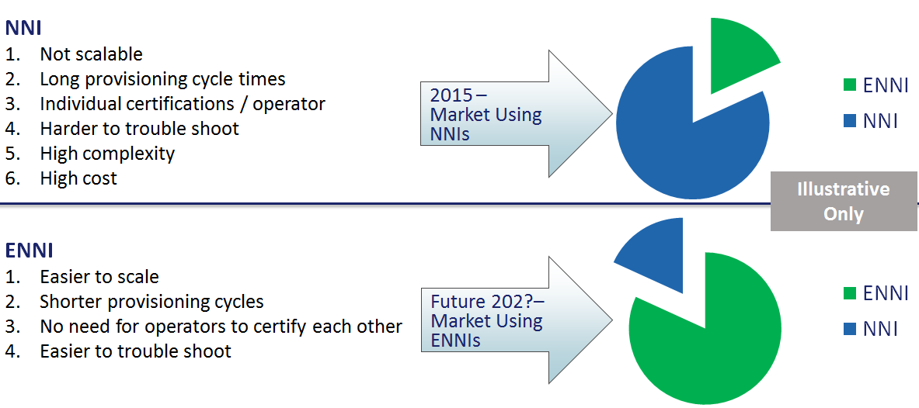
Interconnection Landscape – From NNI to ENNI
Most Ethernet interconnections in the market today are custom built between Operators and are typically referred to as “NNIs” (Network-to-Network Interconnections)
Since NNIs are custom (non-standard), there are many versions, which prevents the market from scaling. The industry needs to build the same MEF standardized interconnection (ENNI) to rapidly scale and reduce complexity.

Slide 17
MEF Specifications and Possible Obstacles
MEF 26.1 documents a Technical Industry Standard Called an External Network-to-Network Interface (ENNI).
MEF 33 defines E-Access Services which use an ENNI defined in MEF 26.1
Obstacles Operators Can Encounter When Implementing MEF 26.1 and MEF 33
Network Hardware Cannot Support the Technical Configurations (Switch and/or Card and/or Operating System)
Dual tagging with TPID of 88a8
Color awareness
CE-VLAN ID preservation
Etc….
IT Systems
Internal Operator IT systems cannot support the quote-to-cash capabilities for E-Access and ENNI configurations
Examples: Support for OVCs / S-Tag preservation at ENNI
MEF 26.1 ENNI Specification
MEF 33 defines
E-Access services using an MEF 26.1 ENNI

Slide 18
Evolution of Tagging & TPIDs – It’s a Journey
Where is your company on this journey?
Goal
Carrier Interconnection
Compatibility
Go to Stage 4 Directly? Go Through Stage 3.5?
EIP Project
1 2 3 3.5 4
Stage 1 - Untagged Traffic
Stage 2 - Single Tagged Traffic with VLANS
Dual Tagged Traffic 0x8100/0x8100
Non-Standard
Dual Tagged Traffic
0x8100/0x8100
0x8100/0x88a8
Dual Tagged Traffic 0x8100/0x88a8 MEF 26.1 (ENNI)
Carrier Interconnection Ability
Custom Interconnections
MEF Standard Interconnections
None
None
Custom Interconnections
1995 2000 2005 2015 2025?
EIP Project
Operator Implementation Timeline – Not to Scale
Notes:
As Ethernet has evolved from LAN to MAN to WAN services, Operators have been required to upgrade their backbones and IT support systems to keep pace. This figure attempts to provide a representation of how TPIDs (Tag Protocol Identifier) and tagging have evolved. While the goal of this project is to help Operators reach full MEF 33 compliance, it's evident the current global marketplace contains thousands of Operators that fit into one of the “stages” below. This project is raising awareness of stage "3.5.“ This stage helps Operators who cannot reach stage 4 (full MEF 33 compliance) in one step due to upgrade costs. While there is no market data that accurately places the thousands of global operators into the stages below, it is the belief of the Operators leading this project that the vast majority fall into stage 3.

Slide 19
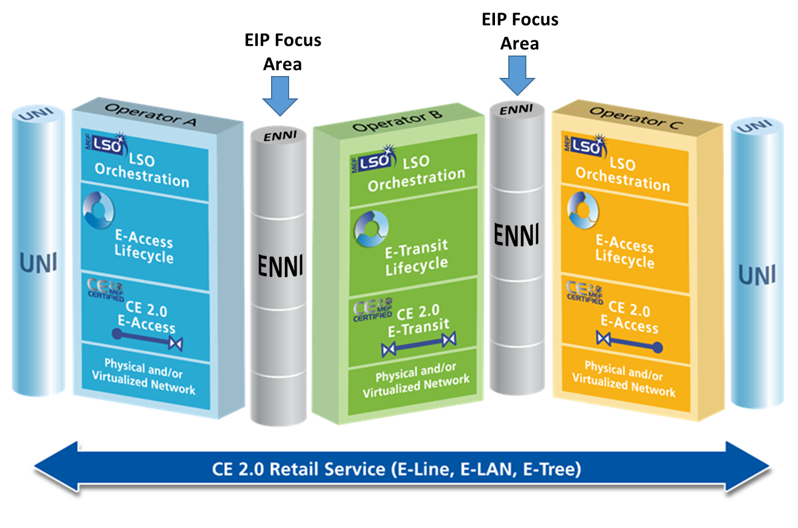
EIP Project
Goal: Help operators make informed decisions on taking the next step on their interconnection journey (e.g., creating a non-standard interconnection (NNI), or preferably an ENNI).
Notes:
Created to understand, and document, why the movement towards standardized interconnections is slow, and to help the global marketplace move forward on their interconnection journey.
Consists of six large US-based Operators, all co-located under one roof, with representative portions of their Ethernet network to conduct interoperability testing.
EIP implementation guidelines use MEF specifications and certifications.

Slide 20
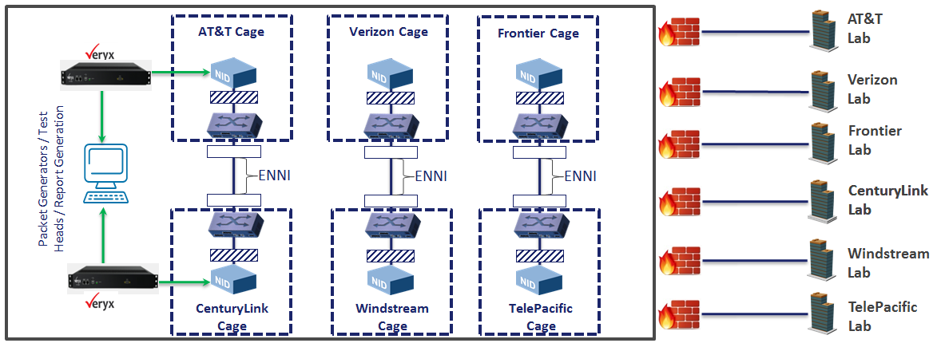
Rapid Prototyping at UNH IOL
?
The University of New Hampshire's Interoperability Lab (IOL) is hosting an industry first test-bed allowing six large Operators to perform ENNI interconnection testing. All six Operators are being tested with each other. Results are being fed directly to their respective Labs via a secure connection. Only the University of New Hampshire knows the results and configurations of each provider.
Notes:
The picture is taken from MEF 50 (Carrier Ethernet Service Lifecycle Process Model)

Slide 21
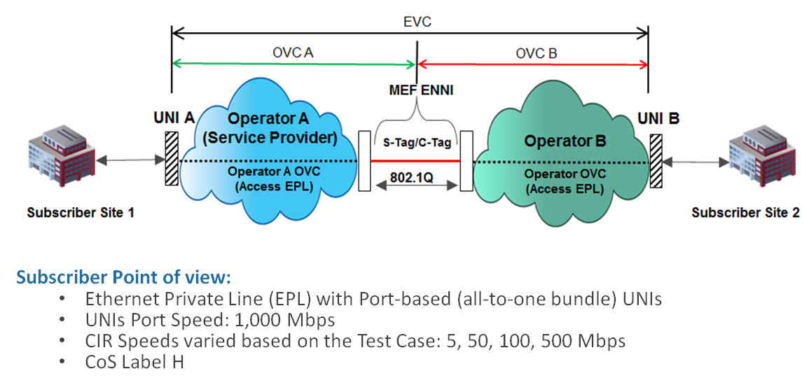
Overview of Connection Tested at UNH
The UNH interoperability testing is simulating the network configuration depicted below. A customer has two sites they wish to connect with an EVC. One of the sites is located in another Operator’s territory. In order for this connection to be made the two Operators must interconnect their networks using either an NNI or an ENNI. Depiction below is of an ENNI.
Notes:
The picture is taken from MEF 50 (Carrier Ethernet Service Lifecycle Process Model)

Slide 22
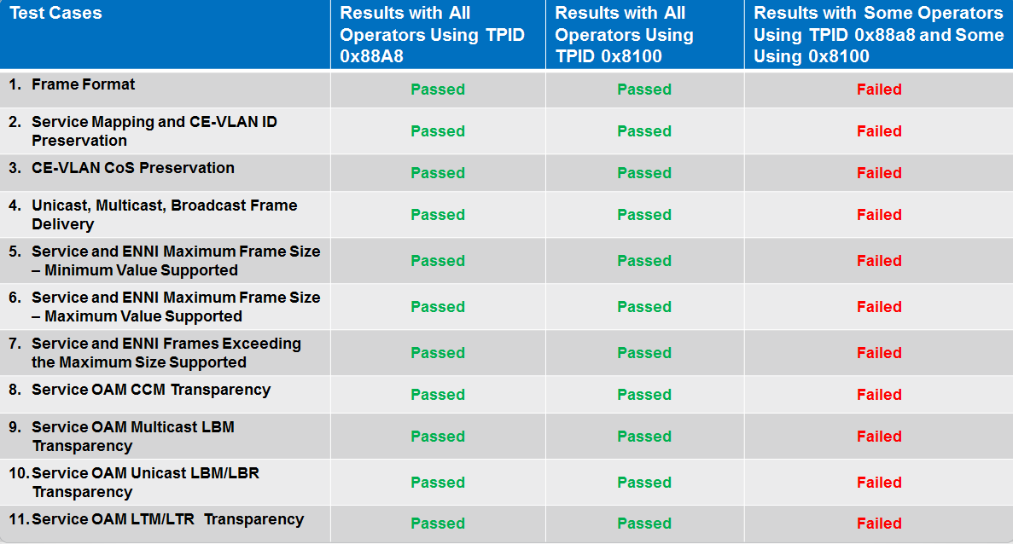
Summary of Test Results
The testing at UNH yielded clear and immediate results. As predicted, the most salient technical challenge to overcome when interconnecting Operator Ethernet networks is ensuring that the TPID of the outer tags, mapped at the ENNI, match at the interconnection point (EIP). There was no way to configure an Ethernet service operating with a TPID outer tag value of 0x8100 to work with an Ethernet network operating with a TPID outer tag value of 0x88a8.
Notes:
The picture is taken from MEF 50 (Carrier Ethernet Service Lifecycle Process Model)

Slide 23
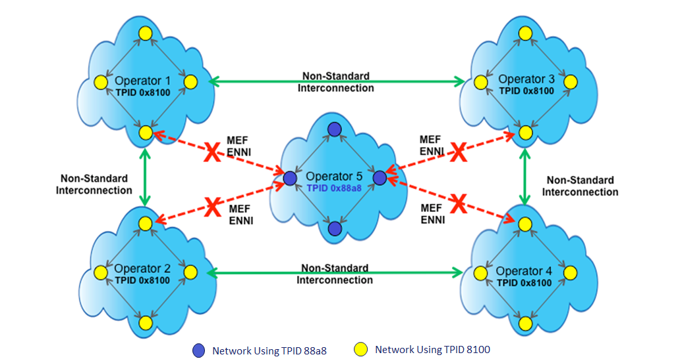
TPID Mismatch - Operator Becomes Completely Isolated
In the figure below, Operator 5 moved to using a standard S-Tag encapsulation at the ENNI (TPID 0x88a8) but the other operators adjacent to its footprint did not. While Operator 5 moved to the new correct "industry standard" (MEF 26.1) they are now isolated from connecting to the Operators around them. Operator 5 is now an "Island" and cannot interconnect with other Operators to create end-to-end services. In this instance, moving to the MEF standard actually diminished their capacity to expand their Ethernet service.

Slide 24
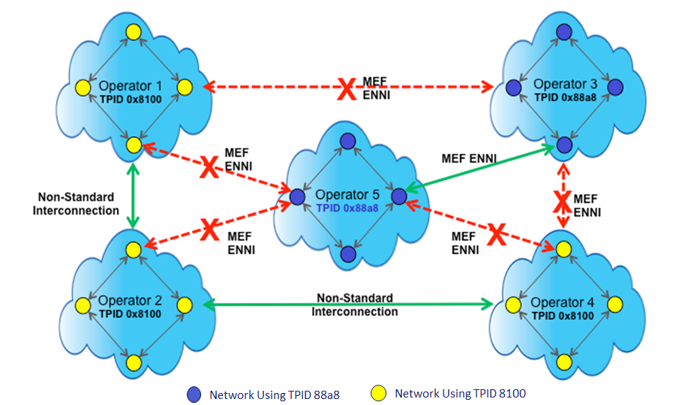
TPID Mismatch - Operator Becomes Partially Isolated
In the figure below both Operator 5 and Operator 3 have moved to the new MEF standard and can now interconnect in an industry standard fashion and enjoy the benefits of MEF 26.1. However, they are still unable to connect with all the other Operators using non-standard interconnections.

Slide 25
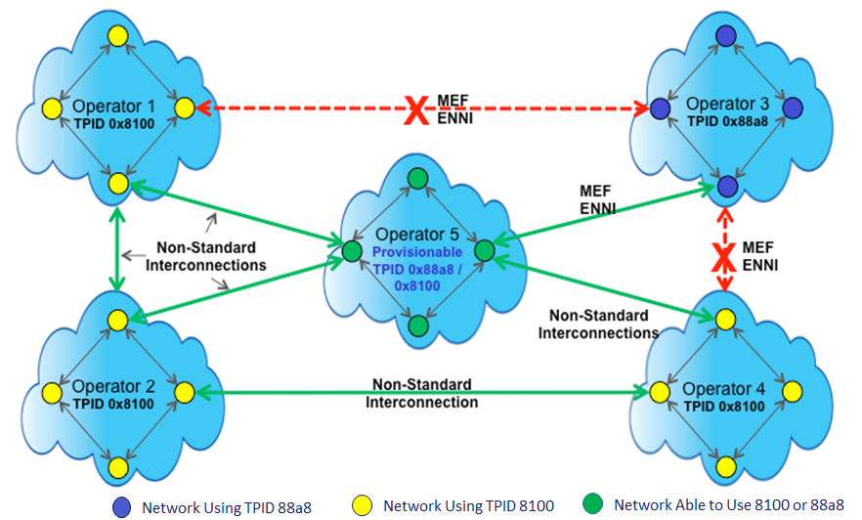
TPID Match - Operator Becomes “Bilingual”
In the figure below Operator 5 is able to create both MEF ENNIs (TPID 0x88a8) and non-standard interconnections (TPID 0x8100) with the Operators adjacent to its footprint. Operator 5 has become "bilingual" and has the greatest capacity to conduct business with Operators who use non-standard interconnections, or the ones who moved to ENNIs. This is the best position for an Operator to be in while the market transitions to Ethernet. Over time, as more and more operators adopt the MEF standard, Operators will stop creating non-standard interconnections. NOTE – An Operator cannot be “bilingual” on the same network port. A port can only be provisioned as an ENNI or an NNI – Not both. However, the same network card can have an ENNI port and an NNI port (depending upon HW).

Slide 26
Overcoming Obstacles
Obstacle Encountered | Remediation | Result
One Operator is Color Blind and the Other Operator is Color Aware | We used CIR only service | All frames are either marked green or red - no need for color awareness
One Operator has an MTU size larger than the Other Operator | We sent traffic with the minimum MTU supported | Picking the minimum MTU ensured that all the Operators passed all their frames in both directions (ingress and egress)
How do you ensure that both Operators use the same value for the outer VLAN at the Interconnect Point? | During the testing at UNH, UNH tester selected the VLAN value for outer tag and communicated it to both Operators; each Operator configured the outer VLAN value | Since both Operators have assigned the same outer VLAN value ("21" for example) the frames flowed across the ENNI (or Non-Standard Interconnection) to the other Operator
Operators did not support the same set of CIR speeds so how do we deliver requested CIR for customer EPL service? | UNH tested common set of customer EPL CIR values supported by both Operators access services | Customer gets the requested CIR, or a CIR that's acceptable for their needs
Notes:
Given the inherent variability in the six Operators at the UNH Lab we immediately encountered obstacles that were preventing us from interconnecting. For example, some Operators are color-aware, and some color-blind, and some Operators offer CIR only, and some offer CIR and EIR offers. Realizing that we'd need to use the "crawl, walk, run" approach we employed the following tactics to hurdle these obstacles:

Slide 27
Operators Need to Know…
As Operators continue their journey towards MEF standardized interconnections (ENNI) there are other non-technical items they will want to consider. Section 11 of the Implementation Agreement is meant to act as a "thought provoker" to help ensure all aspects of Ethernet interconnections are being considered. Topics include:
Where to build an EIP?
How many EIP’s are needed?
How to determine what Ethernet services are available outside an Operator’s footprint?
What should an Operator know about ordering Ethernet services?
Physical equipment considerations

Slide 28
Summary
MEF 5X - EIP

Slide 29
Summary MEF 54
All Operators who offer TDM-based services, whether they know it or not, are on a journey away from TDM towards Ethernet
All Ethernet Operators (Telecom, Cable, CLEC, ILEC) are on a Journey towards MEF standardized interconnections (ENNI)
Testing performed in this project demonstrated Operators with different TPID values cannot interconnect
Operators should become “bilingual” to ensure they can interconnect with other operators on their boarder
Operators should consult the EIP Implementation Agreement to help them begin, or take the next step, on their journey towards MEF standardized interconnections

Slide 30
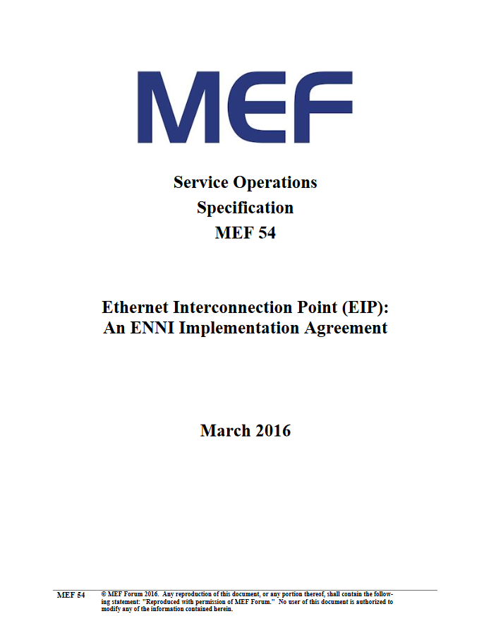
For Full Details …
Visit http://www.mef.net Select “Specifications” and select MEF 54 to access the full Implementation Agreement
Visit the EIP site at: www.mef.net/eipproject

Slide 31
How to Perform ENNI Testing and Certification
Operators who wish to perform their own Interoperability testing – whether using TPID 0x88a8 (ENNI) or 0x8100 (NNI) are encouraged to contact the University of New Hampshire’s Interoperability Lab. Visit: https://www.iol.unh.edu/
Operators who are ready to create, or can already create, an industry standard ENNI using TPID 0x88a8 as per MEF 26.1 should get MEF certified for “MEF 33 E-Access services.” They will then appear on MEF’s “Certification Registry.” Doing so allows other Operators, who boarder their network, to understand where the Operator is on its interconnection journey. It also allows retail customers with large RFPs to view an Operator’s capabilities. Visit: https://www.mef.net/certification/services-certification-overview

Slide 32
Related Documents
MEF 26.1 - External Network Network Interface (ENNI) – Phase 2
MEF 33 - Ethernet Access Services Definition
MEF 51 - OVC Services Definitions Technical Specification

Slide 33
Accelerating Worldwide Adoption of Carrier-class Ethernet Networks and Services
MEF.net

