Slide 1
Introducing the
Specifications of the MEF
MEF 36: Service OAM Performance Monitoring
Definition of Managed Objects
October 2012

Slide 2
MEF Reference Presentations
Intention
  These MEF reference presentations are intended to give general overviews of the MEF work and have been approved by the MEF Marketing Committee
  Further details on the topic are to be found in related specifications, technical overviews, white papers in the MEF public site Information Center:
  http://metroethernetforum.org/InformationCenter
  Notice
  © The Metro Ethernet Forum 2012.
  Any reproduction of this document, or any portion thereof, shall contain the following statement: "Reproduced with permission of the Metro Ethernet Forum." No user of this document is authorized to modify any of the information contained herein.

Slide 3
Outline
Approved MEF Specifications
This presentation
About this Specification
In Scope / Out of Scope
Terminology, Concepts & Relationship to other standards
Section Review
  Major topics
    Minor topics
Examples/Use Cases
Summary

Slide 4
Approved MEF Specifications*
Specification | Description
MEF 2 | Requirements and Framework for Ethernet Service Protection
MEF 3 | Circuit Emulation Service Definitions, Framework and Requirements in Metro Ethernet Networks
MEF 4 | Metro Ethernet Network Architecture Framework Part 1: Generic Framework
MEF 6.1 | Metro Ethernet Services Definitions Phase 2
MEF 7.1 | EMS-NMS Information Model Phase 2
MEF 8 | Implementation Agreement for the Emulation of PDH Circuits over Metro Ethernet Networks
MEF 9 | Abstract Test Suite for Ethernet Services at the UNI
MEF 10.2 | Ethernet Services Attributes Phase 2
MEF 11 | User Network Interface (UNI) Requirements and Framework
MEF 12.1 | Metro Ethernet Network Architecture Framework Part 2: Ethernet Services Layer
MEF 13 | User Network Interface (UNI) Type 1 Implementation Agreement
MEF 14 | Abstract Test Suite for Traffic Management Phase 1
MEF 15 | Requirements for Management of Metro Ethernet Phase 1 Network Elements
MEF 16 | Ethernet Local Management Interface
*Current at time of publication. See MEF web site for official current list, minor updates and superseded work (such as MEF 1 and MEF 5)

Slide 5
Approved MEF Specifications
Specification | Description
MEF 17 | Service OAM Framework and Requirements
MEF 18 | Abstract Test Suite for Circuit Emulation Services
MEF 19 | Abstract Test Suite for UNI Type 1
MEF 20 | User Network Interface (UNI) Type 2 Implementation Agreement
MEF 21 | Abstract Test Suite for UNI Type 2 Part 1: Link OAM
MEF 22.1 | Mobile Backhaul Implementation Agreement Phase 2
MEF 23.1 | Class of Service Implementation Agreement Phase 2
MEF 24 | Abstract Test Suite for UNI Type 2 Part 2: E-LMI
MEF 25 | Abstract Test Suite for UNI Type 2 Part 3: Service OAM
MEF 26.1 | External Network Network Interface (ENNI) – Phase 2
MEF 27 | Abstract Test Suite For UNI Type 2 Part 5: Enhanced UNI Attributes & Part 6: L2CP Handling
MEF 28 | External Network Network Interface (ENNI) Support for UNI Tunnel Access and Virtual UNI
MEF 29 | Ethernet Services Constructs

Slide 6
Approved MEF Specifications
Specification | Description
MEF 30 | Service OAM Fault Management Implementation Agreement
MEF 31 | Service OAM Fault Management Definition of Managed Objects
MEF 32 | Requirements for Service Protection Across External Interfaces
MEF 33 | Ethernet Access Services Definition
MEF 34 | Abstract Test Suite for Ethernet Access Services
MEF 35 | Service OAM Performance Monitoring Implementation Agreement
MEF 36 | Service OAM SNMP MIB for Performance Monitoring
MEF 37 | Abstract Test Suite for ENNI
MEF 38 | Service OAM Fault Management YANG Modules Technical Specification
MEF 39 | Service OAM Performance Monitoring YANG Modules Technical Specifications
*Current at time of publication. See MEF web site for official current list, minor updates (such as MEF 31.0.1 amendment to this document)
and superseded work (such as MEF 1 and MEF 5)

Slide 7
MEF Specification Overview
MEF 36 - Service OAM (SOAM) Performance Monitoring Definition of Managed Objects
Purpose
Specifies the Performance Monitoring (PM) Management Information Base (MIB) necessary to manage Service Operations, Administration, and Maintenance (OAM) implementations that satisfy the Service OAM requirements and framework specified by MEF 17, MEF 35, and the management objects specified in MEF 7.1, and the PM functions defined in ITU-T Y.1731 and IEEE 802.1ag.
Audience
Applicable to entire Metro Ethernet Market including Service Providers, Access Providers, equipment vendors, and EMS/NMS/OSS vendors to provision and monitor equipment that is MEF compatible.
Standardized Services

Slide 8
Overview of MEF 36

Slide 9
About MEF 36
Purpose:
  This presentation is an introduction to MEF 36 - Service OAM Performance Monitoring Definition of Managed Objects
Audience
  Equipment Manufacturers building devices that will carry Carrier Ethernet Services
  Service Providers delivering Carrier Ethernet Services
  EMS/NMS/OSS tool vendors developing back office applications for managing Carrier Ethernet Services
Other Documents
  Presentations of other MEF specifications and an overview of all specifications is available on the MEF web site
  Other materials such as white papers and case studies are also available

Slide 10
MEF 36 - In Scope/Out of Scope
MEF 36 requirements are primarily driven by MEF 35 and leverage the OAM functions & managed objects defined by MEF 31, IEEE 802.1ag (CFM) and 802.1ap (MIB) and ITU-T Y.1731
Managed objects to perform Loss Measurement, Delay Measurement, and support Threshold Crossing Alerts

Slide 11
Terminology and Concepts
MEF 36 adheres to MEF 30 and MEF 35 terminology:
  Refer to MEF 30 for ME, MEG, MEP, MIP, CoS
  Refer to MEF 35 for Single-Ended, Dual-Ended, one-way, two-way, PM Function, PM Session, PM Solution, PM Tool, Controller MEP, Responder MEP, Measurement Bin, and Measurement Interval
MEF 36 relies on MEF 31 for protocol specific terminology
  Simple Network Management Protocol (SNMP)
  SNMP Manager
  Management Information Model (MIB)
  Element Management System (EMS)
  Network Management System (NMS)
  Operations Support System (OSS)

Slide 12
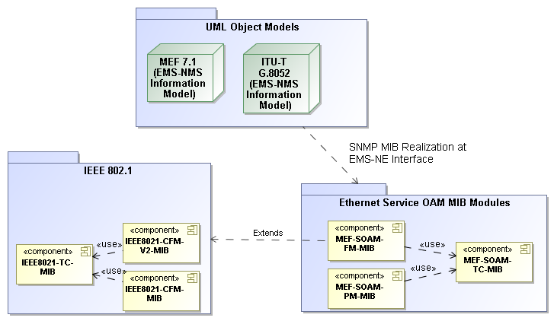
Relationship with other Specifications
MEF 31
MEF 31
MEF 36

Slide 13
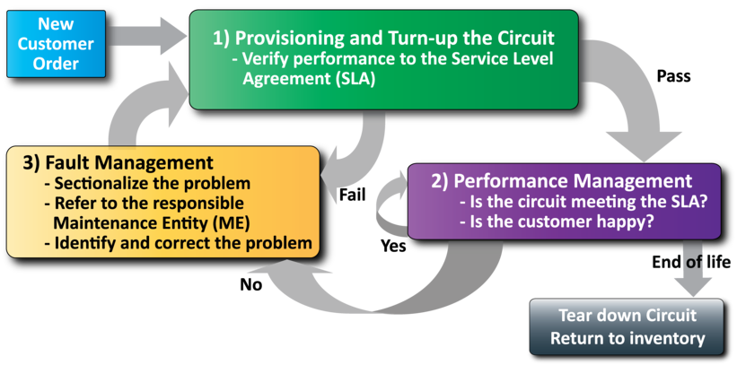
MEF Service Lifecycle and SOAM
Network Management
Performance Management is use to monitor the service

Slide 14
MEF Specification Section Review

Slide 15
Introducing MEF 36
The presentation is broken into sections:
  Overview
  Network Management Concepts/Topologies
  Initial Configuration
  OAM Functions
    Loss Measurement
    Delay Measurement
    Threshold Configuration
  Summary
  Where to find additional information

Slide 16


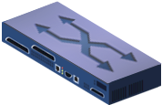
What is a MIB?
A Management Information Base (MIB), or data model, is a collection of managed objects that can be used to provision or query a network device from a management system, such as a centrally located NMS (Network Management System).
A MIB along with the management protocol, such as SNMPv2c, defines a standard network management interface for administration and maintenance of network elements.
Configuration and Monitoring Data
MIB
Network Element
Network Management System

Slide 17
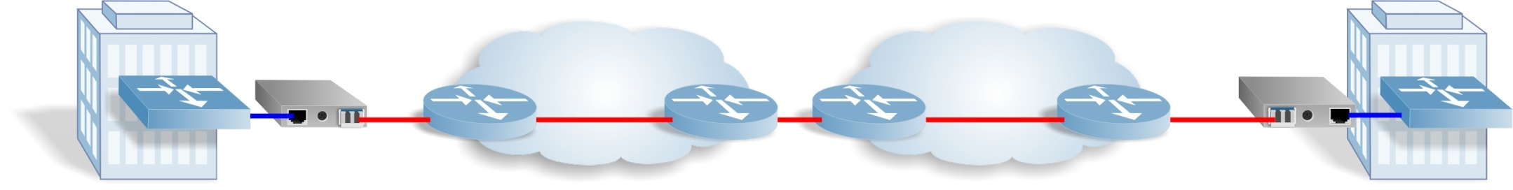
Management Framework
Trouble Ticket System
Notify
O
Network Management System
SNMP
SNMP
SP Network Ops
MIB
MIB
UNI
MIB
ENNI
MIB
UNI
MIB
MIB
CPE
NID
Operator 1 Network
Operator 2 Network
NID
CPE
Ethernet Virtual Connection
Service OAM
ITU-T Y.1731 End-to-End Performance Monitoring
IEEE 802.1ag End-to-End Connectivity Fault Management

Slide 18
SOAM PM MIB Components
MEF 36 uses some of the elements from the Connectivity Fault Management (CFM) MIBs specified in IEEE 802.1ag and IEEE 802.1ap
The IEEE CFM MIB set includes
  IEEE8021-CFM-MIB
  IEEE8021-CFM-V2-MIB
  IEEE8021-TC-MIB
MEF 36 augments the CFM MIB set as follows
  MEF-SOAM-TC-MIB (From MEF 31)
  MEF-SOAM-PM-MIB (MEF 36)

Slide 19
SOAM TC MIB Overview
MEF 31.0.1
MEF-SOAM-TC-MIB defines a collection of Textual Conventions (common data types)
  AvailabilityType
  ConnectivityStatusType
  DataPatternType
  DelayMeasurementBinType
  IntervalTypeAisLck
  MegIdType
  MeasurementPeriodType
  OperationTimeType
  SessionType
  StatusType
  TestPatternType

Slide 20
SOAM PM MIB Overview
MEF-SOAM-PM-MIB defines the managed objects necessary to support SOAM PM functionality
Loss Measurement
Delay Measurement
Configuration
Statistics
Availability Statistics
Configuration
Bins
Statistics
Threshold Crossing
Configuration
Delay Measurement Thresholds
Notifications

Slide 21
Terminology
Single-Ended
  A type of process where a MEP sends a measurement request and the peer MEP replies with the requested information so the originating MEP can calculate the measurement.
Dual-Ended
  A type of process where a MEP sends measurement information to a peer MEP that will perform the calculations.
Proactive
  OAM actions that are carried on continuously to permit timely reporting of fault and/or performance status
On-Demand
  OAM actions that are initiated via manual intervention for a limited time to carry out diagnostics.

Slide 22
Overview of the PM Process
The PM Session is defined by the specific PM function (PM tool) being run along with the Start Time, Message Period (the blue up arrows below), Measurement Interval and Repetition Time (not shown)

Slide 23
Overview of PM Process
Start Time is the time that the PM Session begins
  Applicable to On-Demand sessions, no Proactive sessions
Stop Time is the time that the measurement ends
  Not applicable to Proactive
Message Period is the SOAM PDU transmission frequency
Measurement Interval is the time period over which measurements are gathered
Repetition Time is the time between the start times of the Measurement Intervals

Slide 24
Initial SOAM Configuration via 802.1ag/ap MIBs
Before SOAM operations are instantiated by a NMS application, the following must be provisioned at each Network Element (NE) performing OAM Functions:
  Maintenance Domain (MD)
    Create entry in dot1agCfmMdTable
  Maintenance Association (MA)/Maintenance Entity Group (MEG)
    Create entry in dot1agCfmMaNetTable, ieee8021CfmMaCompTable, mefSoamNetCfgTable and mefSoamMegCfgTable
  MEG End Point (MEP)
    Create entry in dot1agCfmMepTable

Slide 25
MEP Setup
PM MIB Per MEP Objects
  The mefSoamPmMepTable augments the dot1agCfmMepEntry
  The objects in this table are used to identify the index to use in the LM or DM table
  The objects are also used to differentiate between Single-Ended and Dual-Ended Solutions

Slide 26
Loss Measurement Configuration Entries
The mefSoamLmCfgTable is used to provide the configuration information for the Loss Measurement PM Session
  This table uses the same indexes that the MEP configuration uses
  mefSoamLmCfgIndex contains the specific LM session number on a MEP
There are eight categories of LM configuration options
  LM Session type, version, enable
  LM Session PDU transmission frequency and Measurement Interval size
  LM Session PDU composition and length
  LM Session peer partner selection
  LM Session start, stop, and repetition selection
  LM Session availability configuration
  LM Session status
  LM Session history table clear

Slide 27
LM Statistics Tables
There are five tables that are used to report measurements
  mefSoamLmMeasuredStatsTable
    Contains the information from that last received SOAM PDU
  mefSoamLmCurrentAvailStatsTable
    Contains the availability statistics for the current measurement interval
  mefSoamLmHistoryAvailStatsTable
    Contains the historical interval data that is copied from the current availability statistics table
  mefSoamLmCurrentStatsTable
    Contains the statistic counters for the current measurement interval
  mefSoamLmHistoryStatsTable
    Contains the historical interval data that is copied from the current statistics table

Slide 28
Loss Measurement Statistics
Start Time
Elapsed Time
Suspect Flag
Forward/Backward Availability High Loss/High Consecutive Loss
Forward/Backward Availability/Unavailability indicators
Forward/Backward Availability Min/Max/Avg FLR
Forward/Backward Transmitted/Received Frames
Forward/Backward Min/Max/Avg FLR (Frame Loss Ratio)
SOAM PDUs sent/received

Slide 29
Delay Measurement Configuration Entries
The mefSoamDmCfgTable is used to provide the configuration information for the Delay Measurement PM Session
  This table uses the same indexes that the MEP configuration uses
  mefSoamDmCfgIndex contains the specific DM session number on a MEP
There are eight categories of DM configuration options
  DM Session type, version, enable
  DM Session PDU transmission frequency and Measurement Interval size
  DM Session PDU composition and length
  DM Session peer partner selection
  DM Session start, stop, and repetition selection
  DM Session status
  DM Session measurement bin configuration
  DM Session history table clear

Slide 30
Delay Measurement Bins
A Measurement Bin is a counter that stores the number of delay measurements falling within a specified range, during a Measurement Interval.
The configuration information for Measurement Bins is found in
  mefSoamDmCfgMeasBinTable

Slide 31
DM Statistics Tables
There are five tables that are used to report measurements
  mefSoamDmMeasuredStatsTable
    Contains the information from that last received SOAM PDU
  mefSoamDmCurrentStatsTable
    Contains the statistic counters for the current measurement interval
  mefSoamDmHistoryStatsTable
    Contains the history data that is copied from the current statistics table
  mefSoamDmCurrentStatsBinsTable
    Contains the statistic bin counters for the current measurement interval
  mefSoamDmHistoryStatsBinsTable
    Contains the history data that is copied from the current statistics bin table

Slide 32
Delay Measurement Statistics
Start Time
Elapsed Time
Suspect Flag
Frame Delay
  TwoWay/Forward/Backward Min/Max/Avg
IFDV
  TwoWay/Forward/Backward Min/Max/Avg
Frame Delay Range
  TwoWay/Forward/Backward Max/Avg
SOAM PDUs sent/received

Slide 33
Threshold
Used to notify the EMS using an SNMP notification when a specific performance parameter does not meet a specified boundary value
Two Threshold configuration tables, one for DM and one for LM
  mefSoamDmThresholdCfgTable
  mefSoamLmThresholdCfgTable
Threshold Above
  Used within a Measurement Interval
Threshold Set/Clear
  Uses information from the current and previous Measurement Interval

Slide 34
Thresholds
FLR
  Measured/Max/Avg, Forward/Backward
Consecutive High Loss
  Forward/Backward
High Loss
  Forward/Backward
Unavailable Count
  Forward/Backward
Availability Ratio
  Forward/Backward
Frame Delay
  Two-Way/Forward/Backward, Measured/Max/Avg
IFDV
  Two-Way/Forward/Backward, Measured/Max/Avg
Frame Delay Range
  Two-Way/Forward/Backward, Max/Avg

Slide 35
Notifications
There are a number of Notifications (TRAPS) that are defined to notify the EMS of various situations
  mefSoamAvailabilityChangeAlarm
    Sent when the state of mefSoamLmMeasuredStatsAvailForwardStatus or mefSoamLmMeasuredStatsAvailBackwardStatus changes
  mefSoamLmSessionStartStopAlarm
    sent when the state of mefSoamLmCfgSessionStatus changes
  mefSoamDmSessionStartStopAlarm
    sent when the state of mefSoamDmCfgSessionStatus changes
  mefSoamPmThresholdCrossingAlarm
    sent if the a threshold crossing condition is met for a particular type

Slide 36
Summary MEF 36
MEF 36 defines the managed objects for using an SNMP management interface for the MEF 35 Service OAM Performance Monitoring protocol
MEF 36 enables MEF equipment providers to provide a standardized management interface for the SOAM Performance Monitoring functions:
  Loss Measurement
  Delay Measurement
  Threshold Crossing Alerts

Slide 37
Final Word
Service OAM
  In the context of MEF 31, data models (MIBs) are defined that support service-level OAM in MENs
Next Actions (For Further Information)
  Read the full MEF 35 Performance Monitoring Implementation Agreement specification
  Read the full MEF 36 specification
  Read the full MEF 30 Fault Management Implementation Agreement specification
  Read the full MEF 31 and MEF 31.0.1 specifications (note, review of MEF 17, MEF 7.1 and MEF 15 may also be helpful)
  Understand the principal service OAM components and capabilities
Notes:
This section goes into further detail in detailing the defined Service Attributes and parameters requirement and recommendations as specified for each of the defined services: EPL, EVPL and E-LAN.
(Refer to the Specs and the accompanying Ethernet Service Description document for more details)

Slide 38



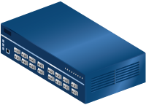













For Full Details …
Please visit www.metroethernetforum.org
Select Information Center on Left Navigation to access the full specification and extracted MIB files
E-Line Service type
Carrier Ethernet 2.0
EVPL Services
UNI
UNI
CE
E-LAN Service type
Carrier Ethernet Network
CE
Carrier Ethernet 2.0
EVP-LAN Service
Internet
ISP POP
UNI
UNI
CE
CE
EVC: Ethernet Virtual Connection
UNI: User Network Interface. the physical demarcation point between the responsibility of the Service Provider and
the responsibility of the End-User/Subscriber
CE Customer Equipment
CE
UNI
UNI
Carrier Ethernet Network
CE

Slide 39

Accelerating Worldwide Adoption of
Carrier-class Ethernet Networks and Services
www.MetroEthernetForum.org

