Slide 1
Introducing the Specifications of the MEF
MEF 40: UNI and EVC Definition of Managed Objects
April 2013

Slide 2
MEF Reference Presentations
Intention
These MEF reference presentations are intended to give general overviews of the MEF work and have been approved by the MEF Marketing Committee
Further details on the topic are to be found in related specifications, technical overviews, white papers in the MEF public site Information Center: http://metroethernetforum.org/InformationCenter
Notice
© The Metro Ethernet Forum 2013. Any reproduction of this document, or any portion thereof, shall contain the following statement: "Reproduced with permission of the Metro Ethernet Forum." No user of this document is authorized to modify any of the information contained herein.

Slide 3
Outline
Approved MEF Specifications
About this Specification
In Scope / Out of Scope
Terminology, Concepts & Relationship to other standards
MEF Service Lifecycle & Management Framework
UNI-EVC MIB Review
Section Descriptions
Summary
Related Specifications

Slide 4
Approved MEF Specifications*
Specification | Description
MEF 2 | Requirements and Framework for Ethernet Service Protection
MEF 3 | Circuit Emulation Service Definitions, Framework and Requirements in Metro Ethernet Networks
MEF 4 | Metro Ethernet Network Architecture Framework Part 1: Generic Framework
MEF 6.1 | Metro Ethernet Services Definitions Phase 2
MEF 7.2 | Carrier Ethernet Management Information Model
MEF 8 | Implementation Agreement for the Emulation of PDH Circuits over Metro Ethernet Networks
MEF 9 | Abstract Test Suite for Ethernet Services at the UNI
MEF 10.2 | Ethernet Services Attributes Phase 2
MEF 11 | User Network Interface (UNI) Requirements and Framework
MEF 12.1 | Metro Ethernet Network Architecture Framework Part 2: Ethernet Services Layer
MEF 13 | User Network Interface (UNI) Type 1 Implementation Agreement
MEF 14 | Abstract Test Suite for Traffic Management Phase 1
MEF 15 | Requirements for Management of Metro Ethernet Phase 1 Network Elements
MEF 16 | Ethernet Local Management Interface
*Current at time of publication. See MEF web site for official current list, minor updates and superseded work (such as MEF 1 and MEF 5)

Slide 5
Approved MEF Specifications
Specification | Description
MEF 17 | Service OAM Framework and Requirements
MEF 18 | Abstract Test Suite for Circuit Emulation Services
MEF 19 | Abstract Test Suite for UNI Type 1
MEF 20 | User Network Interface (UNI) Type 2 Implementation Agreement
MEF 21 | Abstract Test Suite for UNI Type 2 Part 1: Link OAM
MEF 22.1 | Mobile Backhaul Implementation Agreement Phase 2
MEF 23.1 | Class of Service Implementation Agreement Phase 2
MEF 24 | Abstract Test Suite for UNI Type 2 Part 2: E-LMI
MEF 25 | Abstract Test Suite for UNI Type 2 Part 3: Service OAM
MEF 26.1 | External Network Network Interface (ENNI) – Phase 2
MEF 27 | Abstract Test Suite For UNI Type 2 Part 5: Enhanced UNI Attributes & Part 6: L2CP Handling
MEF 28 | External Network Network Interface (ENNI) Support for UNI Tunnel Access and Virtual UNI
MEF 29 | Ethernet Services Constructs

Slide 6
Approved MEF Specifications
Specification | Description
MEF 30.1 | Service OAM Fault Management Implementation Agreement: Phase 2
MEF 31 | Service OAM Fault Management Definition of Managed Objects
MEF 32 | Requirements for Service Protection Across External Interfaces
MEF 33 | Ethernet Access Services Definition
MEF 34 | Abstract Test Suite for Ethernet Access Services
MEF 35 | Service OAM Performance Monitoring Implementation Agreement
MEF 36 | Service OAM SNMP MIB for Performance Monitoring
MEF 37 | Abstract Test Suite for ENNI
MEF 38 | Service OAM Fault Management YANG Modules Technical Specification
MEF 39 | Service OAM Performance Monitoring YANG Modules Technical Specifications
MEF 40 | UNI and EVC Definition of Managed Objects
*Current at time of publication. See MEF web site for official current list, minor updates (such as MEF 31.0.1 amendment to this document) and superseded work (such as MEF 1 and MEF 5)

Slide 7
MEF Specification Overview
MEF 40 – UNI and EVC Definition of Managed Objects
Purpose
Specifies the SNMP UNI and EVC Management Information Base (MIB) that supports the MEF UNI and EVC defined in MEF 4, MEF 6.1, MEF 6.1.1, MEF 10.2, the management requirements in MEF 15, and the managed objects specified in MEF 7.2 and ITU-T Q.840.1. The MIB includes objects necessary to configure and monitor UNIs and EVCs via SNMP.
Audience
Applicable to entire Metro Ethernet Market including Service Providers, Access Providers, equipment vendors, and EMS/NMS/OSS vendors to provision and monitor equipment that is MEF compatible.
Standardized Services

Slide 8
Overview of MEF 40

Slide 9
About MEF 40
Purpose:
This presentation is an introduction to MEF 40 – UNI and EVC Definition of Managed Objects
Audience
Equipment Manufacturers building devices that will carry Carrier Ethernet Services
Service Providers delivering Carrier Ethernet Services
EMS/NMS/OSS tool vendors developing back office applications for managing, provisioning and monitoring Carrier Ethernet Services
Other Documents
Presentations of other MEF specifications and an overview of all specifications is available on the MEF web site
Other materials such as white papers and case studies are also available

Slide 10
MEF 40 - In Scope/Out of Scope
MEF 40 requirements are primarily driven by
Network Management requirements for ME NEs (MEF 15)
Carrier Ethernet Common Information Model (MEF 7.2 and ITU-T Q.840.1)
MEF 40 defines functionality for managing UNI and EVC
MEF 40 does not define functionality for managing ENNI or OVC

Slide 11
Terminology and Concepts
MEF 40 adheres to these MEF Specifications for terminology:
Refer to MEF 6.1 for Ethernet service definitions
Refer to MEF 6.1.1 for L2CP definition
Refer to MEF 10.2 for EVC & UNI Service Attribute and Parameter definitions
MEF 40 relies on MEF 31 for protocol specific terminology
Simple Network Management Protocol (SNMP)
SNMP Manager
Management Information Model (MIB)
Element Management System (EMS)
Network Management System (NMS)
Operations Support System (OSS)

Slide 12
Relationship with other Specifications
MEF 40

Slide 13
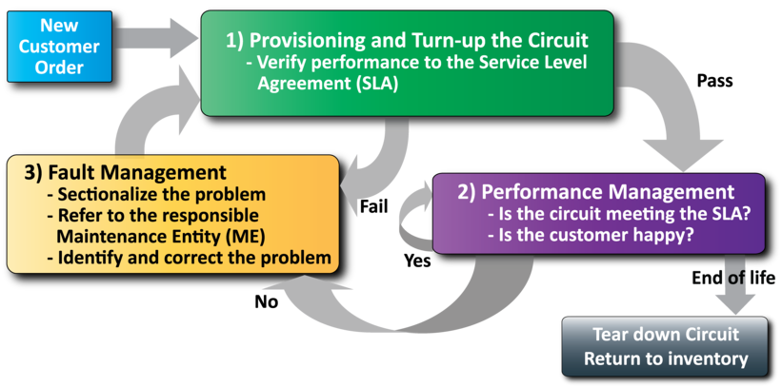
MEF Service Lifecycle and SOAM
Network Management
Provisioning and Turn-up is used to bring the service “in-service”

Slide 14
MEF Specification Section Review

Slide 15
Introducing MEF 40
The presentation is broken into sections:
Overview
Network Management Concepts/Framework
Interfaces MIB Indexing
UNI-EVC MIB Structure
Descriptions
Summary
Where to find additional information

Slide 16
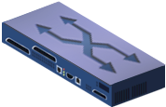
What is a MIB?
A Management Information Base (MIB), or data model, is a collection of managed objects that can be used to provision or query a network device from a management system, such as a centrally located NMS (Network Management System).
A MIB along with the management protocol, such as SNMPv2c, defines a standard network management interface for administration and maintenance of network elements.
Configuration and Monitoring Data
MIB
Network Element
Network Management System

Slide 17
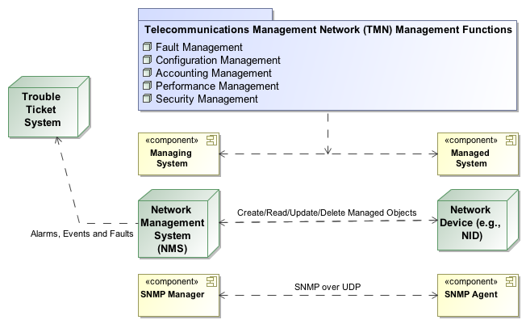
Management Framework
Trouble Ticket System
Notify
O
Network Management System
SNMP
SNMP
SP Network Ops
MIB
MIB
UNI
MIB
ENNI
MIB
UNI
MIB
MIB
CPE
NID
Operator 1 Network
Operator 2 Network
NID
CPE
Ethernet Virtual Connection

Slide 18
Interfaces MIB Indexing
MEF 40 uses RFC 2863 ifIndex with several tables
MEF 40 supports several objects from the ifTable.
The ifType used is ethernetCsmacd(6)

Slide 19
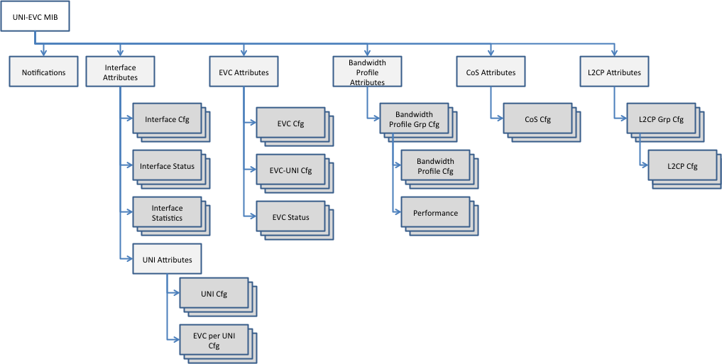
UNI-EVC MIB Structure
MEF-UNI-EVC-MIB defines the following groups of managed objects necessary to support configuration, status and statistics

Slide 20
Service Interface Attributes
This group of managed objects consists of
mefServiceInterfaceCfgTable
Contains basic objects (type, identifier, frame format, etc.) to provision the MEF interface on the Metro Ethernet-Network Element (ME-NE)
mefServiceInterfaceStatusTable
Contains basic status reporting objects (type, maximum number of virtual channels, maximum number of end points per virtual channel) for the MEF interface of the ME-NE
mefServiceInterfaceStatisticTable
Contains various egress/ingress frame and octet counter statistics for the MEF interface of the ME-NE

Slide 21
Service UNI Attributes
This group of managed objects consists of
mefServiceUniCfgTable
Contains objects (identifier, bundling, all-to-one bundling, multiplexing, CE VLAN ID, CE VLAN Priority) to provision the UNI attributes on the Metro Ethernet-Network Element (ME-NE)
mefServiceEvcPerUniCfgTable
Contains objects (identifier, service type, CE VLAN Map, Egress/Ingress BWP Indexes) to provision the EVC per UNI attributes on the Metro Ethernet-Network Element (ME-NE)

Slide 22
Service EVC Attributes
This group of managed objects consists of
mefServiceEvcCfgTable
Contains objects (identifier, MTU size, service type, CE VLAN id preservation, CE VLAN CoS preservation, etc.) to provision the EVC attributes on the Metro Ethernet-Network Element (ME-NE)
mefServiceEvcUniCfgTable
Contains an object to allow configuring the UNI type (root, leaf) on an EVC
mefServiceEvcStatusTable
Contains basic status reporting objects (maximum MTU size, maximum number of UNIs, operational state) for the EVC of the ME-NE

Slide 23
Service Bandwidth Profile Attributes
This group of managed objects consists of
mefServiceBwpCfgTable
Contains objects (CIR, EIR, CBS, EBS, CF, CM, etc.) to provision a Bandwidth Profile (BWP) as well as associate the BWP with a CoS ID.
mefServiceBwpGrpCfgTable
Contains objects to support BWP group settings

Slide 24
Class of Service Attributes
This group of managed objects consists of
mefServiceCosCfgTable
Contains objects (identifier, type, identifier list, L2CP destination MAC Address, L2CP Ethernet Protocol, L2CP Subtype) to provision a Class of Service Identifier profile

Slide 25
Service L2CP Attributes
This group of managed objects consists of
mefServiceL2cpCfgTable
Contains objects (type, matching scope, destination MAC address, L2CP Ethernet Protocol, L2CP Subtype) to provision an L2CP profile
mefServiceL2cpGrpCfgTable
Contains objects to support L2CP group settings

Slide 26
Service Performance Attributes
This group of managed objects consists of
mefServicePerformanceTable
Contains basic objects to support Traffic Performance Data Set profile settings on a Bandwidth Profile (e.g., green, yellow, red frame/octet counters)

Slide 27
Service Notification Attributes
This group of managed objects consists of
Contains an object to enable/disable SNMP notifications
Contains objects carried within the payload of SNMP notifications (date, time, configuration change type)
Contains the SNMP Notification which can be triggered when the configuration of an object is added, deleted or modified

Slide 28
Summary

Slide 29
Summary MEF 40
MEF 40 defines the managed objects for using an SNMP management interface for configuring the UNI and EVC reference points of a CEN
In addition, managed objects are defined for retrieving configuration status and statistics for the UNI and EVC reference points
MEF 40 enables MEF equipment providers to provide a standardized management interface for the UNI and EVC for
Configuration Management
Interface Network Monitoring

Slide 30
Related Specifications
MEF 6.1 – Ethernet Services Definitions (Phase 2)
MEF 6.1.1 – Layer 2 Control Protocol Handling Amendment
MEF 7.2 – Carrier Ethernet Management Information Model
MEF 10.2 – Ethernet Services Attributes (Phase 2)
MEF 15 – Requirements for Management of Metro Ethernet Phase 1 Network Elements
IETF RFC 2863 – The Interfaces Group MIB (IF-MIB)

Slide 31
Final Word
Configuration Management
In the context of MEF 40, data models (MIBs) are defined that support UNI and EVC configuration management in CENs
Next Actions (For Further Information)
Read the full MEF 40 technical specification and familiarize yourself with the set of defined managed objects
Read the full MEF 6.1 and MEF 10.2 specifications (note, review of MEF 7.2 and MEF 15 may also be helpful)
Understand the principal Interfaces Group (IF-MIB) managed objects, indexing and capabilities
Notes:
This section goes into further detail in detailing the defined Service Attributes and parameters requirement and recommendations as specified for each of the defined services: EPL, EVPL and E-LAN.
(Refer to the Specs and the accompanying Ethernet Service Description document for more details)

Slide 32
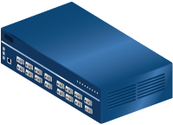
For Full Details …
Please visit www.metroethernetforum.org Select Information Center on Left Navigation to access the full specification and extracted MIB files
E-Line Service type
Carrier Ethernet 2.0
EVPL Services
UNI
UNI
CE
E-LAN Service type
Carrier Ethernet Network
CE
Carrier Ethernet 2.0
EVP-LAN Service
Internet
ISP POP
UNI
UNI
CE
CE
EVC: Ethernet Virtual Connection
UNI: User Network Interface. the physical demarcation point between the responsibility of the Service Provider and the responsibility of the End-User/Subscriber
CE Customer Equipment
CE
UNI
UNI
Carrier Ethernet Network
CE

Slide 33
Accelerating Worldwide Adoption of Carrier-class Ethernet Networks and Services
www.MetroEthernetForum.org

