Slide 1
Introducing the Specifications of the MEF
An Overview of MEF 6.1, 6.1.1, 10.3
Carrier Ethernet Definitions and Attributes
November 2013

Slide 2
MEF Reference Presentations
Intention
These MEF reference presentations are intended to give general overviews of the MEF work and have been approved by the MEF Marketing Committee
Further details on the topic are to be found in related specifications, technical overviews, white papers in the MEF public site
Notice
© The Metro Ethernet Forum 2013. Any reproduction of this document, or any portion thereof, shall contain the following statement: "Reproduced with permission of the Metro Ethernet Forum." No user of this document is authorized to modify any of the information contained herein.

Slide 3
Outline
Approved MEF Specifications
About this Specification
In Scope / Out of Scope
Terminology, Concepts & Relationship to other standards
MEF Service Lifecycle & Management Framework
UNI-EVC MIB Review
Section Descriptions
Summary
Related Specifications

Slide 4
Topics
Approved MEF Specifications
Quick guide to difference between 10.3 and previous version
This Presentation
About these Specification
Terminology, Concepts
Section Review
Major topics
Minor topics
Examples/Use Cases
Summary

Slide 5
Approved MEF Specifications*
Specification | Description
MEF 2 | Requirements and Framework for Ethernet Service Protection
MEF 3 | Circuit Emulation Service Definitions, Framework and Requirements in Metro Ethernet Networks
MEF 4 | Metro Ethernet Network Architecture Framework Part 1: Generic Framework
MEF 6.1 | Metro Ethernet Services Definitions Phase 2
MEF 7.2 | Carrier Ethernet Management Information Model
MEF 8 | Implementation Agreement for the Emulation of PDH Circuits over Metro Ethernet Networks
MEF 9 | Abstract Test Suite for Ethernet Services at the UNI
MEF 10.3 | Ethernet Services Attributes Phase 3
MEF 11 | User Network Interface (UNI) Requirements and Framework
MEF 12.1 | Metro Ethernet Network Architecture Framework Part 2: Ethernet Services Layer
MEF 13 | User Network Interface (UNI) Type 1 Implementation Agreement
MEF 14 | Abstract Test Suite for Traffic Management Phase 1
MEF 15 | Requirements for Management of Metro Ethernet Phase 1 Network Elements
MEF 16 | Ethernet Local Management Interface
*Current at time of publication. See MEF web site for official current list, minor updates and superseded work

Slide 6
Approved MEF Specifications
Specification | Description
MEF 17 | Service OAM Framework and Requirements
MEF 18 | Abstract Test Suite for Circuit Emulation Services
MEF 19 | Abstract Test Suite for UNI Type 1
MEF 20 | User Network Interface (UNI) Type 2 Implementation Agreement
MEF 21 | Abstract Test Suite for UNI Type 2 Part 1: Link OAM
MEF 22.1 | Mobile Backhaul Implementation Agreement Phase 2
MEF 23.1 | Class of Service Implementation Agreement Phase 2
MEF 24 | Abstract Test Suite for UNI Type 2 Part 2: E-LMI
MEF 25 | Abstract Test Suite for UNI Type 2 Part 3: Service OAM
MEF 26.1 | External Network Network Interface (ENNI) – Phase 2
MEF 27 | Abstract Test Suite For UNI Type 2 Part 5: Enhanced UNI Attributes & Part 6: L2CP Handling
MEF 28 | External Network Network Interface (ENNI) Support for UNI Tunnel Access and Virtual UNI
MEF 29 | Ethernet Services Constructs

Slide 7
Approved MEF Specifications
Specification | Description
MEF 30.1 | Service OAM Fault Management Implementation Agreement: Phase 2
MEF 31 | Service OAM Fault Management Definition of Managed Objects
MEF 32 | Requirements for Service Protection Across External Interfaces
MEF 33 | Ethernet Access Services Definition
MEF 34 | Abstract Test Suite for Ethernet Access Services
MEF 35 | Service OAM Performance Monitoring Implementation Agreement
MEF 36 | Service OAM SNMP MIB for Performance Monitoring
MEF 37 | Abstract Test Suite for ENNI
MEF 38 | Service OAM Fault Management YANG Modules Technical Specification
MEF 39 | Service OAM Performance Monitoring YANG Modules Technical Specifications
MEF 40 | UNI and EVC Definition of Managed Objects
MEF 41 | Generic Token Bucket Algorithm
*Current at time of publication. See MEF web site for official current list, minor updates (such as MEF 31.0.1 amendment to this document) and superseded work (such as MEF 1 and MEF 5)

Slide 8
This Presentation
Purpose:
Introduction to MEF 6.1, MEF 6.1.1, MEF 10.3
Highlight the differences between MEF 10.3 and it’s predecessor MEF 10.2, etc.
Highlights of MEF 6.1 Services and Service Attributes.
This presentation does not cover examples of all Services and Service Attributes
Audience
Most importantly, Subscribers of Ethernet Services
Equipment Manufacturers supporting MEF 6.1 Services using Service Attributes defined in MEF 10.3 Service Providers supporting MEF 6.1 Services
Other Documents
Presentations of the other specifications and an overview of all specifications is available on the MEF web site
Other materials such as white papers and case studies are also available
Notes:
This slide deck highlights key recommendations and requirements as defined in the MEF 6 and MEF 10 specifications.
It leverages the Ethernet services model and terminology as defined in MEF 10 as well as the Metro Ethernet Network Architecture concepts further defined in MEF 4. The service Definitions and concepts covered in the first half of the deck are outlined in greater detail within MEF 6. The traffic classification and traffic profile concepts are detailed in MEF 10 in greater detail. This deck also summarizes the MEF 10 defined attributes and parameter requirements/recommendations for each MEF 6 defined service type.

Slide 9
Changes from Services Attributes Phase 2
Changes from 10.2, 10.2.1
The terms "Class of Service Instance" and "Class of Service Frame Set" have been removed and replaced by "Class of Service Name,"
The terminology of UNI Root type and UNI Leaf type are changed to UNI Root Role and UNI Leaf Role,
When CE-VLAN ID Preservation is Enabled for an EVC, Ingress VLAN Tagged Data Service Frames whose CE-VLAN ID equals the CE-VLAN ID used for Untagged and Priority Tagged Service Frames are now exempted from having their CE-VLAN ID Preserved (Section 8.6.1),
The Service Frame Delivery Service Attributes are revised to align them with the requirements of the Rooted-Multipoint EVC (Section 8.5),
Details for the EVC Layer 2 Control Processing Service Attribute are replaced with a reference to MEF 6.1.1 [13] (Section 8.7),
The definition of Qualified Service Frames is revised to improve clarity and logical consistency (Section 8.8),
EVC Maximum Service Frame Size Service Attribute replaces the EVC Maximum Transmission Unit Size and makes the maximum size of the Service Frame format dependent (Section 8.9),
Requirements limiting the length of identifiers are changed to 45 characters and requirements are added that such identifiers be RFC 2579 [10] DisplayStrings,
UNI Maximum Service Frame Size Service Attribute replaces the UNI Maximum Transmission Unit Size and makes the maximum size of the Service Frame format dependent (Section 9.7),
Details for the UNI Layer 2 Control Processing Service Attribute are replaced with a reference to MEF 6.1.1 [13] (Section 9.19),
The description of the Class of Service Identifier is revised to improve clarity and align with MEF 23.1
The concept of Egress Equivalence Class is introduced for specifying Egress Bandwidth Profiles
"Metro Ethernet Network" (MEN) is replaced by "Carrier Ethernet Network" (CEN). These two terms are equivalent and thus this change is editorial not technical.

Slide 10
Changes from Services Attributes Phase 2
NEW for MEF 10.3
Behavior for Service Frames with TPID = 0x88e7 (I-tagged frames in IEEE Std 802.1Q – 2011 [2]) is specified (behavior for Service Frames with TPID = 0x88a8 is beyond the scope of this document),
SOAM Service Frame (Section 8.5.1.2),
One-way Group Availability Performance for an EVC: A characterization of availability of sets of ordered UNI pairs associated by an EVC (Section 8.8.6),
Synchronous Mode Service Attribute: Support of Synchronous Ethernet at the UNI (Section 9.3),
Number of Links Service Attribute: The number of links supporting the UNI (Section 9.4),
UNI Resiliency Service Attribute: Support of Link Aggregation when there are two links supporting the UNI (Section 9.5),
Link OAM Service Attribute: Support of Link OAM at the UNI (Section 9.16),
UNI MEG Service Attribute: Support of the UNI Maintenance Entity Group at the UNI (Section 9.17),
E-LMI Service Attribute: Support of Ethernet Local Management Interface at the UNI (Section 9.18),
Color Identifier Service Attribute: The mechanism for indicating the color of Service Frames for an EVC at a UNI (Section 10.3),
Source MAC Address Limit Service Attribute: A limit on the number of source MAC addresses that can be used for an EVC at a UNI (Section 10.9),
Test MEG Service Attribute: Support of the Test Maintenance Entity Group for an EVC at a UNI (Section 10.10),
Subscriber MEG MIP Attribute: Support of the Subscriber Maintenance Entity Group, Maintenance Intermediate Point for an EVC at a UNI (Section 10.11),
One-way Multiple EVC Group Availability Performance: A characterization of availability of sets of ordered UNI pairs associated by more than one EVC (Section 11.1), and
New Bandwidth Profile Algorithm: A backward compatible generalization of the Bandwidth Profile algorithm in MEF 10.2 that allows token sharing among Bandwidth Profile Flows (Section 12).

Slide 11
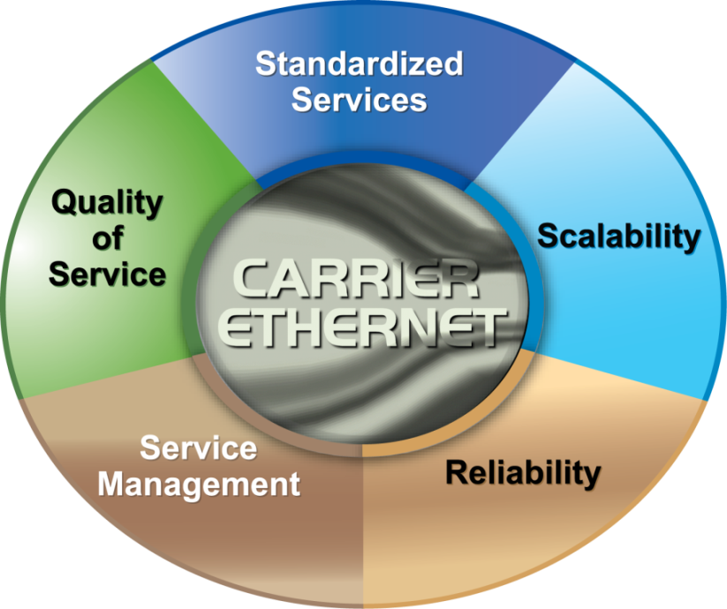
Key Carrier Ethernet Definitions and Concepts
Provides foundational definitions and concepts for Metro Ethernet Services, service attributes and parameter requirements and as well as traffic classification, traffic profiles and related recommendations to deliver Carrier Ethernet Services.
Notes:
MEF 6.1 uses service attributes and parameters defined in the MEF Specification “Ethernet Services Attributes Phase 2”, applies them to create different Ethernet services and defines three Ethernet Service types and their associated service attributes and parameters used to create Point-to-Point, Multipoint-to-Multipoint, and Rooted-Multipoint Ethernet services.
MEF 10.2, which supersedes MEF 10, defines the attributes of Ethernet Services observable at a User Network Interface (UNI) and from User Network Interface to User Network Interface (UNI to UNI) and a framework for defining specific instances of Ethernet Services is described.
MEF 10.2.1 enhances and modifies MEF 10.2 in the definition of Qualified Service Frames, Availability, new performance attributes for resiliency performance and adds new terms.

Slide 12
MEF Specification Overview
MEF 6.1
Metro Ethernet Services Definitions Phase 2
Purpose
Defined Service types (E-Line, E-Lan, E-Tree) and standardizes few services based onthe the Service Types (EPL, EVPL, EP-LAN, EVP-LAN, EP-TREE, EVP-TREE)"
MEF 6.1.1
Amendment to MEF 6.1: Layer 2 Control Protocol
Purpose
Aligns Layer 2 Control Protocol treatment at MEF compliant UNI to be consistent with IEEE specifications.
Ethernet Services Attributes Phase 3
MEF 10.3
Purpose
Defines the service attributes and parameters required to offer the services defined in MEF 6.1. Updated from Original MEF 10 and 10.1, 10.2, etc

Slide 13
Terminology, Concepts & Relationship to other standards

Slide 14
Terminology & Concepts
Services model and taxonomy
Services type definitions
Service attributes and parameters
Per UNI
EVC per UNI
Per EVC
* Refer to the MEF specification documents for details on all attributes.

Slide 15
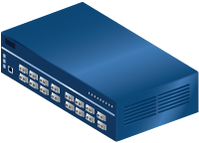
Carrier Ethernet Reference Diagram
End User Subscriber Headquarters
Ethernet Virtual Connection
End User Subscriber Branch Site
UNI
Service Provider
UNI
Carrier Ethernet Network
CE
CE
UNI
Internet
Hosted Applications
Key Carrier Ethernet Terminology
EVC: Ethernet Virtual Connection
UNI: User Network Interface: the physical demarcation point between the responsibility of the Service Provider and the responsibility of the Subscriber
CE: Customer Edge
See notes
Notes:
“In a Carrier Ethernet network, data is transported across Point-to-Point and Multipoint-to-Multipoint Ethernet Virtual Connections according to the attributes and definitions of the E-Line, E-LAN, and E-Tree services”

Slide 16
MEF Carrier Ethernet Terminology
Ethernet Virtual Connection (EVC)
Connects two or more UNI’s
Between UNIs that are associated with the same EVC
Three types of EVCs
Point-to-Point
Multipoint-to-Multipoint
Rooted Multipoint
One or more VLANs can be mapped (bundled) to a single EVC
A UNI can support up to 4K EVCs
Defined in MEF 10.3 (Ethernet Services Attributes)

Slide 17
Attributes
UNI Service Attribute | EVC per UNI Service Attribute | EVC Service Attribute
UNI Identifier | UNI EVC ID | EVC Type
Physical Medium | CE-VLAN ID / EVC Map | EVC ID
Speed | Ingress Bandwidth Profile Per EVC | UNI List
Mode | Ingress Bandwidth Profile Per CoS Identifier | Maximum Number of UNIs
MAC Layer | Egress Bandwidth Profile Per EVC | EVC MTU size
UNI MTU Size | Egress Bandwidth Profile Per CoS Identifier | CE-VLAN ID Preservation
Service Multiplexing |  | CE-VLAN CoS Preservation
Bundling |  | Unicast Service Frame Delivery
All to One Bundling |  | Multicast Service Frame Delivery
CE-VLAN ID for untagged and priority tagged Service Frames |  | Broadcast Service Frame Delivery
Maximum number of EVCs |  | Layer 2 Control Protocol Processing (only applies for L2CPs passed to the EVC)
Ingress Bandwidth Profile Per UNI |  | EVC Performance
Egress Bandwidth Profile Per UNI
Layer 2 Control Protocols Processing

Slide 18
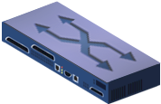
Three Types of EVC’s
Point to Point EVC: each EVC associates exactly 2 UNIs – in this diagram one site is connected to two other sites with two EVCs
Multipoint to Multipoint EVC: each EVC associates ≥ 2 UNIs – in this diagram, three sites joint share a multipoint EVC and can forward Ethernet frames to each other
Rooted Multipoint EVC : each EVC associates ≥ 2 UNIs with 1 or more UNIs as Roots – The roots can forward to the leaves, each leaf can only forward to the roots
Leaf
Root
Leaf
Broadcast, multicast and unicast unknown
Known unicast
Broadcast, multicast and unicast

Slide 19
MEF 6.1 Ethernet Services Definitions Phase 2
MEF 6.1 Enhancements
Defines a service type (E-Tree) in addition to those defined in MEF 6
Adds four services – two each to E-LAN and E-Tree
EPL with > 1 CoS
Updates Service Attributes
Updates L2CP Processing
Service Type | Port-Based (All-to-One Bundling) | VLAN-Based (Service Multiplexed)
E-Line (Point-to-Point EVC) | Ethernet Private Line (EPL) | Ethernet Virtual Private Line (EVPL)
E-LAN (multipoint-to-multipoint EVC) | Ethernet Private LAN (EP-LAN) | Ethernet Virtual Private LAN (EVP-LAN)
E-Tree (rooted multipoint EVC) | Ethernet Private Tree (EP-Tree) | Ethernet Virtual Private Tree (EVP-Tree)

Slide 20
Services Using E-Line Service Type
Ethernet Private Line (EPL)
Replaces a TDM Private line
Port-based service with single service (EVC) across dedicated UNIs providing site-to-site connectivity
Typically delivered over SDH (Ethernet over SDH)
Most popular Ethernet service due to its simplicity
UNI
Carrier Ethernet Network
UNI
Storage Service Provider
CE
CE
Point-to-Point EVCs
See notes
Notes:
An Ethernet Private Line (EPL) service is specified using an E-Line Service type. An EPL service uses a Point-to-Point EVC between two UNIs and provides a high degree of transparency for Service Frames between the UNIs it interconnects such that the Service Frame’s header and payload are identical at both the source and destination UNI when a Service Frame is delivered. Figure 6 below shows the basic structure of EPL service.

Slide 21
Services Using E-Line Service Type
Ethernet Virtual Private Line (EVPL)
Replaces Frame Relay or ATM Layer 2 VPN services
Enables multiple services (EVCs) delivered over single physical connection (UNI) to customer premises
Optimizes use of bandwidth and ports with Classes of Services (CoS)
Supports “hub & spoke” connectivity via Service Multiplexed UNI at hub site
Service Multiplexed Ethernet UNI
UNI
CE
Carrier Ethernet Network
CE
Point-to-Point EVCs
UNI
CE
See notes
Notes:
An Ethernet Virtual Private Line (EVPL) is created using an E-Line Service type. An EVPL can be used to create services similar to the Ethernet Private Line (EPL) with some notable exceptions. First, an EVPL allows for service multiplexing at the UNI. This capability allows more than one EVC to be supported at the UNI where the EPL does not allow this. Second, an EVPL need not provide as much transparency of Service Frames as with an EPL. Because service multiplexing is permitted, some Service Frames may be sent to one EVC while other Service Frames may be sent to other EVCs.
An E-Line Service such as EVPL can provide point-to-point EVCs between UNIs analogous to using Frame Relay PVCs to interconnect sites.
Replaces Frame Relay or ATM L2 VPN services
- To deliver higher bandwidth, end-to-end services
Enables multiple services (EVCs) to be delivered over single physical connection (UNI) to customer premises
Supports “hub & spoke” connectivity via Service Multiplexed UNI at hub site
- Similar to Frame Relay or Private Line hub and spoke deployments
An E-Line Service can be used to construct services analogous to Frame Relay or private leased
lines. However, the range of Ethernet bandwidth and connectivity options is much greater.

Slide 22
Services Using E-LAN Service Type
EP-LAN
Ethernet Private LAN
Port-Based
Each UNI is dedicated to the EP-LAN service
Example use: Transparent LAN
UNI
UNI
CE
CE
Multipoint-to-Multipoint EVC
UNI
CE
EVP-LAN
ISP POP
Internet
Ethernet Virtual Private LAN
VLAN-Aware
Service Multiplexing allowed at UNI
Example use : Internet access and corporate VPN via one UNI
CE
UNI
UNI
Point-to-Point EVC
(EVPL)
CE
CE
CE
UNI
Multipoint-to-Multipoint EVC
UNI
See notes
Notes:
Some Subscribers commonly desire an E-LAN service type to connect their UNIs in a metro network, while at the same time accessing other services from one or more of those UNIs.
Example on right a Subscriber site wants to access a public or private IP service from a UNI that is also used to for E-LAN service among the Subscriber’s several metro locations.
The EP-LAN service is defined to provide CE-VLAN tag preservation and tunneling of key Layer 2 Control Protocols. A key advantage of this approach is that the Subscriber can configure VLANs across the sites without any need to coordinate with the Service Provider. Each interface is configured for All to One Bundling and, therefore, EP-LAN service supports CE-VLAN ID preservation. In addition, EP-LAN supports CE-VLAN CoS preservation.

Slide 23
Services Using E-Tree Service Type
Ethernet Private Tree and Ethernet Virtual Private Tree
Allow root-root and root-leaf communication (but not leaf-leaf)
Provide traffic segregation for cloud or franchise networks
EP-Tree requires dedication of the UNIs to the single EP-Tree service
EVP-Tree allows each UNI to support multiple simultaneous services
EP-Tree
EVP-Tree
UNI
UNI
Rooted-Multipoint EVC
CE
Rooted-Multipoint EVC
Multipoint to Multipoint EVC
Leaf
Root
CE
Root
Leaf
Leaf
UNI
UNI
CE
See notes
Notes:
Subscribers with multiple sites may want to interconnect them to provide services other than those that resemble a LAN. These services may be distributed from a centralized site (or few such sites) where the distribution site is designated as a Root and all the remaining sites are designated as leaves.
The EP-Tree service is defined to provide CE-VLAN tag preservation and tunneling of key Layer 2 Control Protocols. A key advantage of this approach is that the Subscriber can configure VLANs across the sites without any need to coordinate with the Service Provider. Each interface is configured for All to One Bundling and, therefore, EP-Tree service supports CE-VLAN ID preservation. In addition, EP-Tree supports CE-VLAN CoS preservation.
Some subscribers desire access to certain applications or content services from well-defined access points within their own (or an external) network. In this case it is necessary to interconnect the participating UNIs in a Rooted-Multipoint connection to the well-defined access (or root) point. One or more of the Subscriber’s UNIs may also support other services, e.g., EVPL or EVP-LAN. For such cases, the EVP-Tree service is used.

Slide 24
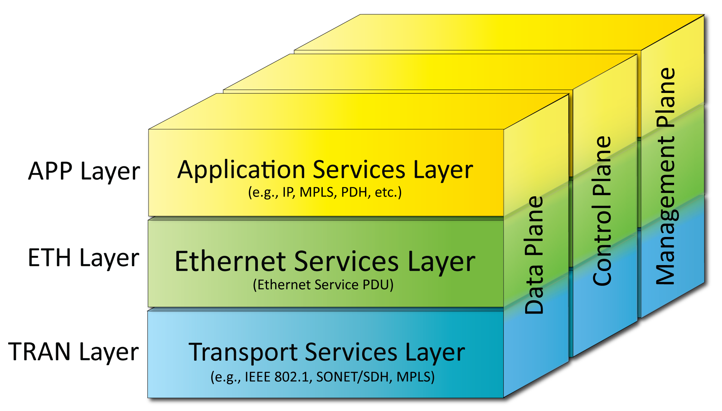
Carrier Ethernet Architecture
Data moves from UNI to UNI across "the network" with a layered architecture.
When traffic moves between ETH domains is does so at the TRAN layer. This allows Carrier Ethernet traffic to be agnostic to the networks that it traverses.

Slide 25
Delivery of Service Frames
Broadcast
Deliver to all UNIs in the EVC but the ingress UNI
Multicast
Delivered to all UNIs in the EVC but the ingress UNI
Unicast (unknown and known destination address
Delivered to all UNIs in the EVC but the ingress UNI if unknown destination address
Delivered to the UNI with known destination MAC address
Layer 2 Control (e.g., BPDU)
Discard, peer, or tunnel
Notes:
Service frames are defined as
Broadcast, Multicast, Unicast, frames – as generated by the customer. MEF 10 defines their treatment for each service type defined in MEF 6

Slide 26
Options for Layer 2 Control Protocols
Discard
The MEN will discard ingress L2CP frames
Peer
The MEN will actively participate with the protocol
Tunnel
Service Frames containing the protocol will be transported across the MEN to the destination UNI(s) without change
L2CP Service Frame Received
STEP 1
Destination Address is one that is tunneled
per Table B or C
Yes
Tunnel the Frame
No
STEP 2
Specific Protocol is one that is peered
per Table D, E, F,G,H or I
Yes
Peer the Frame
No
Discard the Frame
Above: The Logic Flow Chart for L2CP Service Frames
Notes:
Options for handling of L2 control protocols as defined in MEF 10.

Slide 27
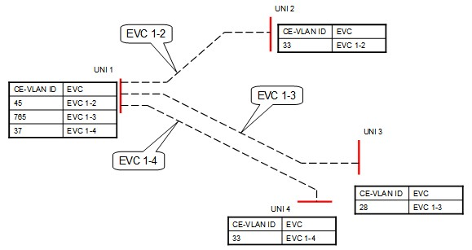
CE-VLAN ID Preservation (1)
Ethernet Virtual Private Lines to a Hub Location
In this example, CE-VLAN Preservation = No for all EVCs (See EVC service attribute table 16 of MEF 6.1)
Service Provider has three EVCs, each from a branch location to a hub location.
UNI 1 is the hub location and the other UNIs are the branch locations.
The CE-VLAN ID/EVC Maps as agreed to by the Subscriber and the Service Provider for each UNI are included in the figure.
The example shows the EVCs as perceived by the Subscriber.

Slide 28
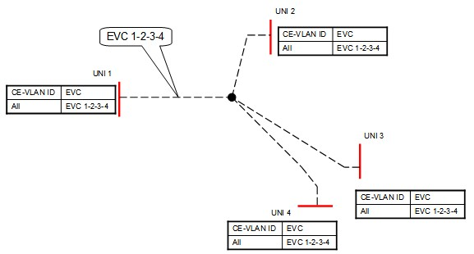
CE-VLAN ID Preservation (2)
Ethernet Private LAN
In this example, CE-VLAN Preservation = Yes (See EVC service attribute table 20 of MEF 6.1.1)
the Service Provider provides a single Ethernet Private LAN associating four UNIs.

Slide 29
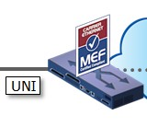
All to One Bundling (Map)
Untagged* Priority Tagged* Tagged, VID = 1 Tagged, VID = 2 . . . Tagged, VID = 4094 Tagged, VID = 4095
CE-VLAN ID 1 2 . . . 4094 4095
EVC Red
Send all
Customer
VLANs
CE-VLAN ID/EVC Map
Only one EVC at the UNI (no service multiplexing)
All CE-VLAN IDs map to this EVC – no need for coordination of CE-VLAN ID/EVC Map between Subscriber and Service Provider
EVC must have CE-VLAN ID Preservation
Notes:
All to one Bundling is typically defined for Ethernet Private Line applications or dedicated access (such as to a VPN service), or for extending LANs between multiple remote sites.
This makes set-up of circuits simple as well as ensuring all traffic that enters a EP ingress - properly egresses at the other side

Slide 30
Using All to One Bundling
Branch
VLAN 6,7,9
CE
Branch
Simplified Branch
LAN extension Set-up
CE-VLAN map to 1 EVC
CE-VLAN preservation
VLAN 6,7,9
CE
Branch
HQ
VLAN 6,7,9
CE
Customer VLAN 6,7,9
CE
Notes:
This is an example of using All to one bundling in an E-LAN. The HQ has three separate LANs that need to be extended to the remote sites. In this case they can all share a single EVC. The customer routers at each site deliver the frames as appropriate and discard other not intended for that site.

Slide 31
One to One Map
Untagged Priority Tagged Tagged, VID = 1 Tagged, VID = 2 . . . Tagged, VID = 4094 Tagged, VID = 4095
CE-VLAN ID 1 2 . . . 4094 4095
EVC Red Blue
CE-VLAN ID/EVC Map
Subscriber and Service Provider must coordinate CE-VLAN ID/EVC Map
No more than one CE-VLAN ID is mapped to each EVC at the UNI
If CE-VLAN ID not mapped to EVC, ingress Service Frames with that CE-VLAN ID are discarded
Service Multiplexing possible
CE-VLAN ID Preservation is optional

Slide 32
CE-VLAN ID Translation
UNI
UNI
CE-VLAN ID 37
EVC Blue
EVC Blue
CE-VLAN ID 156
CE-VLAN ID/EVC Map can be different at different UNIs in an EVC
Fine for CE routers
Problematic for CE bridges (depends on configuration)
Notes:
CE-VLAN ID Translation is important for applications where service is handed off to a third party…such as an
ISP, VPN provider who has many customers hat need to have traffic kept separate and may have overlapping VLAN address space. The next slide shows an example how VLAN translation will support Ethernet access networks that are served by frame Relay today

Slide 33
Identifying an EVC at a UNI
CE-VLAN ID/EVC Map
Service Frame Format
Untagged* Priority Tagged* Tagged, VID = 1 Tagged, VID = 2 . . . Tagged, VID = 4094 Tagged, VID = 4095
CE-VLAN ID
1 2 . . . 4094 4095
EVC
Red Green . . . Blue
CE-VLAN ID/EVC Map
*Untagged and Priority Tagged Service Frames can have the same CE-VLAN ID. (depends on use case) Configurable at each UNI. This is the behavior expected by an IEEE 802.1Q CE.

Slide 34
Using One to One Map w/ Translation – 1
Internet Service Provider
CE-VLAN ID Preservation would constrain ISP
178 ↔ Blue 179 ↔ Yellow 180 ↔ Green
2000 ↔ Green
ISP Customer 3
2000 ↔ Blue
2000 ↔ Yellow
ISP Customer 1
ISP Customer 2
Frame Relay PVC Replacement
}
CE Router
Pt to Pt EVCs
Notes:
Mapping with translation helps enable Frame Relay replacement by point to point Ethernet services

Slide 35
Using One to One Map – 2
(application
servers)
ASP/SaaS
(application
servers)
ASP/SaaS
ASP/SaaS
Customer 3
ASP/SaaS
Customer 3
ASP/SaaS Customer 1
ASP/SaaS Customer 2
CE Router
Multipoint-to-Multipoint EVCs
Notes:
Multipoint Ethernet services open more cost effective new multi-site services. In this case the SAME mapped and translated EVC can support multiple sites (not possible with Frame Relay or ATM).

Slide 36
Industry Service Requirements
For services are to be adopted in the market:
They require strong service attributes
With meaningful and measurable parameters on which to base the SLA Specification
Notes:
MEF 10 defines the concept of Service attributes and parameters. MEF 6 helps establish what those attributes are for each service type.

Slide 37
The Best Of All Worlds
Offer a mix of SLA “ensured” and non SLA traffic
Over the same “shared” MEN access/backbone links.
Allow certain traffic be delivered with strict SLAs (Service Level Agreements),
Allow other traffic to be delivered best efforts.
Critical SLA Service Attributes
Bandwidth Profile
Service Performance
Allows bandwidth to exceed commitments
But does not apply SLA conformance measures to that traffic
Notes:
The Promise of Ethernet services are the mix of connectivity options and the pay for value granularity not allowed with today’s more limited choices.
- End customers will pay for value if it can be meaningfully be demonstrated ( measured and evaluated).
- Service providers can charge more per bit - for a lower transported bit cost if they can optimize the service mix across their shared service MEN.
Both of these concepts require the ability to support transporting a mix of services with verifiable SLOs over a single network.

Slide 38
How to Classify the Traffic
Apply Bandwidth Profiles (MEF 10.2)
The Bandwidth Profile is the set of traffic parameters that define the maximum limits of the customer’s traffic
An Ingress Bandwidth Profile limits traffic transmitted into the network,
Each Service Frame is checked for compliance against the profile
Separately definable for each UNI (MEF 10.2)
Service frames that meet the profile are forwarded
Service frames that do not meet the profile are dropped at the interface
An Egress Bandwidth Profile
Could be applied anywhere in the network to control the focused overload problem of multiple UNIs sending to an egress UNI simultaneously
Notes:
MEF 6 defines the concept that traffic be classified at the UNI hand-off as it enters the MEN. Separate profiles can be set-up for different handling by the network. MEF 10.1 defines how that traffic that meets a profile will be handled to meet a defined SLA. It also allows for handling traffic that exceeds the profile and can be transported at best efforts (without SLA conformance measures applied).
To do this MEF 10.1 defines how traffic frames can be marked (colored) in profile and out of profile for further treatment at other nodes through the MEN. Coloring allows for detecting which frames should be subject to SLA conformance testing upon MEN network egress.

Slide 39
Coloring Classified Traffic
MEF 10.2 specifies three levels of Bandwidth Profile compliance for each individual Service Frame
Green: Service Frame subject to SLA performance guarantees
Yellow: Service Frame not subject to SLA performance guarantees, but will be forwarded on a “best effort” basis. They have lower priority and are discard-eligible in the event of network congestion.
Red: Service Frame discarded at the UNI by the traffic policer
Notes:
Coloring is optional, but is an important concept for supporting value added capabilities such as “bursting” over Ethernet Virtual Private Lines services. It allows for handling a flexible mix of traffic from the same customer and still maintain a sound basis for applying and measuring SLAs.

Slide 40
Bandwidth Profile Parameters
Customers are allowed a combination of rate and burst
Green frames conform to the Committed Information Rate (CIR) and Committed Burst Size (CBS) limits
Yellow frames conform to the Excess Information Rate (EIR) and Excess Burst Size (EBS) limits
In Color Mode (CM) unaware service, the service provider will mark the frames green or yellow solely according to each frame’s arrival time
Customers may have the option of marking their frames green or yellow themselves (Color Mode aware) to better allow them to utilize their CIR/CBS/EIR/EBS bandwidth profile
In Color Mode aware service there may be an optional Coupling Flag (CF) that can be enabled to allow customers to better utilize unused tokens from the committed token bucket (unused CIR/CBS capacity)
The total set of Bandwidth Profile Parameters is CIR/CBS/EIR/EBS/CM/CF

Slide 41
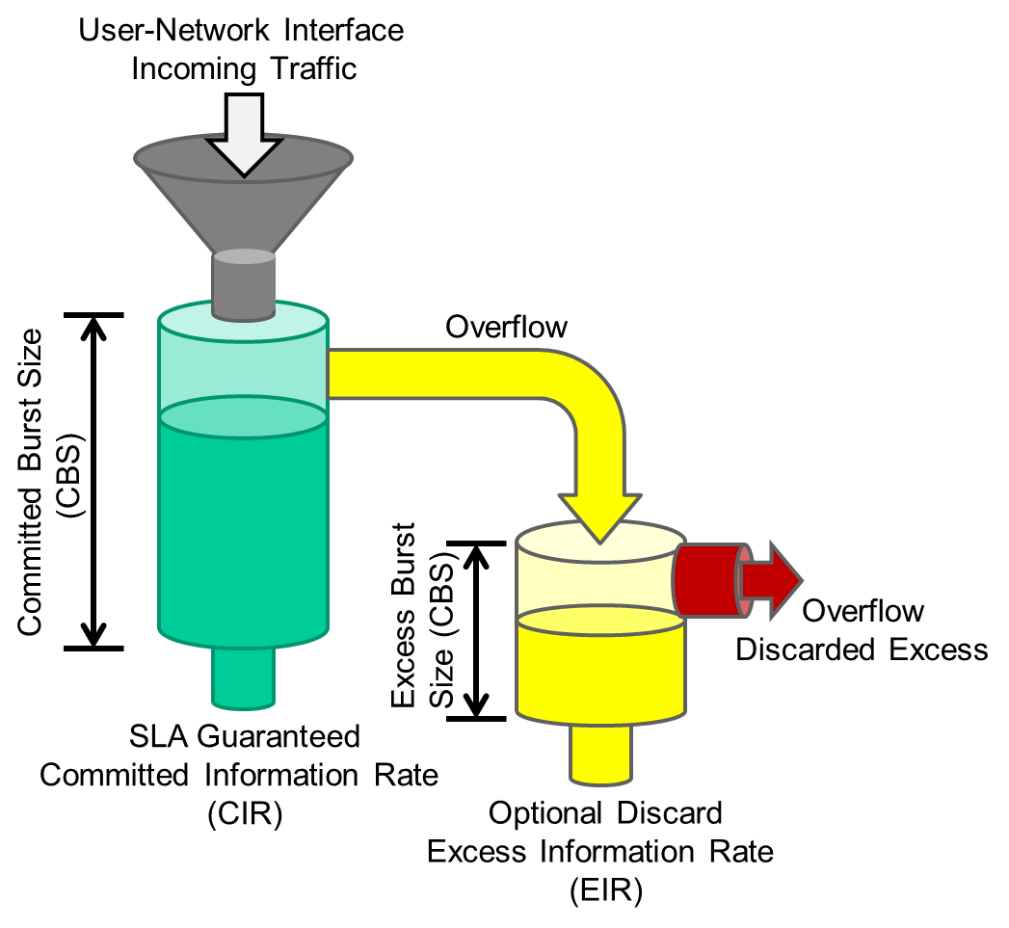
Bandwidth Profile Defined by Token Bucket Algorithm (2 rates, 3 colors)
Color Blind Algorithm:
If (Service Frame length is less than C-Bucket tokens) {declare green; remove tokens from C-Bucket}
else if (Service Frame length is less than E-Bucket tokens)
{declare yellow; remove tokens from E-Bucket}
else declare red
(Important – see MEF 41 Generic Token Bucked Algorithm)
Notes:
Better diagram – see previous slide

Slide 42
CBS vs. EBS
Burst size in Bytes per second allowed
CBS marked Green, EBS is Yellow,
Bursts beyond EBS limit is discarded
Bytes/Second
Data flow
Y
Y
Y
Burst Threshold
CBS
limit
EBS
Time
Notes:
[Please refer to the specification documents: 10.2 and 10.2.1 for this diagram]
The diagram in this slide attempts to depict these bursting concepts as specified in MEF 10
Bursting parameters indicate the amount of bytes that can be accepted over a sustained period at the point of measurement. Buffer capacity (typically at the MEN UNI demark) may be allocated in byte thresholds as committed burst size (CBS) and excess burst size (EBS). Frames arriving within the CBS parameter can be marked “green” and passed into the MEN for subsequent egress SLA conformance measurement. Frames burst beyond the CBS time interval but within the EBS time interval can be marked “yellow” and passed, but will not be subject to egress SLA conformance measurement. Frames burst beyond the EBS threshold time limit will be dropped.

Slide 43
CIR vs. EIR Service Example
Conceptual Example
3 EVCs share fixed UNI bandwidth
3 CIRs can always be met
3 EIRs can not always be assured (simultaneously)
Total Bandwidth at UNI
EVC1
EVC2
EIR
CIR
EIR
CIR
Traffic Passed at CIR rates
are subject to SLS conformance
- if other parameters also met
EIR
CIR
EVC3
EIR traffic is marked yellow – not subject to SLS
Notes:
This slide provides a conceptual example of CIR vs EIR where multiple EVCs share the SAME UNI, or transport line.
Service example - comparing CIR conformance marked traffic vs. EIR conformance marked traffic:
CIR conforming traffic can be marked green, indicating it should be measured upon egress to determine if the traffic is within the Service level objective agreed upon parameters. Traffic that exceeds the CIR is Marked yellow and is not subject to the SLA, hence is not measured at network egress.
Traffic that exceeds the EIR is discarded.

Slide 44
Application of Bandwidth Profiles
Bandwidth profiles may be applied with 3 layers of granularity:
Ingress Bandwidth Profile Per Ingress UNI
Ingress Bandwidth Profile Per EVC
Ingress Bandwidth Profile Per CoS ID
Note: Only one profile may be applied to a given service name
Notes:
Bandwidth profiles can be applied per UNI (all traffic regardless of VLAN tag or EVC ID)…or more granular on an EVC basis or even a COS marking such as a customer applied VLAN priority tag).
The parameters are similar in concept to those defined for Frame Relay…Committed rates and excess rates – in bits per second. For bursting a burst size buffer allocation can also be specified - in bytes per second.

Slide 45
Port, EVC, and VLAN based BWPs
Three Types of Bandwidth Profiles Defined in MEF 10.1
Port-based
Port/VLAN-based
EVC₁
EVC₁
Ingress Bandwidth Profile Per EVC₁
EVC₂
Ingress Bandwidth Profile Per Ingress UNI
UNI
EVC₂
UNI
Ingress Bandwidth Profile Per EVC₂
EVC₃
EVC₃
Ingress Bandwidth Profile Per EVC₃
CE-VLAN CoS 6
Port/VLAN/CoS-based
CE-VLAN CoS 4
EVC₁
Ingress Bandwidth Profile Per CoS ID 6
CE-VLAN CoS 2
UNI
Ingress Bandwidth Profile Per CoS ID 4
Ingress Bandwidth Profile Per CoS ID 2
EVC₂
Notes:
3 Tiered hierarchical qos:
At the physical port
At the port and VLAN
At the port, VLAN and traffic type or Class of Service

Slide 46
Two Ways to Identify CoS Instance
EVC
All Service Frames mapped to the same EVC receive the same CoS
EVC, priority marking
All Service Frames mapped to an EVC with one of a set of user priority values receive the same Class of Service
The user may be able to mark the priority with 802.1Q Priority bits in the VLAN Tag Priority Code Point (C-TAG)
The user may be able to mark the priority with IP DSCP bits
L2CP can have their own CoS ID
Notes:
COS can be applied at the EVC level (same COS for all frames transmitted over the EVC), or can be applied within the EVC by customer defined priority values in the data – such as CE-VLAN IEEE 802.3 “Q” or “p” tag markings.

Slide 47
EVC Related Performance Service Attributes
Five performance attributes are considered in MEF 10.2.1
Frame Delay Performance
a) Frame Delay
b) Frame Delay Range
c) Mean Frame Dela
Notes:
Delay and frame delay range as attributes
Frame Delay Performance
a) Frame Delay
b) Frame Delay Range
c) Mean Frame Delay

Slide 48
Frame Delay and Delay Variation
Frame Delay
This is measured as the time taken for service frames to cross the network
Frame Delay is measured from the arrival of the first bit at the ingress UNI to the output of the last bit of the egress UNI. I.e. an end-to-end measurement as the customer views it.
Inter Frame Delay Variation
Frame Delay Variation is therefore the variation in this delay for a number of frames. This delay is an important factor in the transmission of unbuffered video and where variation occurs in the millisecond range can affect voice quality. For data can cause a number of undesirable effects such as perceived frame loss, etc
Notes:
Frame Delay variation depicts the difference in time gap between two subsequent frames at the ingress UNI in comparison to the delay measured between the arrival of the same frames at the egress UNI.

Slide 49
Frame Delay Performance
One-way Frame Delay Performance for an EVC
Defines three performance attributes: the One-way Frame Delay Performance corresponding to a percentile of the distribution, the One-way Mean Frame delay, and the One-way Frame Delay Range.
The One-way Frame Delay for an egress Service Frame at a given UNI in the EVC is defined as the time elapsed from the reception at the ingress UNI of the first bit of the corresponding ingress Service Frame until the Transmission of the last bit of the Service Frame at the given UNI. This delay definition is illustrated above
CE
CE
Metro Ethernet
Time
Network
first bit in
UNI to UNI
Frame
Delay
last bit out

Slide 50
Frame Delay Performance
Inter-Frame Delay Variation Performance for Point-to-Point EVC
Inter-Frame Delay Variation (IFDV): The difference between the one-way delays of a pair of selected Service Frames. (same as in RFC3393 [6] where IP packet delay variation is defined.)
The Inter-Frame Delay Variation Performance: The “P-percentile” of the absolute values of the difference between the Frame delays of all Qualified Service Frame pairs if the difference in the arrival times of the first bit of each Service Frame at the ingress UNI was exactly
This definition agrees with IP packet delay variation definition where delay variation is defined as the difference between the one-way delay of two packets selected according to some selection function and are within a given interval [ T₁, T₂]
Inter-Frame Delay Variation Performance depends on the choice of the value for . Values for both and T typically should be chosen to achieve a reasonable level of statistical accuracy.
Notes:
[Future work on this slide will simplify the calculations to user-friendly diagrams]

Slide 51
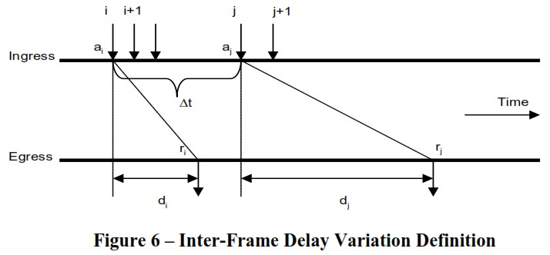
Inter-Frame Delay Variation Performance (Example)
T
(Must arrive by T)
Service Frame
first time of arrival
Of first bit of “i” Service
Frame at ingress UNI
time of arrival of last bit of “i” Service Frame at Egress UNI
Service Frame
The difference in delays encountered by frame i and j is given by d_{i} – d_{j}
For a particular Class of Service instance, Inter-Frame Delay Variation Performance metrics may be specified over any given subset of two or more UNIs on an EVC

Slide 52
Frame Loss Ratio (FLR)
Frame loss is a measure of the number of lost service frames inside the MEN
Frame loss ratio is % = # frames lost / # frames sent
CE
CE
time
CE
CE
Metro Ethernet
Metro Ethernet
Network
Network
5000 frames in
UNI to UNI
UNI to UNI
4995 frames out
5 frames lost/or received as errored
0.1% Frame Loss Ratio (5/5000)
Notes:
Frame loss is measured as a ratio of the number of frames lost (lost or discarded at egress due to FCS indicated error) measured at the Egress UNI divided by the number of frames sent as measured at the ingress UNI.
Note E-LAN service frame loss ratio measures are left for further study

Slide 53
Frame Loss Ratio Performance
One-way Frame Loss Ratio Performance for an EVC
There may be multiple One-way Frame Loss Ratio Performance metrics defined for a particular Class of Service instance on an EVC.
Each such metric is based on a subset of the ordered pairs of UNIs in the EVC for a time interval “T”.
One-way Frame Loss Ratio Performance metric is defined as follows:
a One-way Frame Loss Ratio Performance metric entry must specify a set of parameters and an objective. The parameters and objective of a One-way Frame Loss Ratio Performance metric are referenced in Table 6 of MEF 10.2.
Given T, S, and a One-way Frame Loss Ratio Performance objective, the One-way Frame Loss Performance SHALL be defined as met over the time interval T for the subset S if and only if
Notes:
[Future work on this slide will simplify the calculations to user-friendly diagrams]

Slide 54
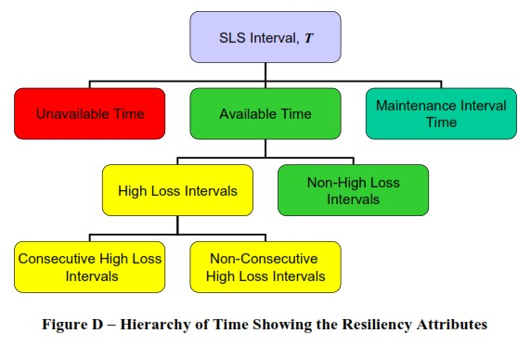
Availability & Resilience Performance
One-way Availability Performance for an EVC
Availability Performance is based on Service Frame loss during a sequence of consecutive small time intervals and the availability state during the previous small time interval; it is the percentage of time within a specified time interval during which the frame loss is small.
if frame loss is high for each small time interval in the current sequence, then the small time interval at the beginning of the current sequence is defined as unavailable; otherwise it is defined as available.
One-way Resiliency Performance for an EVC
The figure to the right illustrates how the two resiliency attributes defined here, counts of High Loss Intervals and counts of Consecutive High Loss Intervals, fit into the hierarchy of time and other attributes

Slide 55
Availability Parameters
Parameter | Description
T | The time interval
S | Subset of the UNI pairs
∆t | A time interval much smaller than T
C_{u} | Unavailability frame loss ratio threshold
C_{a} | Availability frame loss ratio threshold with C_{a} ≤ C_{u}
n | Number of consecutive small time intervals for assessing availability
ˆ A | Availability Performance objective
(used for Multipoint EVC)

Slide 56
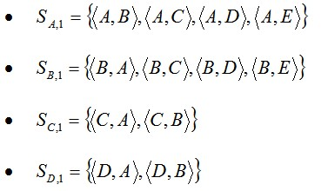
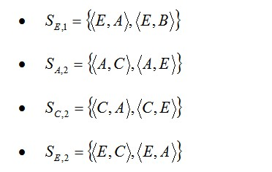
UNI-oriented Availability Example
In this case, an Availability Performance metric is defined for each UNI for each Class of Service. The metric is based on the ability to communicate between the UNI in question and the other UNIs identified by the important traffic flows. Define the following subsets of UNI pairs:
For this example, assume that T, , , , and n, are used for all availability definitions. Then using the definition in Section 6.8.4, can be viewed as the availability of UNI A for Class of Service 1 and this reflects the availability of the important point to point paths that UNI A is a part of. Similarly, can be viewed as the availability of UNI C for Class of Service 2

Slide 57
EVC-oriented Availability Example
In this case, Availability Performance metric is defined for each Class of Service supported by the EVC
For this example, assume that T, , , , and n, are used for both availability definitions. Then using the definition in Section 6.8.4, can be viewed as the availability of Class of Service 1 on the EVC and can be viewed as the availability of Class of Service 2 on the EVC.

Slide 58
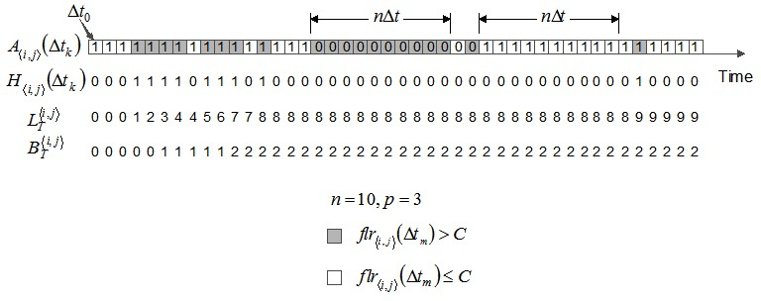
High Loss Interval/Consecutive High Loss Interval
High Loss Interval (HLI) is a small time interval contained in T (having the same duration as the interval, with a high frame loss ratio.
When sufficient HLIs are adjacent, the interval is designated as a Consecutive High Loss Interval (CHLI)
Figure 12 shows an example that depicts the HLI and CHLI counting processes.

Slide 59
Summary

Slide 60
Summary
MEF 6.1.1 modifies MEF 6.1 with respect to Layer 2 Control Protocol processing requirements, and provides a closer alignment to IEEE 802.1 specifications.
MEF 10.2 defines the attributes of Ethernet Services observable at a User Network Interface (UNI) and from User Network Interface to User Network Interface (UNI to UNI) and a framework for defining specific instances of Ethernet Services.
The 10.2.1 modifies and enhances MEF 10.2 in the definition of Qualified Service Frames, Availability, new performance attributes for resiliency performance and adds new terms.

Slide 61
Final Word
Service Attributes & Parameters
Ethernet Private Line, Ethernet Virtual Private Line, Ethernet LAN attributes and parameters are covered in detail in the specifications
Next Actions
After reading this document you should now be familiar with the main concepts of Ethernet Services and be in a position to follow the details contained in both the MEF 6.1 and MEF 10.2 and 10.2.1 Specifications
Notes:
This section goes into further detail in detailing the defined Service Attributes and parameters requirement and recommendations as specified for each of the defined services: EPL, EVPL and E-LAN.
(Refer to the Specs and the accompanying Ethernet Service Description document for more details)

Slide 62
Accelerating Worldwide Adoption of Carrier-class Ethernet Networks and Services
www.MetroEthernetForum.org

Slide 63
Accelerating Worldwide Adoption of Carrier-class Ethernet Networks and Services
www.MetroEthernetForum.org

